Slide 1
Work place learning

Slide 2
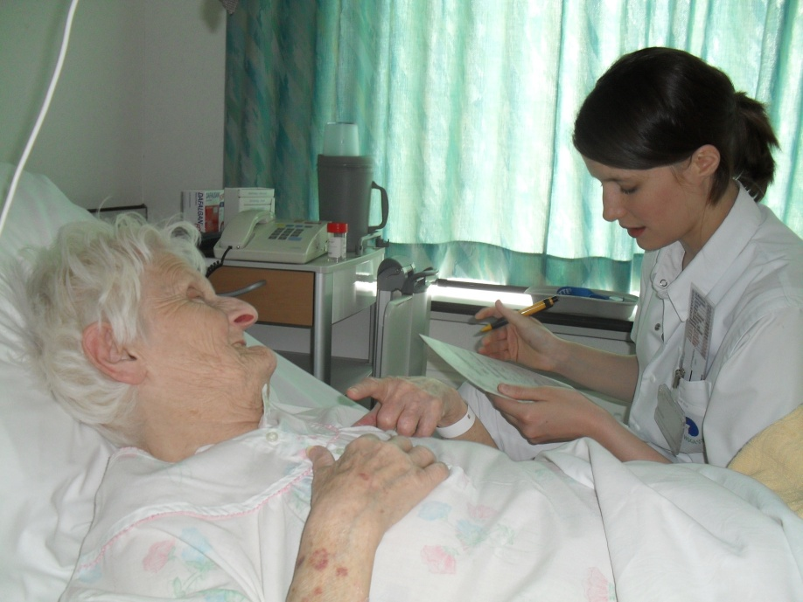
Work place learning
AZ Nikolaas: V1 & V3
WZC De Spoele
Sint-Niklaas

Slide 3
What is work place learning?
It is a form of internship where a minimum of eight students do internship at the same time on the same ward. They will be coached by the nurses of the ward. The educational institution and work organization together give form to the guidance of students. They are taught and supervised according to the principles of skills-based learning: responsibility for the own learning process in practice, learn in team and being coached
According to Borkus & Hekkert (2005) work place learning will take place when a part of the nursing department of the hospital is acquired by students. Students are responsible for the running of the ward.

Slide 4
Anno 2008
When we evaluated in 2008 our concept of internship we saw that students always are under the direct supervision of a nurse. Besides that we noted that certain important competences weren’t enough developed. These competences are necessary to get started in the working field. Also the working field indicated that these competences are missing at many novice nurses, while the base must be present when the student gets in the working field.
Missing competences:
Set priorities
Administrative tasks
Hospitalization/discharge/transfer
Work organization
Interdisciplinary communication
Briefing
leadership

Slide 5
2012-2013: project work place learning
First experience: 2009-2010: I2 (neurological ward)
Second experience: 2011 – 2012: V3 (geriatric ward)
Third experience: 2012 – 2013: V1 (geriatric ward)
Fourth experience: 2013 – 2014:
V1, V3 & WZC De Spoele

Slide 6
Characteristics work place learning
Number of participants: minimum 10 – maximum 18
Main goal: provision of care and training
The design of the guidance should be done by both partners. Both the institution as the nursing education should invest in the guidance of both the students and the nurses.
Supervision and intervision on the workplace by the teacher
learning in a team from the principles of skills-based learning
Working towards an independent function with corresponding responsibilities

Slide 7
Objectives and results
Creation of an additional training space for students
Improving the integration between theory and practice
Setting up an expert nursing department in the field of student guidance and coaching
Increasing the production by expanding spare capacity
Improve the quality of the services

Slide 8
What do we expect from the cooperative hospital?
A motivated interdisciplinary team
  Enthousiastic mentors who dare to let go the students but also keep looking critical
  A doctor who is willing to go on the way with the students
  A nursing department that gives away his unit for 5 weeks

Slide 9
Advantages for the hospital
After graduation nurses will be incorporated sooner
Students will get a new look in their own work
Mentors learn how to work attendant
Create an enhanced cooperation

Slide 10
Advantages for the student
Higher learning efficiency
Better integration of theory and practice
Increased motivation
Competence development: organization, taking initiative, collaboration skills

Slide 11
Role of the mentor
Letting go instead of performing actively
Coaching

Slide 12
3. Preparations work place learning
Choose nursing department:
Geriatric ward: V1 - V3(AZ Nikolaas Sint-Niklaas)
Nursing home “De spoele”
Preparatory meetings AZ Nikolaas – Odisee or AZ Nikolaas – WZC “De spoele”
  Explain or clarify the different roles
  Practical agreements
  Organization of care e.g. briefing
  Edit preparation week for the students
  Coaching nurses
  Edit a list of technical nursing skills
  Evaluation student
  Evaluation nursing team
  Nurses and students have to fill in a survey
Notes:
Neurologie, endocrinologie: uitdagende afdeling, verschillende pathologie, gemotiveerde equipe artsen en verpleegkundigen

Slide 13
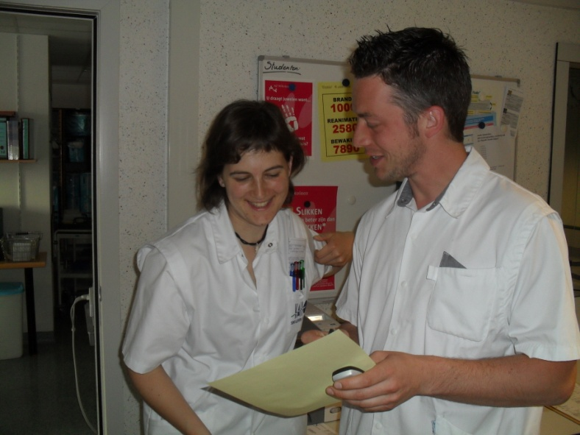
Preparations
Role student/nurse/teacher
  Student
    Responsibility total patient care
  Student-head nurse or chief nurse
    Point of contact for the multidisciplinary team
    Making the timetables
    Practical organization
Notes:
- Sollicitatie hoofdverpleegkundige student
Eindverantwoordelijkheid zorg wordt ingedekt door het opstellen van een lijst waarin studenten competenties moeten bewijzen. Nooit alleen medicatie klaarzetten/toedienen.
Verpleegkundige: ingrijpen in zorgverleningsproces indien nodig

Slide 14
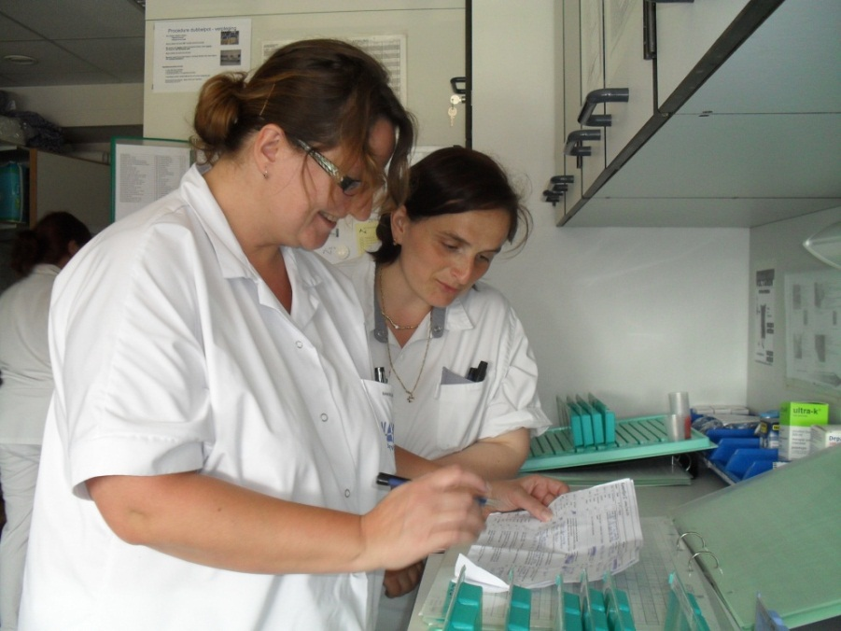
Preparations
  Nurses
    Final responsibility of the caring proces
    Give feedback to the students
  Teacher
    Final responsibility of the learning proces
    Evaluation of the students

Slide 15
Preparations
Preparations nurses
    Information session
    Coaching: situational leadership
    Giving feedback
Preparations other aid workers
    Information session to doctors
    Informing logisticians, physiotherapists, occupational therapists, psychologist
    Informing other head nurses on the heads meeting

Slide 16
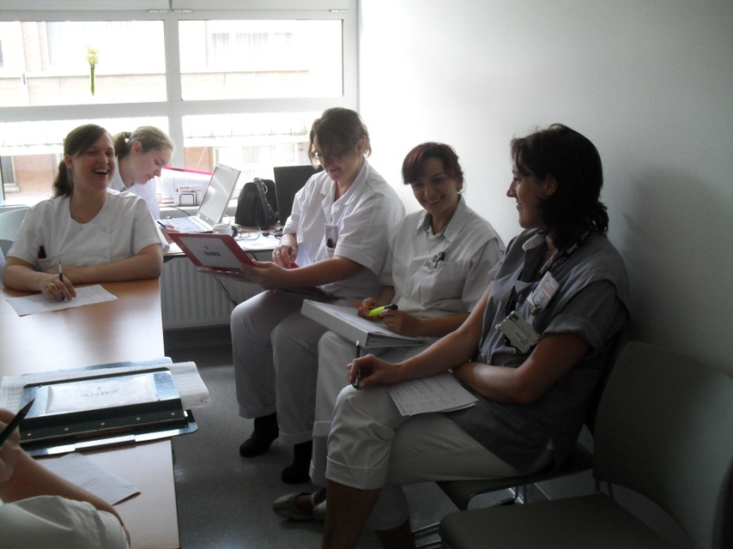
Preparations: practical
Internship: 5 weeks
  Third year students option hospital nursing (entire department)
Division of labour (students) (example):
    4 à 5 early shift
    1 day shift (student-head nurse)
    3 late shift
    1 night shift
  38 hours per week
  Briefing
  Amount of nurses :
    4 nurses with the early shift
    2 nurses with the late shift
    1 nurse with the night shift
Notes:
Nachtdienst is samen met verpleegkundige
-Laatdienst: eerst onder toezicht van verpleegkundige -> onevenwicht op afdeling -> terecht kunnen bij

Slide 17
Follow up work place learning
Daily individual discussions and feedback with the student (student & nurse possibly also teacher)
Access to daily reflections by the teacher present on the work place
Interim team meeting (only students and teachers)
Interim and final evaluation (student/mentor/teacher)
Evaluation meeting with the head nurse, middle management, lecturers and nurses working on the work place

Slide 18
5. Pitfalls
Student:
Acclimatize/ routine
Focus on practical organization
Lector:
Guarding the private work place learning
Don’t forget to involve nurses at preparatory meetings and evaluations
Nurses:
Finding a good balance between letting go – instructing and giving confidence
Notes:
Focus op praktische organisatie: weinig diepgang omdat studenten zich focussen op de praktische organisatie én fysieke aspecten van zorg. Vb. bij een briefing. Vb. 1 E packed Cells-> labowaarden? 24-uursdebiet-> Waarom? Onze verwachtingen van een bachelorverpleegkundige nog onvoldoende ingelost.
Conformeren: studenten vallen terug op gewoontes, dezelfde manier van werken overnemen
Bedoeling dat ze toch een kritisch blijven nadenken
Innovatief, vernieuwend denken, niet de bedoeling dat ze alles gaan veranderen
Bv. soep bedeling
Eigenheid: blijven nadenken, kritische blik, in vraag stellen en mogelijkheid tot leren nieuwe vaardigheden

Slide 19
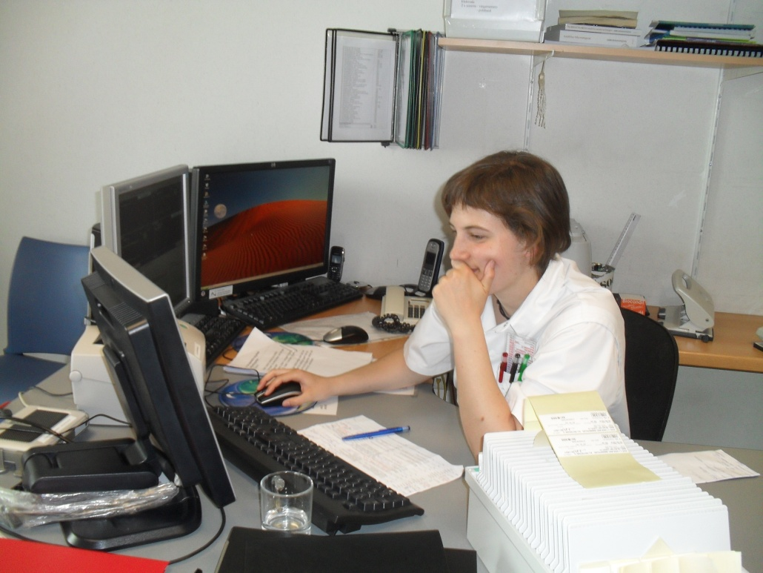
6. Experiences work place learning
Student
Nurses

Slide 20
To what extent is work place learning an added value for the students?
Students indicate that they have a better view on the responsibilities and the total package of tasks
Students indicate that they learn to plan the care giving task: they learn to set priorities, to have an overview about the care. Students indicate that they don’t do any of these task at an ordinary internship
Students are initiated in the administrative tasks of a nurse
Student learn be independent, to take responsibility and get more confidence
Students indicate that the contact with doctors increased or improved and that they have less fear to the medical staff, they become more professional
They’re more confident to step into the working field
Students indicate that they get to know themselves better, they have a better view on their own strengths and weaknesses
The training period will therefore hopefully pass by more smoothly
Experience of ' reality ' but with enough shelter and guidance
A very fine and informative experience, you learn more than on an ordinary internship. Good experience

Slide 21
Evaluation by nurses
Nurses evaluated the work place learning mostly as positive. They found it worth repeating!
Nurses who normally do not fulfill the role of mentor, now explored mentorship
Added value for the nurses:
  They learned to give daily feedback and to set the given feedback negotiable
Bottlenecks:
  All the nurses said that they experienced a certain pressure during the first two weeks
  insufficient linkage to the same nurse
  greater responsibility

Slide 22
Conclusion
Work place learning is a great investment for all the nurses
  BUT
A huge added value for the students
Work place learning is always a pilot project.
All problems should always be discussed as soon as possible and then deal with them

Slide 23


