Slide 1

Welcome
Groningen CCNURCA

Slide 2
Test Cycle
Testing Process
Assessment Committee
Test Bank
1. Test design
2. Creating a test template
3. Test construction & standard setting
4. Test administra-tion
5. Assessment, processing & analysis
6.
Recording & communica-ting results
7. Evaluation & improve-ments

Slide 3
Practise
Learning in practise
Internship
Notes:
This morning you have heard some presentation about the learning in practise in the Netherlands and in Slovakia. I hope this examples will reflect on the learning in practise in your own country. Before we continue with the program, I noticed that different kind of words are use today: Practise, Learning in Practise and Internship. Maybe this will lead to misunderstanding. So I thought to give a short definition about

Slide 4
Definition: the time a student is learning in a practical situation (a health care institutions) under supervision.
In this presentation: Internship

Slide 5
Learning Outcomes
After today:
You can explain how phases 1-3 of the test cycle is applied to the internship in the final year at your University
You make suggestions for improvement of the assessment of the Internship

Slide 6





Assignment
Describe in five words the ‘internship’ in:

Slide 7
Assignment
Describe the internship for nursing students at your University at this moment
Describe the internship for nursing students in 2025 at your University!
Send email to: j.d.van.wieren@pl.hanze.nl

Slide 8
Assignment
Which competence do you assess in the internship of the final year at your University

Slide 9
Phase 1 - Test Design
Learning Outcomes (workbook p.8)
Taxonomie Bloom (wb p.41)
Types of Test (wb p.11)

Slide 10
Assignment
Describe 3 learning outcomes of the internship of nursing students in the final year at your University
Select the test for the internship and why?
Send me a email with answers: j.d.van.wieren@pl.hanze.nl

Slide 11
Phase 2 – Constructing an assesment matrix
Create an assessment matrix (wb p.17)

Slide 12
Phase 3 – Test construction ans Setting Standards
Analyse the reliability, validity and transparency of test Internship (wb p.21)
Constructing a test Internship (use the appendix 8.6)
Send me a email with answers: j.d.van.wieren@pl.hanze.nl

Slide 13
Assignment
Write down in 1 minute what you will take home from this afternoon.

Slide 14
Test Cycle
Testing Process
Assessment Committee
Test Bank
1. Test design
2. Creating a test template
3. Test construction & standard setting
4. Test administra-tion
5. Assessment, processing & analysis
6.
Recording & communica-ting results
7. Evaluation & improve-ments

Slide 15
Phase 4 – Test Adminstration
Student’s identification.
Notes:
When the test is administreded, the actual student comes into the picture. The students indenty must be establisch whether the test is written, electronic or oral. Digital identification is not easier, in itself, than photo reacongiaont.

Slide 16
Phase 5 – Assessment, Processing and Analyses
Calculating grades
Psychometric analysis
Detecting plagiarism
Inter-rater reliability
Feedback on Assessment
Notes:
After the test has been administred, it is assessed againt the standards set in the test constucton phase. Analysis of the assessment process and the reuslt will provide an insight into the degree of difficulty., the (inter-rater) reliability and the validity of the test. This may prompt a review of the standartd and the cut off score, and items in the test band.

Slide 17
Phase 6 – Recording and Communication Results
Records the test results
The Exam Board formally determines the test results

Slide 18
Phase 7 – Evaluation and improvements
Purpose: the quality and coherence of a set of tests (all tests of a block)
Analyses of the individual tests
Improvements

Slide 19
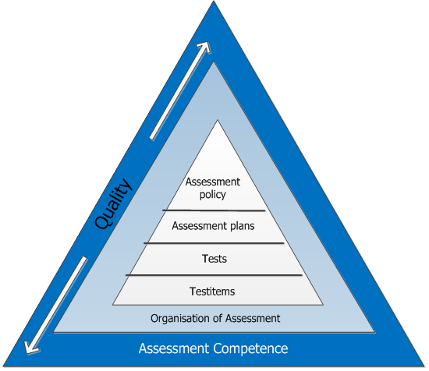

Slide 20
Assignment
Write down in 1 minute what you will take home after these two days.

Slide 21
Learning Outcomes
After today:
You can explain how the test cycle is applied to the internship in the final year at your University
You make suggestions for improvement of the assessment of the Internship

