Slide 1


PROJECT
COMPETENCY BASED CURRICULUM REFORM IN NURSING AND CARING IN WESTERN BALKAN UNIVERSITIES
530438–TEMPUS-1-2012-1-BE-TEMPUS-IPCR
“Eqrem Çabej” University of Gjirokastra
Prof. dr. Liljana Reçka
Ghent, 25th -26 th February 2014

Slide 2

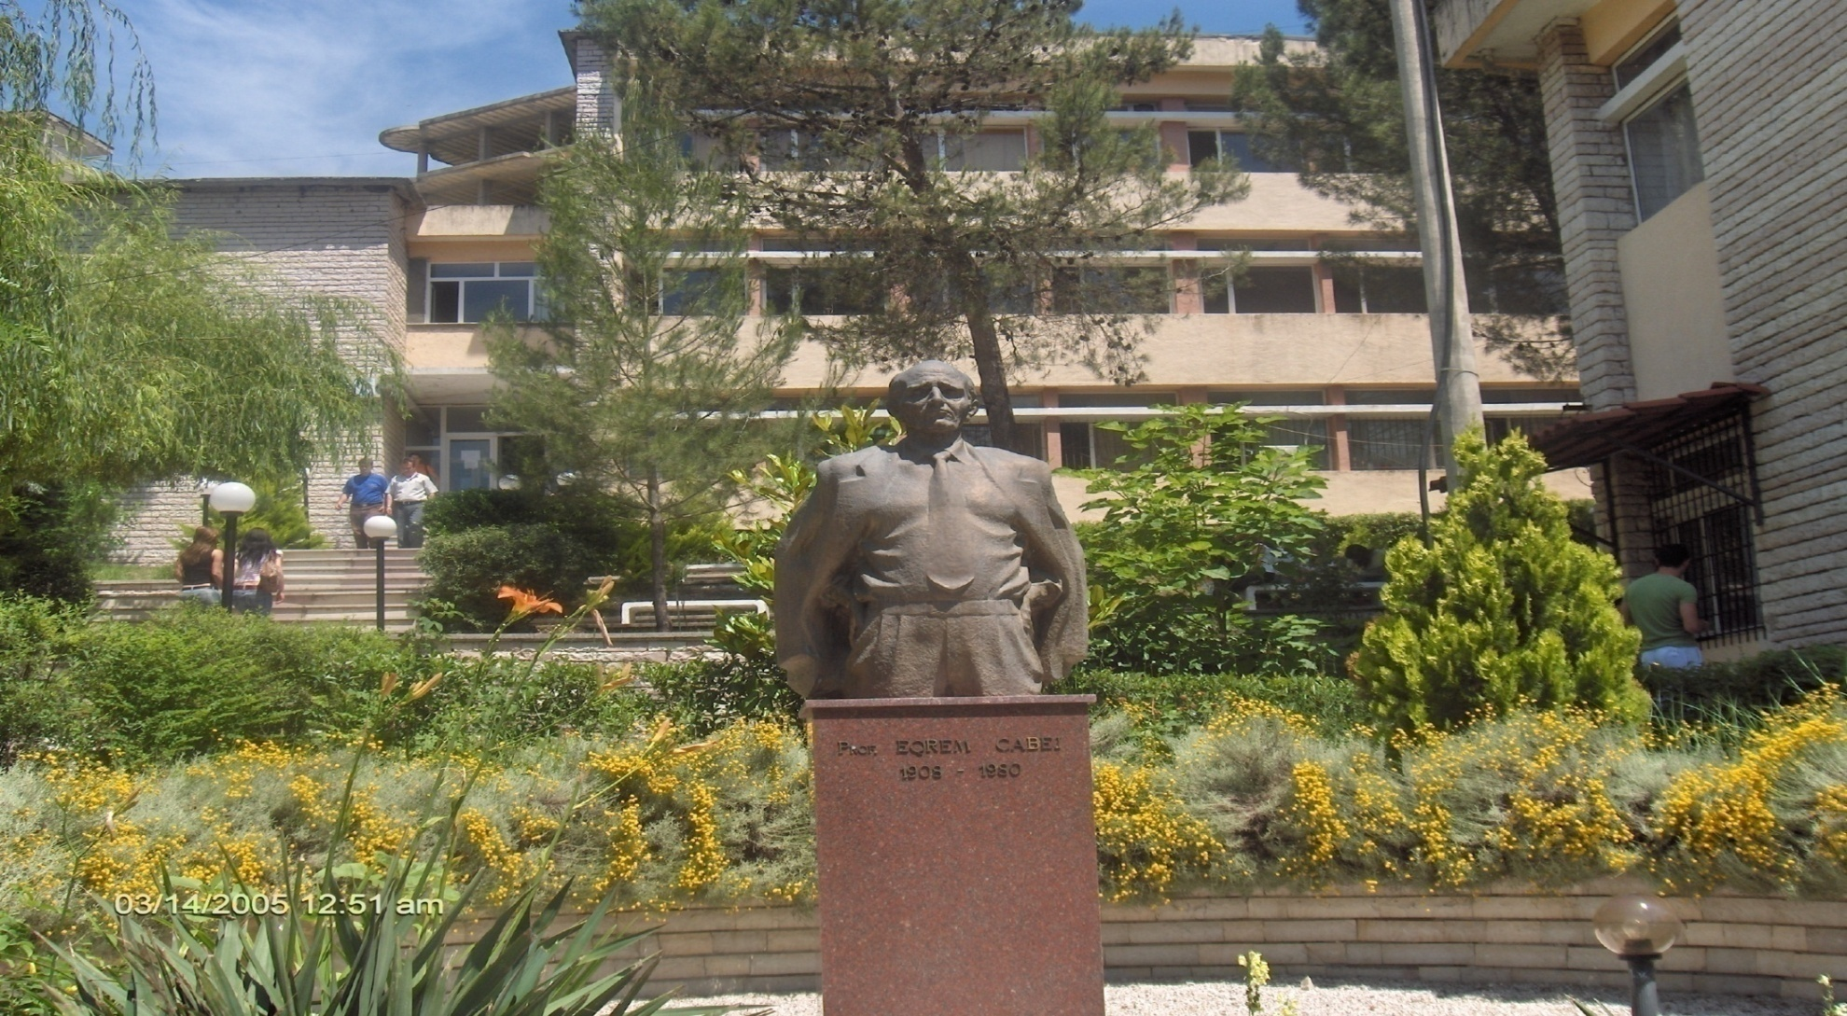

Slide 3
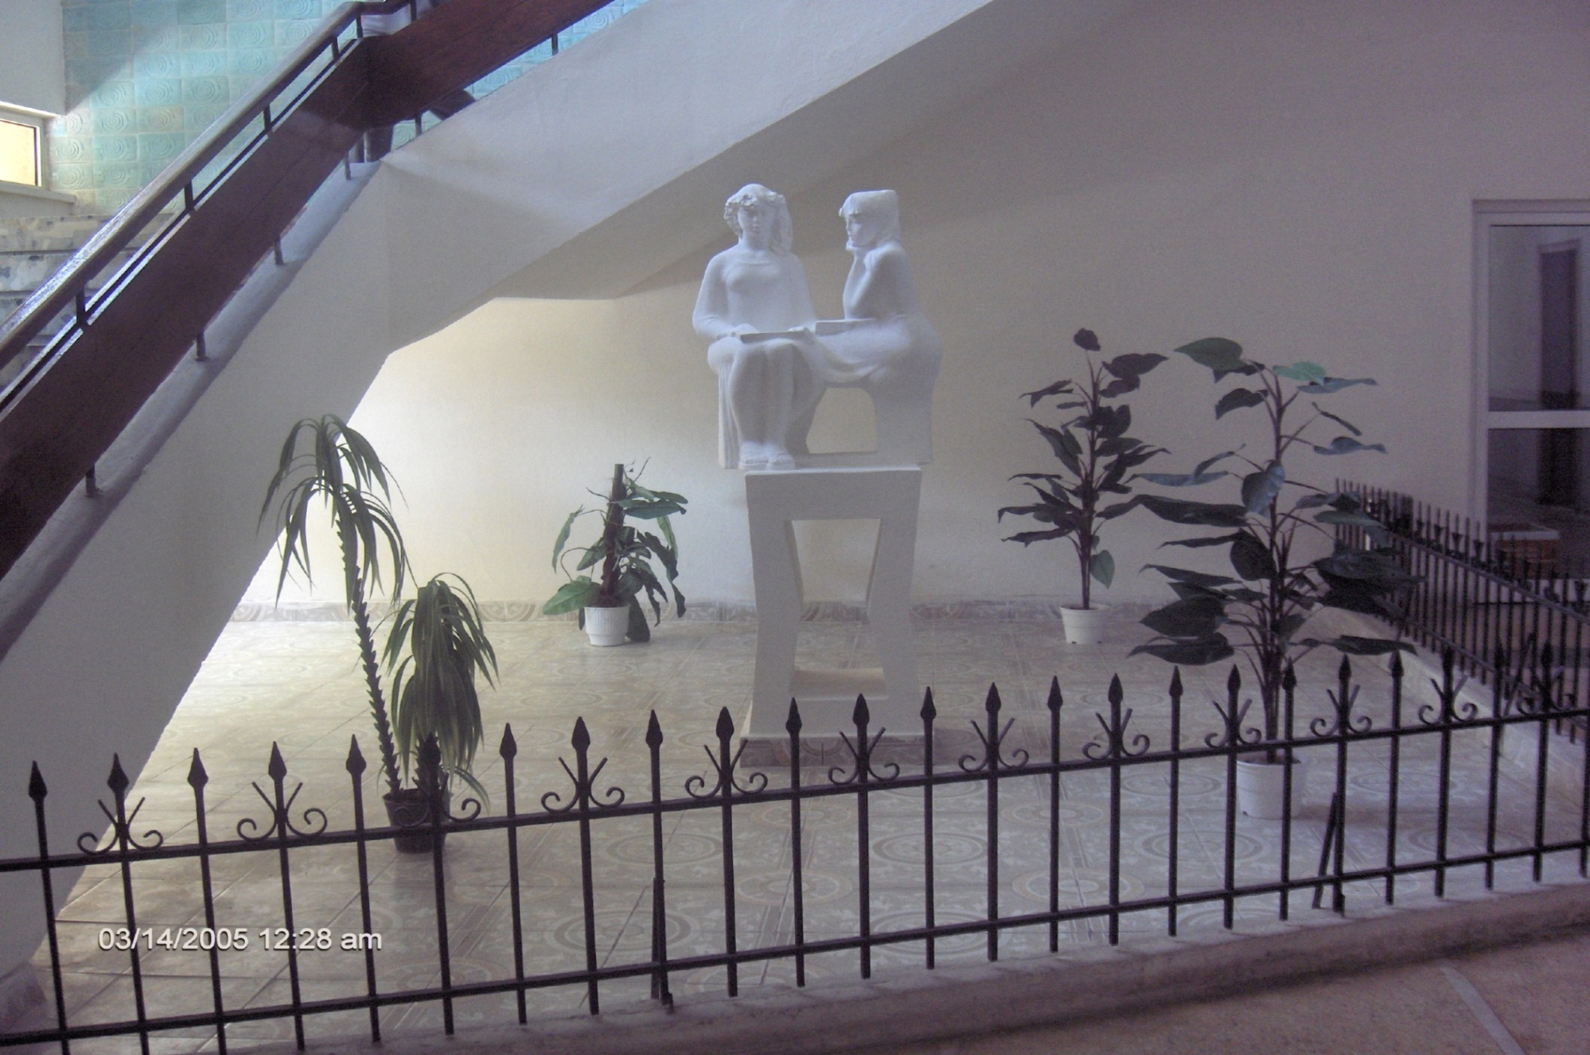

Slide 4
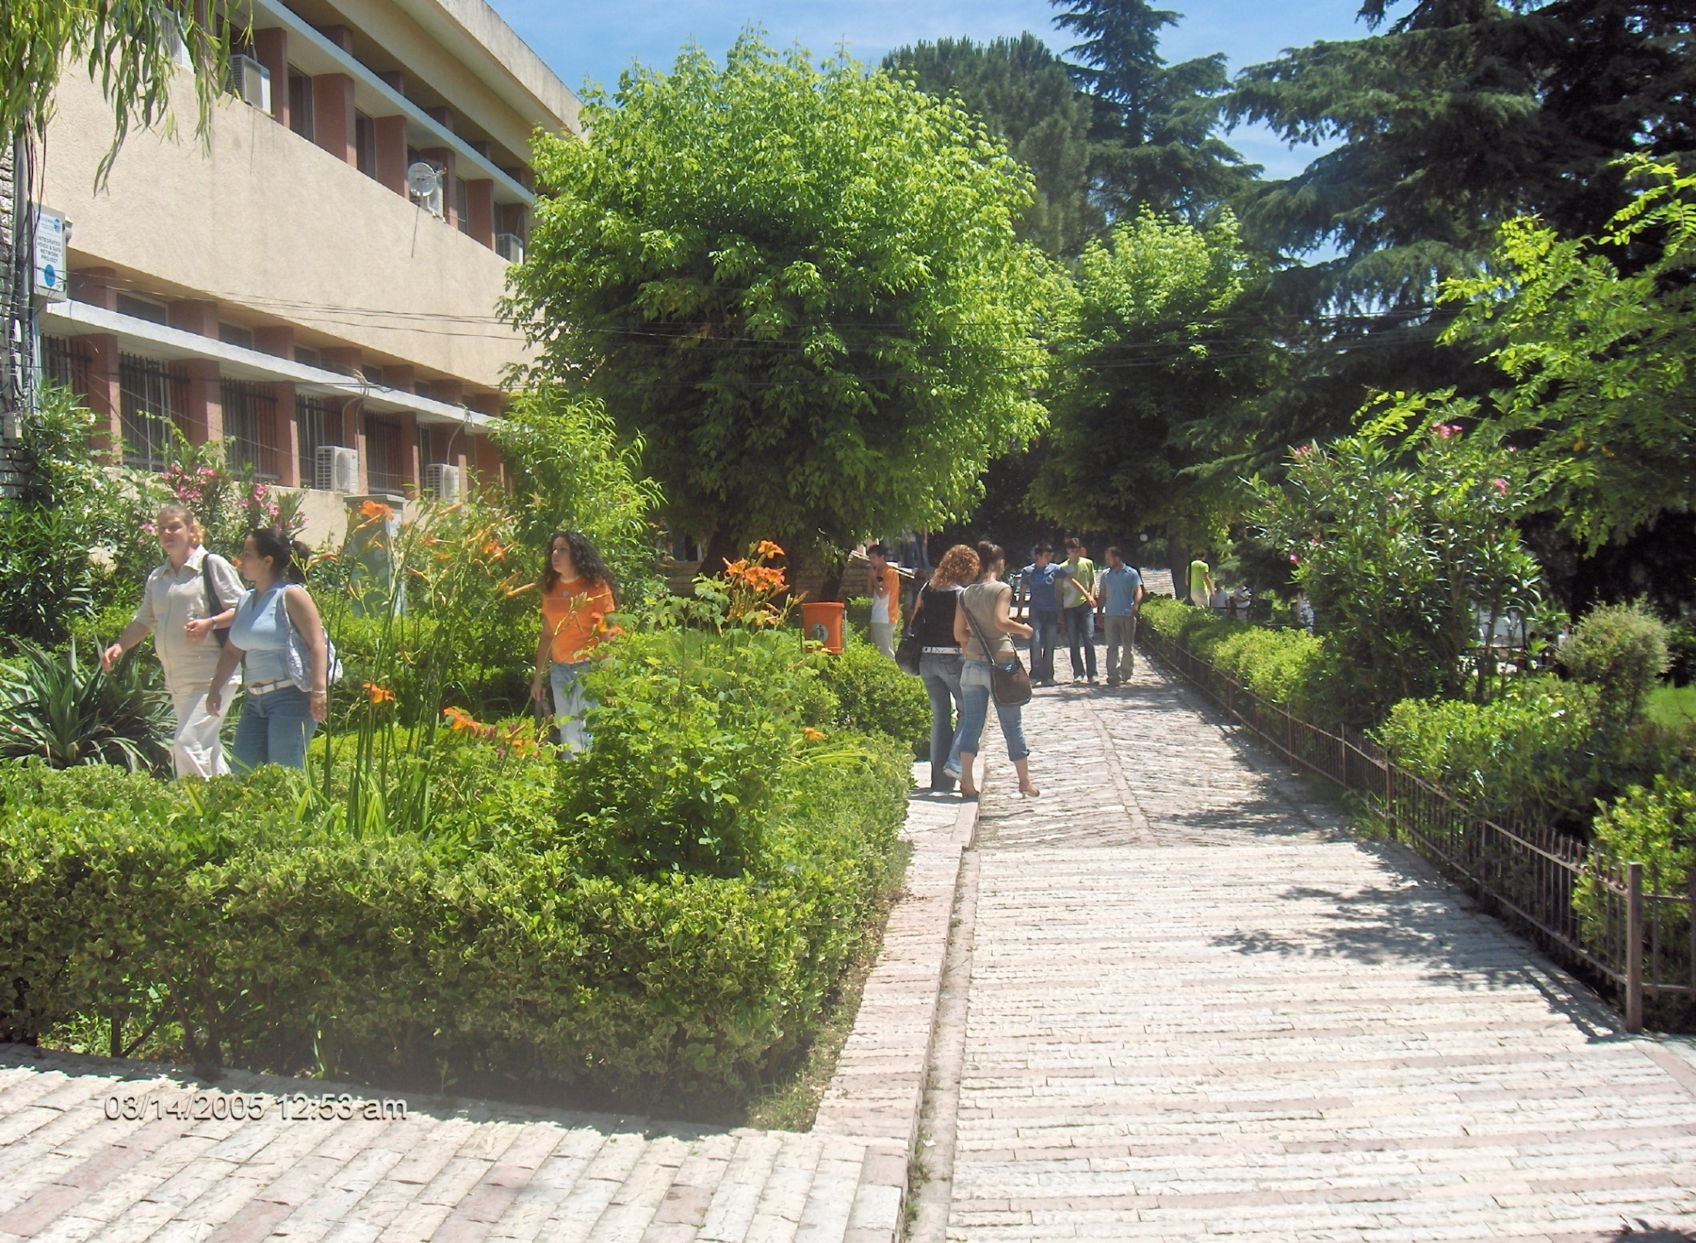

Slide 5
1.1 Short profile university (type of university, size, special features)
“Eqrem Çabej” University of Gjirokastra is the most important higher education institution situated in the Southern Region of Albania.
It was opened by decision of the Council of Ministers, November 1991, on basis of a Higher Pedagogical Institute, opened in 1971. This university welcomes almost 4000 students in all its study programs.
The University attracts students mainly from the Southern Region, but not limited only to this area.
In recent years, it accepts students from all over the country as well as from other neighboring regions of Albania, such as Kosovo, Macedonia and Greece.

Slide 6
THE ORGANISATIONAL STRUCTURE OF THE ECUG
Senate
Rector
Vice rectors
Chancellor
Council of Administration

Slide 7
THE FACULTIES
The Faculty of Education and of the Social Sciences and its first cycle study programmes:
  Albanian Language and Literature
  History-Geography
  English Language and Literature
  Italian Language and Literature
  History and Italian Language
  Greek Language, Literature and Greek Civilisation
  Accountancy-Finance
  Public Administration
  Tourism
  Primary Education
  Pre-school Education

Slide 8
THE FACULTIES
The Natural Sciences Faculty and its first cycle study programmes:
Mathematics-Physics
Physics and Information Technology
Mathematics-Computer Science
Information Technology
Biology-Chemistry
High Nursery and Midwife

Slide 9
University of Gjirokastra offers the following full time and part- time study programs, which are based on the principles of Bologna Chart:
*
19 full time study programs, bachelor, (15 part time study programs, bachelor)
*
12 full time study programs, professional master’s program (9 part time study programs, professional master)
*
3 full time study programs, master of science and 3 others to be opened.
*
1 doctorate study in Albanology with profiles in History, Geography, Linguistic and Literature

Slide 10
International Collaboration
Our University also avails itself of being a partner in bilateral collaboration even in the framework of various projects financed by international organisations, governments or other institutions.

Slide 11
International Collaboration
Our university has always kept continuous links and corporations with all the other universities of our country, and has signed protocols of co-operation with:
University of Ioannina (Greece),
University of Lecce (Italy),
University of National Kapodistian Athens (Greece),
University of Ion (Greece),
“Saint Mary” College, “Ave Maria” University, Michigan, Detroit (USA),
University of Poznan (Poland)
University of Oradea (Romania)
University of Cyprus
University of Macerata (Italy) etc.

Slide 12
This collaboration is very important to the University of Gjirokastra in order to integrate in the contemporary academic, scientific and research developments.

Slide 13
International Programmes
Members of Different Associations
The University of Gjirokastra is involved in many programs of co-operation in the framework of the European project as well as members of different associations
“JEP – TEMPUS PHARE”,
“INTERREG”
Bilateral projects
Cross border programmes
  Albania – Greece
  Albania – Italy
National projects
Members of :
IAU
BASOPED
CUM
ESREA etc

Slide 14
Our University welcomes the most contemporary ideas, progressive curricula for the development of our society, professional ambitions, tangible pedagogical and scientific work.
EÇUG presents interest in the exploration of the region and scientific research in all fields, mainly in:
education,
albanology (linguistics),
anthropology,
interethnic, intercultural and inter-religious relations,
nursing and health care
archaeology,
ecology, and tourism.
economic development
ICT
Mathematics and Physics
Biology, etc.

Slide 15
The mission of the university aims at the need for change, transformation and creation of real capacities, which are valuable for the society. On concrete basis it is focused on:
Regional Development Centre
The preparation of the teachers for all the levels of pre university system.
The preparation of high nurses and midwife.
The preparation of specialists for economy
Being an important scientific, research and publishing center
Continuing Education and LLL Centre

Slide 17
Regional context
Our university intends to adopt and precede the economic and social development of the region. It intends to become a center of continuing education in the southern region of Albania.
University of Gjirokastra is a center for education and scientific research taking into consideration the labor market, the social – economic reforms and the new standards of the European integration.

Slide 18
We maintain contacts with certain groups of interests such as:
Local authorities : Municipality,
District Council, Chamber of
Commerce, Regional Educational Directorate
Banking Institutions
Private enterprises
Health Service Institutions
Local community

Slide 19
We have been, and actually we are involved in different joint projects which have a significant impact on the region.
The contemporary ideas, progressive programs influencing the development of society, professional ambitions, and scientific and pedagogical engagements are welcomed at the University of Gjirokastra

Slide 20
Changes in the role of our university in the context of regional development.
Currently our university is focused on teaching and research process. In the context of regional and social economy development, the university is asked to become a key player within our society. The long/mid- term program for the development of “E.Çabej” university is in accordance with the principal tendencies of the higher education in Europe and further on, particularly with the process of Bologna.
This long/mid- term program for the development of our university is a concrete implementation of the national strategy for the higher education (2008-2013) for the mid-term and long term policies of the higher education institutions, taking into consideration the suggestions of the academic staff and students’ groups, who are interested in the development of this university.

Slide 21
The professors and lecturers of ECUG have always been, and remain active participants in conferences, scientific sessions, and numerous publications within the country and abroad. On the basis of the experience and present achievements, our University has carried out some research work related to its future development, in terms of reconstruction as well as its extension to other study programs and activities.
In developing different programs and other ongoing we rely on a vision of exchange and mutual benefits. Community benefits from the presence of the university as well as from the wider range of services. University also benefits from links with the community by taking other funds from regional and EU authorities. Community is asking the university not only in terms of education, but also forms of individual or company level training, research and consultancy services to various SME, rental facilities such as conference rooms, etc.

Slide 22
Furthermore, the University is an important research, scientific and publication centre.
It also publishes its own scientific journals “University researches” with its two periodicals:
University Research – Social, Economic and Educational Sciences
University Research – Mathematics and Natural Sciences

Slide 23
On basis of the experience and the present achievements, our University has achieved some research work that has to do with its future development, in the direction of reconstruction as well as its extension with many other Faculties and activities.
It is totally involved in the Bologna Process. There are made studies for the reconstruction of the existing branches and the creation of new ones, in order fit itself in this process as well as in the work market.
Teaching and research continue to remain the basic missions of our University, the third one - cooperation with different sectors of society in order to improve regional development has to be in the centre of “The Strategy for the Development of “Eqrem Çabej” University of Gjirokastra” and to be actively implemented in the coming years.

Slide 24
THANK YOU
FOR
YOUR ATTENTION !

