Slide 1
Medical faculty, Univerity of
Montenego
Prof. dr Bogdan Ašanin,contact person of Tempus project
Prof dr Goran Nikolić, Dean of Medical faculty

Slide 2
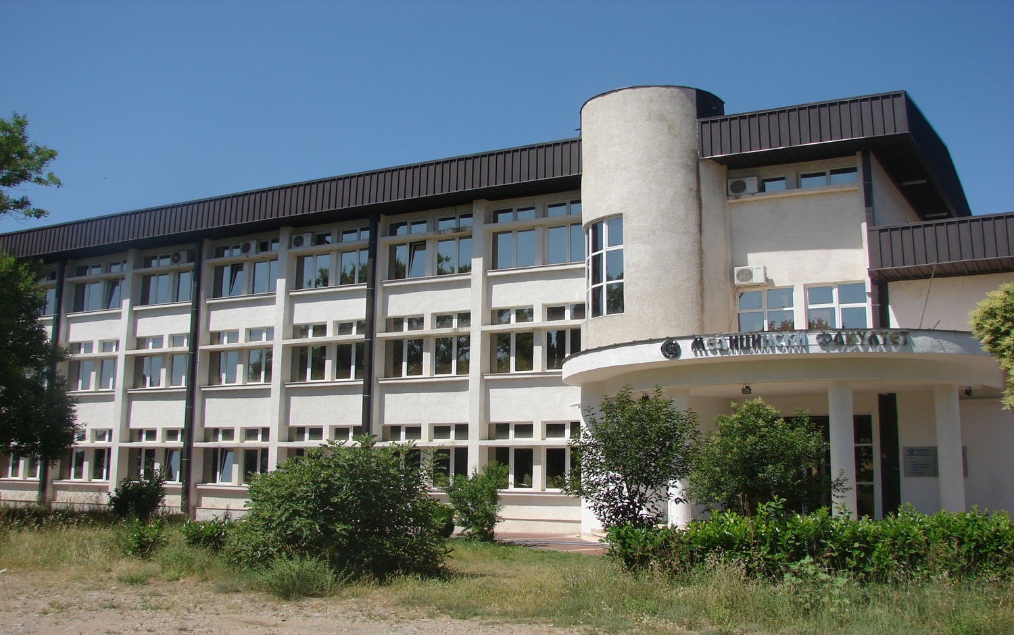
-

Slide 3
THE UNIVERSITY OF MONTENEGROO TODAY
The University of Montenegro was founded in 1974 and situated in ten Montenegrin towns: Podgorica, Nikšic, Cetinje, Kotor, Herceg Novi, Bar, Bijelo Polje, Budva, Pljevlja and Berane and includes 20 faculties, three institutes and two independent study programmes

Slide 4
FIGURES
Faculties : 20
Institutes 3
Autonomous study program for teacher training in Albanian language
University Library
Centre for Information System of the University
Study programmes at undergraduate studies 77
Employees 1170
(372 with academic and scientific titles, 286 associates, 106 expert staff, 406 technical collaborators and administrative staff)
Students 20.475

Slide 5
Faculty of Medicine
Faculty of Medicine, University of Montenegro, Podgorica established in 1996 year,that is the government-owned institution of higher learning which offering 5 programs: undergraduate, postgraduate ( PhD) and specialist programs
medicine, dentistry, nursing(high school of nursing), PhD program and specialization of health professionals.
At present on Faculty studing about 850 students in all programs.

Slide 6
Enroll
Each year enroll:
On medicine program 40 students ,
dentistry program 20 students ,
program for nursing 50,
PhD program 12 students
and specialization about 30 students.

Slide 7
Teaching staff
Faculty have:
70 professors
160 teaching associates (assistants)
20 professors from regional Medical schools (Beograd, Novi Sad, Niš).

Slide 8
Cooperation
Faculty have good cooperation with all medical faculties in region;Beograd,Novi Sad,Niš,(Serbia) Sarajevo.Tuzla(Bosnia and Herzegovina), Skoplje (Macedonia), Rijeka( Croatia), Ljubljana (Slovenia) and Udine ( Italy) and Nijmegen(Netherlands)- during conduction common JTP project from 2006-2009).

Slide 9
Mobility
Students, Assistants and Professors participate in mobility in frame programs:CEPUS, Erasmus mundus, intenat. congres,confereces,projects
Students: inetrnational exchange program for students during summer months

Slide 10
Students mobility
In frame of students associations every year In summer months about 25 our students going for one month in different medical faculties in Europe for clinical practice and some in other countries in the world, and we are host at equals number of foreign students

Slide 11

Thank you for your Attention!

