Slide 1

Undergraduate training in nursing
Maja Racic, MD, PhD
University of East Sarajevo
Faculty of Medicine Foca
Republic of Srpska
BiH

Slide 2
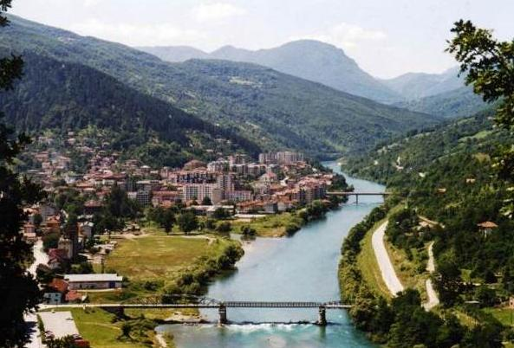
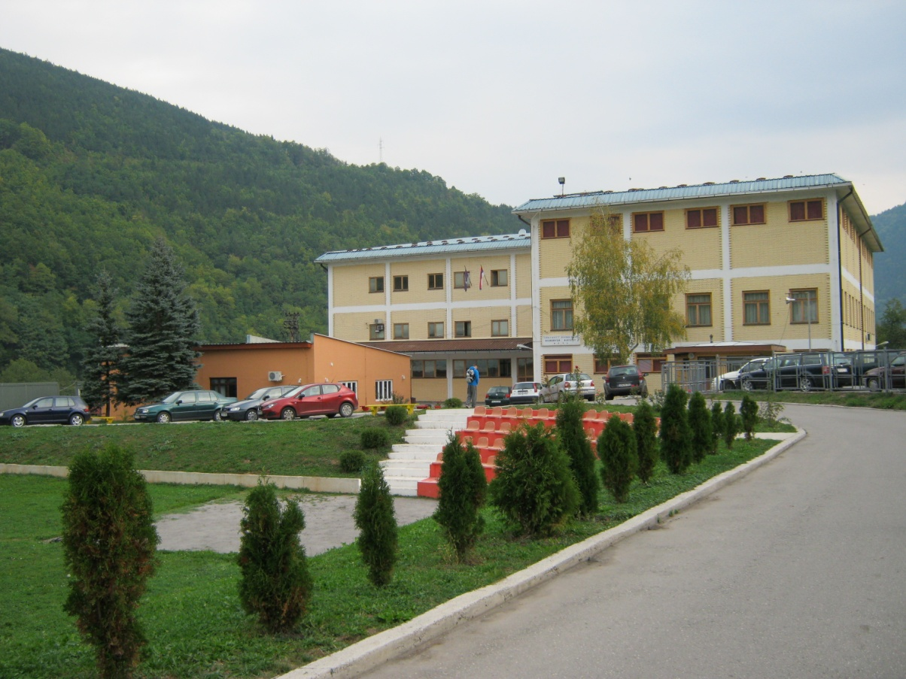

Slide 3
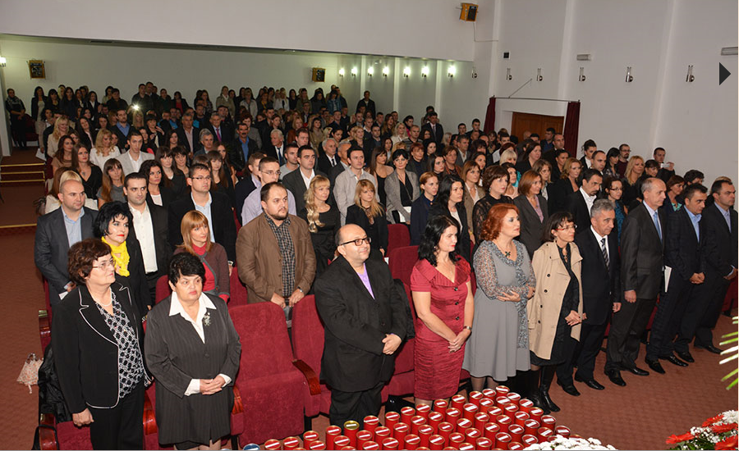
What University of East Sarajevo offers to the students?
Clinically based knowledge and practical skills enhancement, balanced with evidence-based research, ensuring our graduates to become highly successful practitioners by the end of their training.

Slide 4
Undergraduate training
Enables students to develop the professional attributes they need to be able to practice in a range of settings
Delivers skilled, sensitive care to patients and their families
Also prepares a student for a career in nurse education, research or management

Slide 5
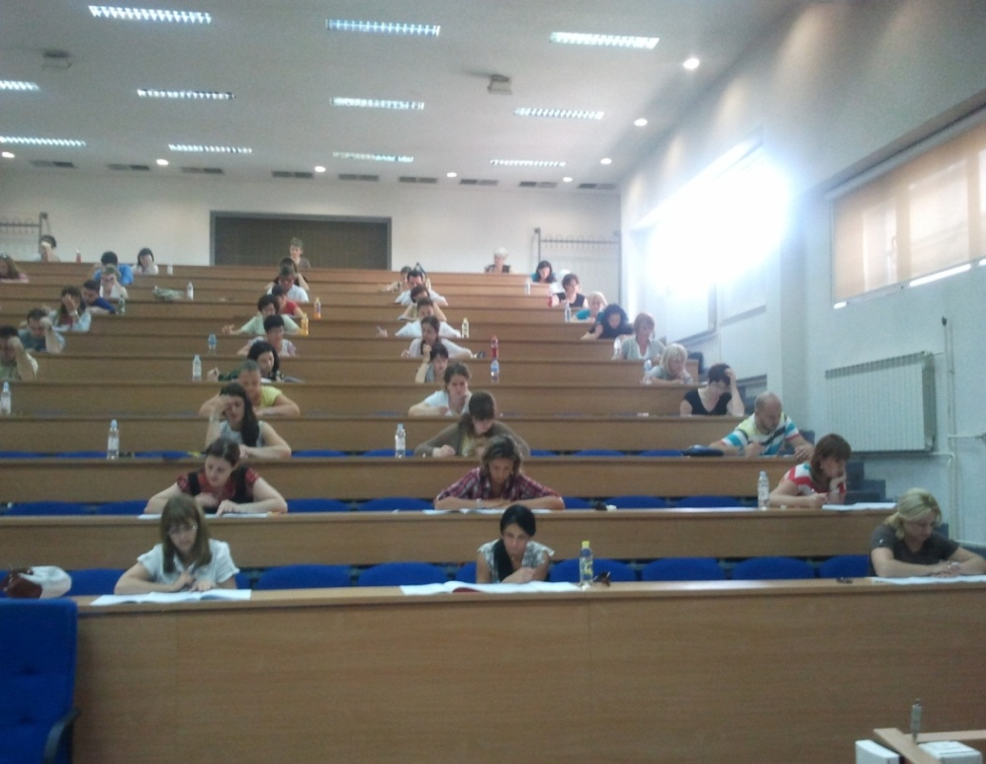
Admission criteria
Grades in high school
Passed entrance exams (biology, chemistry and principles of health care)
Number of students per year: 40

Slide 6
Undergraduate studies
Length: 4 academic years (8 semesters)
ECTS credits: 240
2 790 hours of total teaching (50% practical training)
Degree: Bachelor degree in nursing

Slide 7
Curriculum-first year
SUBJECT | Number of hours
Anatomy, Histology, Embriology | 75
Biochemistry | 75
Genetics | 45
Informatics | 30
Sociology | 30
Introduction to medicine and health care | 90
Physiology | 75
Microbiology | 75
Public health | 75
Medical ethics | 30
Multidisciplinary health care | 75
English language I | 60

Slide 8
Curriculum-second year
Subject | Hours
Pathology and pathophysiology | 75
Pharmacology | 75
Infective diseases | 75
Nutrition and nutritive therapy | 90
Medical statistics | 30
Occupational medicine | 45
Epidemiology | 30
Medical psihology | 30
Clinical skills and health care in hospital setting | 120
Geriatrics | 45
Pediatrics | 75
English language II | 60

Slide 9
Curriculum-third year
SUBJECT | Number of hours
Internal medicine | 75
Surgery | 75
Gyneacology | 45
Psychiatry | 45
Physical medicine and rehabilitation | 45
Primary health care | 60
History of medicine | 30
Art and medicine | 30
Management and organisation in health care | 75
Communication skills | 75
Oncology and palliative care | 75
English language III | 60

Slide 10
Curriculum-fourth year
Subject | Hours
Ecology | 75
Psychology, development and aging | 45
Radiology | 45
Pedagogy | 90
Research methodology | 60
Elective I | 45
Elective II | 180
Thesis | 45

Slide 11
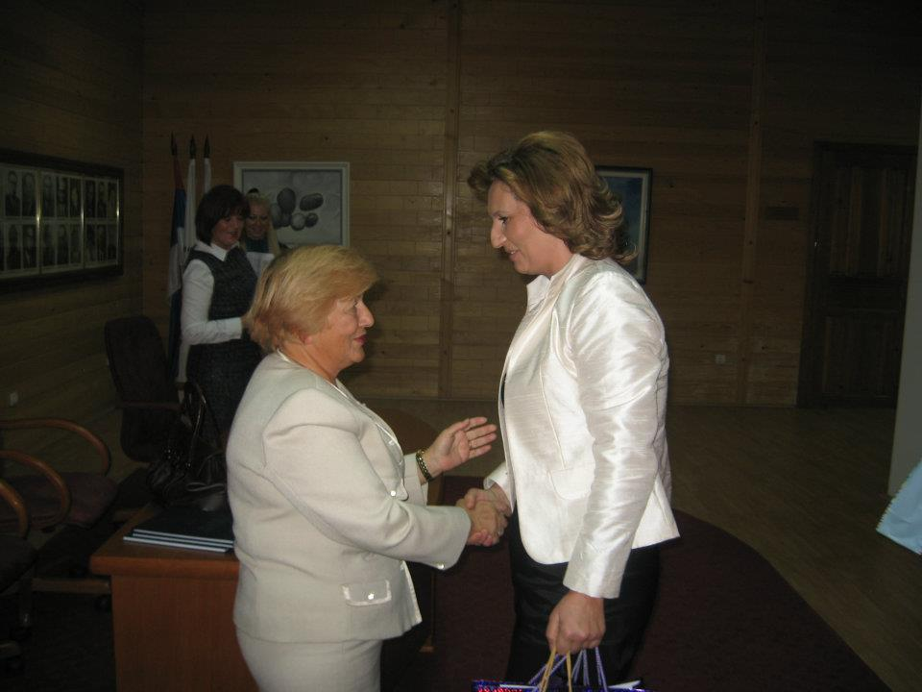
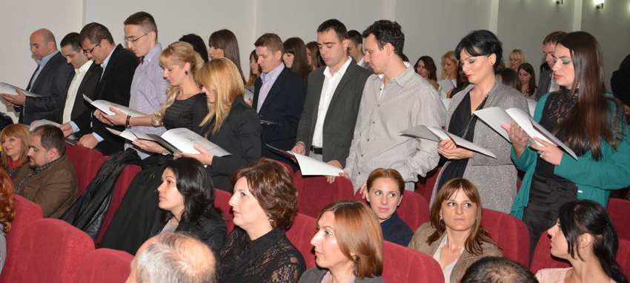
Final exams
final advocacy of the thesis
oral state exam certifying the knowledge, skills and abilities to solve problems of nursing care

Slide 12
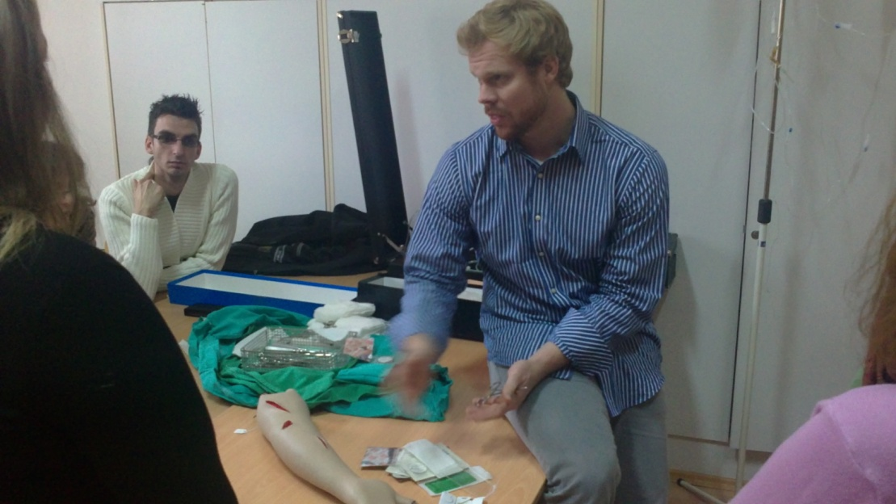



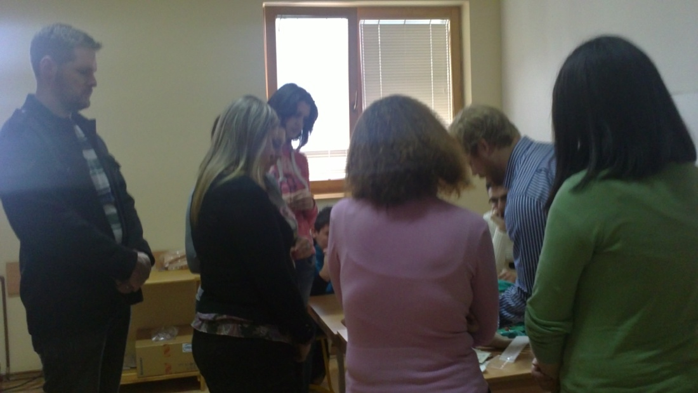
Student exchange

Slide 13
interprofessional learning
To increase knowledge of particular clinical skills or topics
To help to develop skills needed for effective teamwork
To enhance understanding of others’ profesional roles and responsabilities
Notes:
an awareness of personal limitations, willingness to seek help when necessary and ability to work as a member of a team
Such opportunities increase and deepen understanding of each other's roles and
responsibilities, strengths and limitations

Slide 14
Postgraduate studies
Length: 1 academic year (2 semesters)
ECTS credits: 60
405 hours of total teaching (60 % practical training)
Degree: Master of nursing

Slide 15
Principles of teaching
Whole person approach
Mind
Body
Spirit
Notes:
15

Slide 16
Principles of teaching
Adaptability
Improvisation
Life-long learning
Collaboration
Endurance

Slide 17
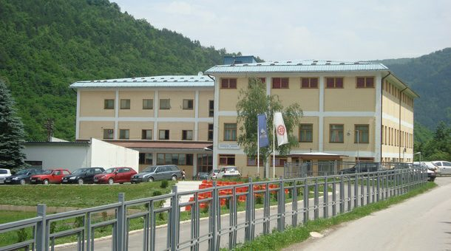
THANK YOU

