Slide 1
University of Shkodra
“Luigj Gurakuqi”
AGENDA
History.
Organisation,
Faculties and Programs of Study,
Faculty of Natural Sciences,
Branch of General Nursing,
Branch of Midwifery,
Branch of Physiotherapy,
Facts and figures on teaching staff and graduated students in these programs of study,
Contacts.

Slide 2
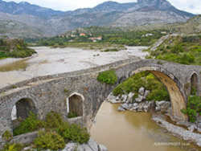

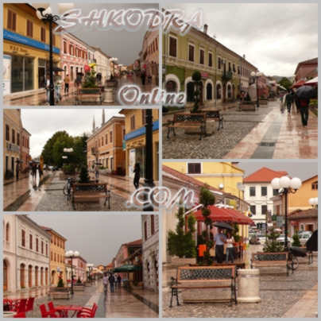
1. Shkodra City
Shkodra city is located in the
northwestern part of Albania.
It is situated in the wedged between
the Rozafa Castle, the magnificent
Albanian Alps, deep blue Lake of Shkodra, a 30-kilometre sand beach and Buna river delta reservation.
It is one of the
oldest and most
historic towns in Albania,
as well as an important
cultural and economic centre.

Slide 3
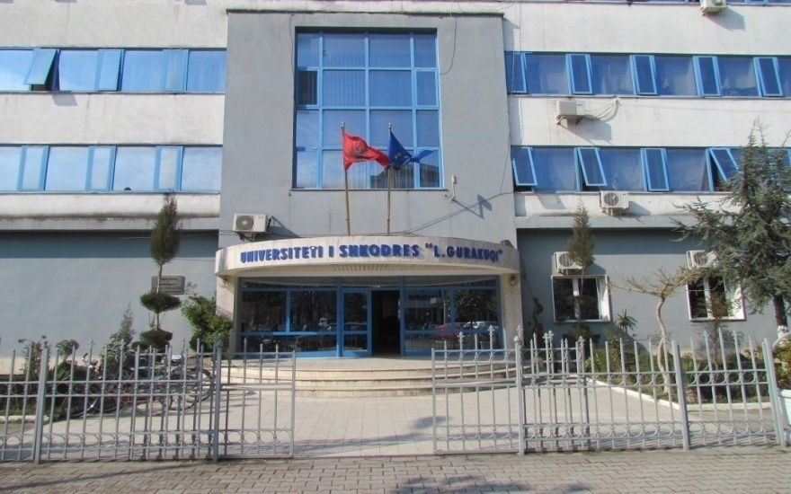
1.1 Shkodra University
Shkodra University is one of the
most prestigious learning centers of Albania.
University of
Shkodra
is located in the
center of the city .

Slide 4
1.2 History of Shkodra University
“Luigj Gurakuqi” University of Shkodra was established on 02. Sept. 1957 as a High Pedagogical Institute. At the beginning this University had 2 Faculties (Faculty of Social Sciences and the Faculty of Natural Sciences).
It changed its status to University of Shkodra, "Luigj Gurakuqi" by the Ministers' Council decree nr. 124, on 28.05.1991.
University of Shkodra has now 6 Faculties (Faculty of Social Sciences, Faculty of Educational Sciences, Faculty of Natural Sciences, Faculty of Economics, Faculty of Law and the Faculty of Foreign Languages).

Slide 5
2. Organisation
Shkodra University is organised as following :
Rector,
Pro – Rector,
Chancellor,
Deans of the Faculties
Heads of the Departments.
The Administrative personnel.
Students are organised in “Students Council” which works within the structures of this university.
In total there are 180 full-time professors and lectures, 603 part-time professors and lecturers, 97 non-academic personel.
About 15 000 students are currently attending the University of Shkodra.

Slide 6
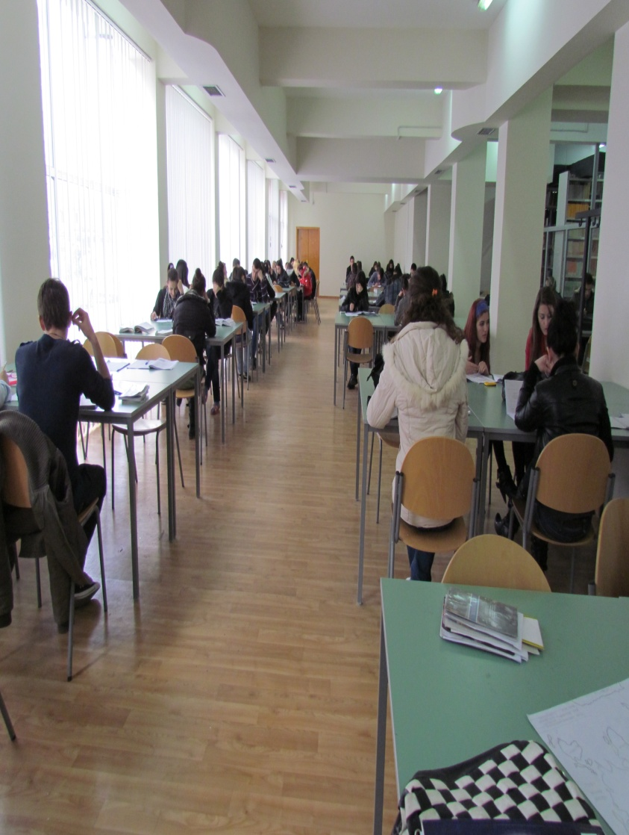
3. Faculties and Programs of Study
Our University has 6 faculties:
Faculty of Natural Sciences
Faculty of Social Sciences
Faculty of Educational Sciences
Faculty of Economics
Faculty of Foreign Languages
Faculty of Law

Slide 7
3. Faculties and programs of Study
The University of Shkodra now offers the following programs of study:
25 programs of study bachelor,
19 programs of study, professional master,
16 programs of study, master of science,
1 doctoral study.

Slide 8
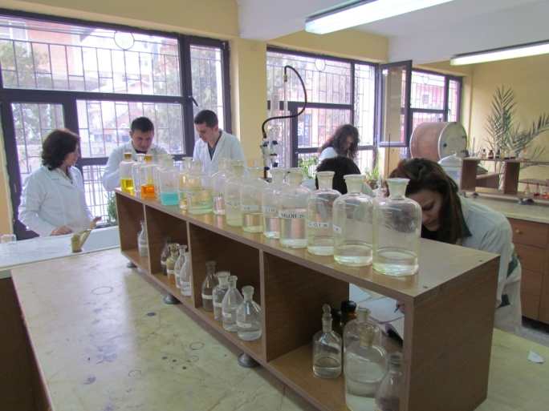
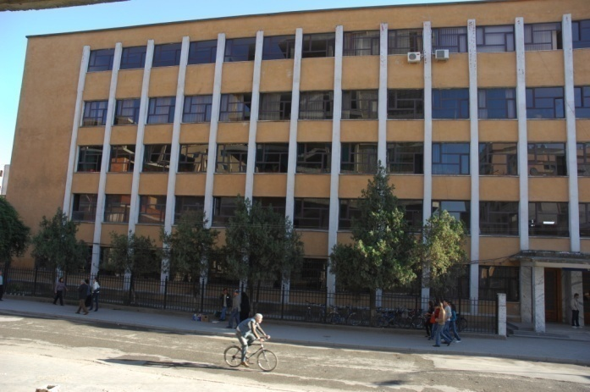
4. Faculty of Natural Sciences
The Faculty of Natural Sciences has 7 branches :
Mathematics,
Informatics,
Physics,
Biology- Chemistry,
General Nursery,
Nursery - Midwifery
Nursery- Physiotherapy branches.
This Faculty, in collaboration with the Faculty of Educational Sciences, also offers master programs of study in the respective fields of study (in teaching these subjects.

Slide 9
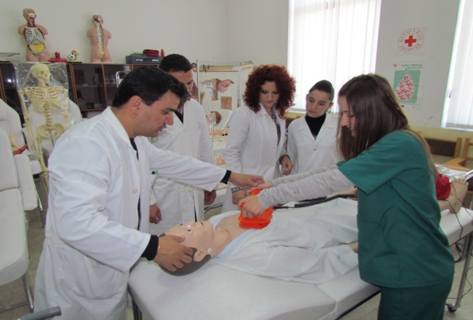
5. Branch of
General Nursing
General nursing was first opened in the academic year 2001-2002. Nowadays there are about 415 students attending their studies.
This program of study is offered in the bachelor level.
Students get a degree in General Nursing.
The professional practices are done at the regional hospital of Shkodra city and sometimes in local hospitals of different cities.
In total this program of study has 30 weeks which are divided as following:
Year one: 26 weeks theory - 4 weeks professional practice.
Year two: 16 weeks theory - 14 weeks professional practice.
Year three: 16 weeks theory - 14 weeks professional practice
.

Slide 10
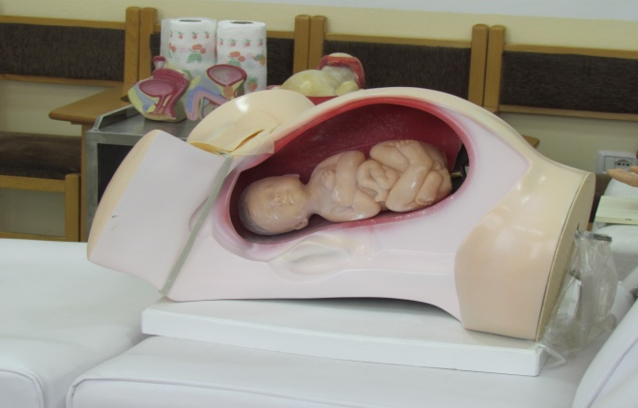
6. Branch of Midwifery
Opened in 2007-2008
Nowadays there are about 389 students attending their studies.
This program of study is offered in the bachelor level.
Graduated students get a degree in Midwifery.
The professional practices are done at the regional hospital of Shkodra city, department of maternity and sometimes in local hospitals of different cities.
In total this program of study has 30 weeks which are divided as following:
Year one: 26 weeks theory - 4 weeks professional practice.
Year two: 16 weeks theory - 14 weeks professional practice.
Year three: 16 weeks theory - 14 weeks professional practice

Slide 11
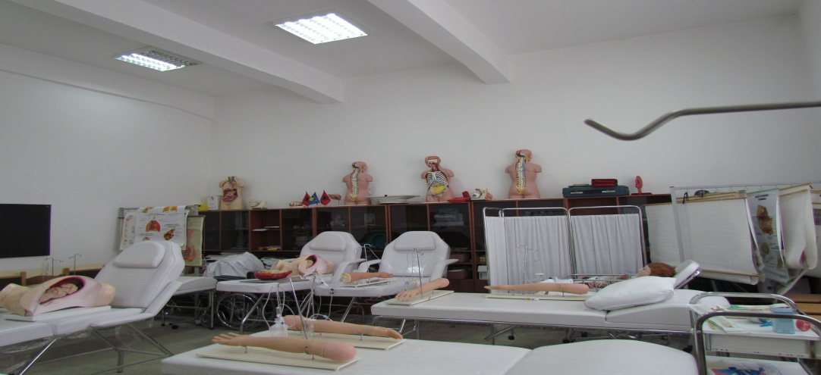
7. Branch of
Physiotherapy
Opened in 2007-2008.
Total number of 184 students.
This program of study was opened in collaboration with the University Florence (Italy) and majority of the professors who teach in this department are Italian professors.
It is offered in the bachelor level.
The professional practices are done at the regional hospital of Shkodra city and in Florence (Italy).
In total this program of study has 30 weeks which are divided as following:
Year one: 20 weeks theory - 10 weeks professional practice.
Year two: 20 weeks theory - 10 weeks professional practice.
Year three: 20 weeks theory - 10 weeks professional practice

Slide 12
8. Facts and figures on teaching staff and graduated students in these programs of study
The staff involved in professional practices is composed of 8 full-time professors and 108 part-time professors and lecturers (57 from them are Italian professors who teach part-time at Physiotherapy program of study).
There are also involved 44 referents that are in charge for the supervision of the professional practices of the students.

Slide 13
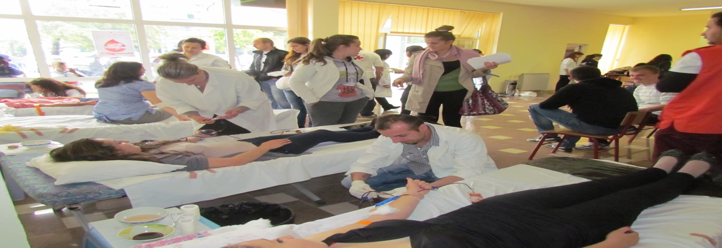
In total there are graduated 921 students in General Nursery, 149 in Midwifery and 44 in Physiotherapy since these programs of studies were first offered.
For the students of the these programs there is offered a master program of study in "Psychology of Health".

Slide 14
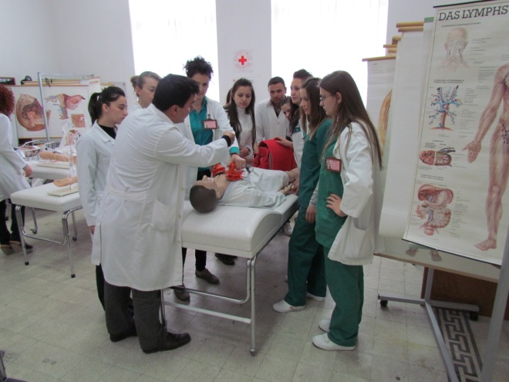
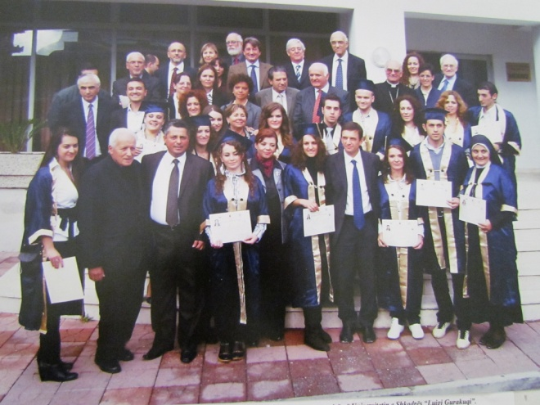
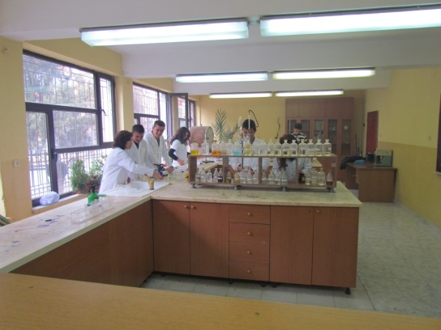
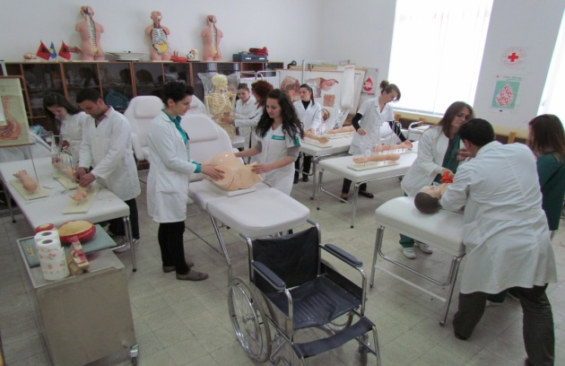
Contacts
W ww.unishk.edu.al
e-mail: erard.unishk@gmail.com
iroshkoder@unishk.edu.al

