Slide 1

School of Nursing
Maarten Kaaijk & Johan van Wieren
Workshop: PROBLEM BASED LEARNING (PBL)

Slide 2
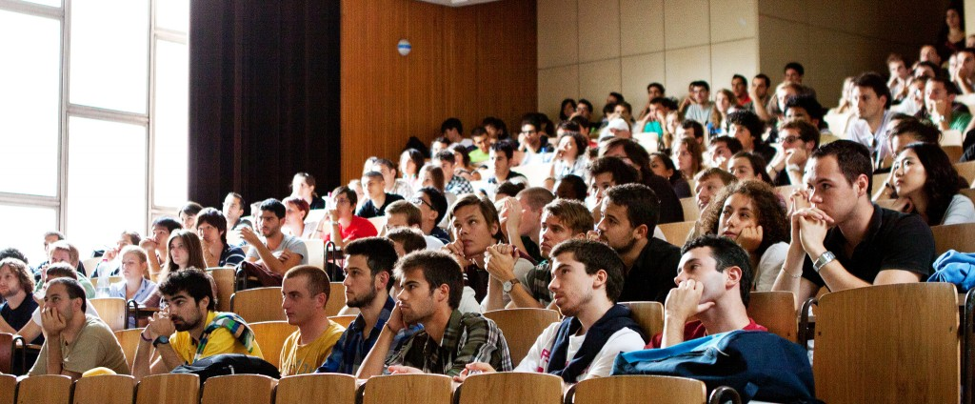
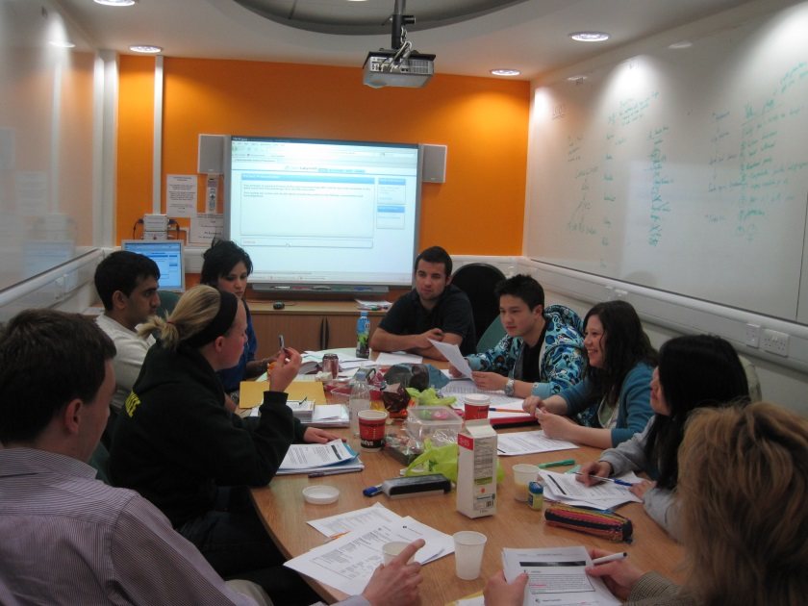
Which picture inspires students?

Slide 3
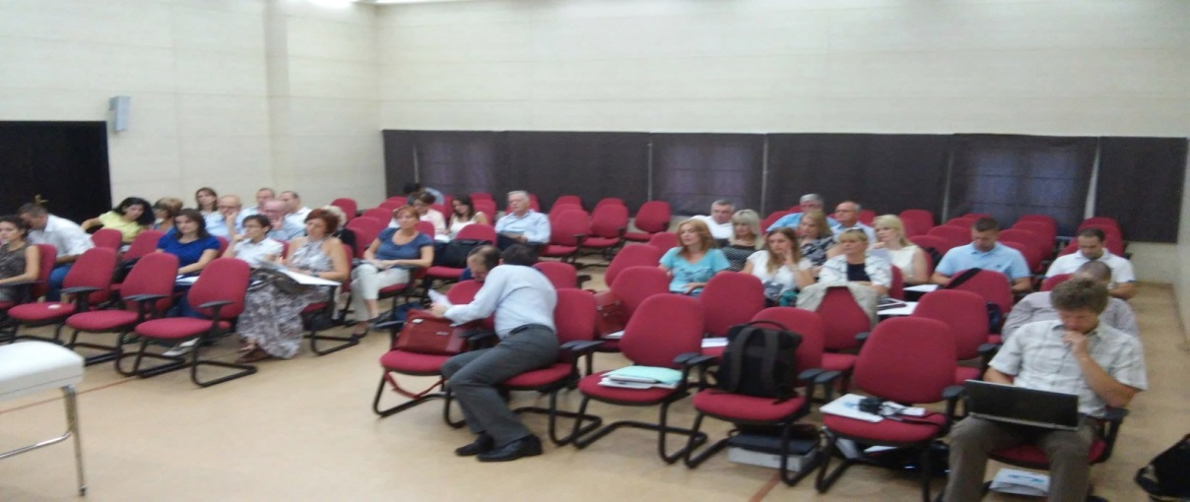
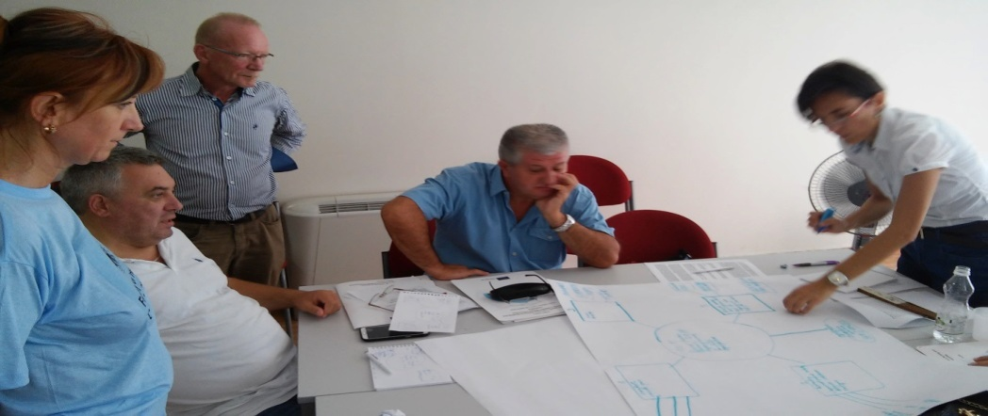
Which picture inspires you?

Slide 4

Problem Bases Learning

Slide 5

Workshop PBL
Learning Outcomes:
The participants apply the 7-steps of PBL in a real case.
The participants analyse the problems and benefits of introducing PBL in the curriculum.
The participants give examples how to implement PBL in the curriculum.

Slide 6
Hanze University Groningen
From a medical oriented program to a nursing oriented program (subject directed: Orem)
From separated subjects towards integrated themes and modules (task groups)
From a traditional teacher centered education approach to a student centered approach (constructivism)
A complete and pure PBL curriculum, 7 contact hours a week
From separated themes to competences (hybrid model)
From competences to professional tasks (products and services (hybrid model)
Curriculum 2020 based on CANMEDS and N3 (Nanda, NIC and NOC)

Slide 7
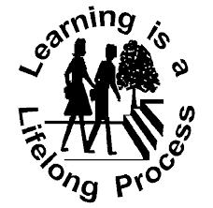
Concepts for curriculum development
Student centered education
Self directed learning
Life long learning
Adult education
Problem solving
Small groups
Evidence Based Nursing

Slide 8
Constructivism
“Constructivism is basically a theory -- based on observation and scientific study -- about how people learn. It says that people construct their own understanding and knowledge of the world, through experiencing things and reflecting on those experiences. When we encounter something new, we have to reconcile it with our previous ideas and experience, maybe changing what we believe, or maybe discarding the new information as irrelevant. In any case, we are active creators of our own knowledge. To do this, we must ask questions, explore, and assess what we know. “

Slide 9
Constructivism
“In the classroom, the constructivist view of learning can point towards a number of different teaching practices. In the most general sense, it usually means encouraging students to use active techniques (experiments, real-world problem solving) to create more knowledge and then to reflect on and talk about what they are doing and how their understanding is changing. The teacher makes sure she understands the students' preexisting conceptions, and guides the activity to address them and then build on them. “
http://www.thirteen.org/edonline/concept2class/constructivism/

Slide 10

Modern Educational Principles
Self directed learning:
The learner takes the initiative for:
Diagnosing learning needs
Formulating goals
Identifying resources
Implementing appropriate activities
Evaluating outcomes

Slide 11
Principles of adult learning
Adults are motivated by learning that:
Is perceived as relevant
Is based on, and builds on their previous experiences
Is participatory and actively involves them
Is focused on problems
Is designed so that they can take responsibility for their own learning
Can be immediately applied in practice
Involves cycles of action and reflection
Is based on mutual trust and respect

Slide 12
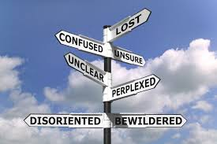
Characteristics of PBL
Emphasizes students’ pre-existing knowledge; “start with what you know”
Students actively participate by helping plan, organize, and evaluate the problem solving process
Interdisciplinary connections stressed
Students undertake authentic roles

Slide 13

Characteristics of PBL
Requires students to solve authentic, real-life open-ended problems with many correct answers possible
Authentic problems are those real-life issues faced by doctors, nurses, social workers, police officers, lawyers, engineers, business administrators, pilots, etc., etc., etc.

Slide 14
PBL Tutorials
Students’ PBL learning at the University aims toward how the student learns (life-long process) and encourages students to integrate concepts from nursing, psychology and sociology in their understanding of the situation/ issues or particular aspects.
  Student’s task is to discover what they need to know to address the problem posed.
  Other skills involved: problem solving skills, inquiry skills and thinking skills explicitly, not merely memorization.
  Self-directive, interdependent collaborative learning, cooperative and reflective learning are valued.

Slide 15
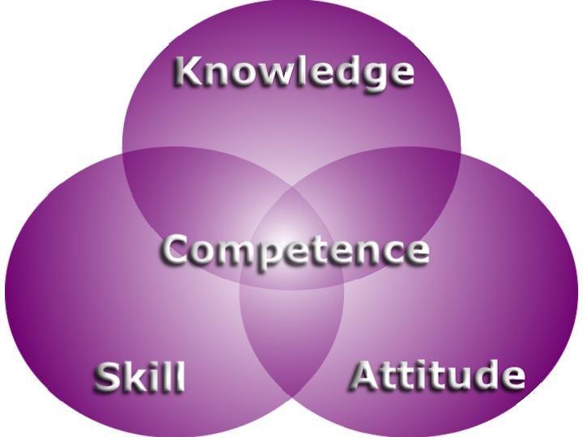
Objectives of the PBL process
Knowledge
  Theoretical
  Clinical
Skills
  Scientific reasoning
  Critical appraisal,
  Information literacy
  Self directed, lifelong learning.
Attitudes
  value of teamwork
  interpersonal skills
  the importance of psycho-social issues.

Slide 16
PBL Process
Prioritize the learning needs, set learning goals and objectives, and allocate resources so that the student knows what is expected of him/her and the timelines. For a group, members can identify which tasks each will perform.
Self-study and preparation
Share the new knowledge effectively so that all the group learn the information and its applicability

Slide 17
Roles in the PBL group
Roles
Scribe
Tutor
Chair
Group member

Slide 18
Role of the sribe
Record points made by group
Help group order their thoughts
Participate in discussion
Record resources used by the group

Slide 19
Role of the tutor
Encourage all group members to participate
Assist chair with group dynamics and keeping to time
Check scribe keeps an accurate record
Prevent sidetracking
Ensure group achieves appropriate learning objectives
Check understanding
Assess performance

Slide 20
Role of the chair
Lead the group through the process
Encourage all menbers to participate
Maintain group dynamics
Keep to time
Ensure group keeps to task in hand
Ensure scribe can keep up and is making an accurate record

Slide 21
Role of the group member
Follow the steps of the process in sequence
Participate in discussion
Listen to and repect contributions of others
Ask open questions
Research all the learning objectives
Share information with others

Slide 22

Steps in PBL (1 and 2)
1. Identify and clarify unfamiliar terms presented in the scenario: scribe lists those that remain unexplained after discussion
2. Define the problem(s) to be discussed; students may have different views on the issues but all should be considered; scribe records a list of agreed problems

Slide 23
Steps in PBL (3 and 4)
3. “Brainstorming” session to discuss the problem(s), suggesting possible explanations on base of prior knowledge; students draw on each other’s knowledge and identify areas of incomplete knowledge; scribe records all discussion
4. Review steps 2 and 3 and arrange explanations into tentative solutions; scribe organizes the explanations and restructures if necessary

Slide 24
Steps in PBL (5 and 6)
5 Formulate learning objectives; group reaches consensus on the learning objectives; tutor ensures learning objectives are focused, achievable, comprehensive and appropriate
6. Private study (all students gather information related to each learning objective
7. Group shares result of private study (students identify their learning resources and share their results; tutor checks learning and may assess the group

Slide 25

How to facilitate PBL?
Small groups of students (<8)
Groups usually meet twice a week for around 2-3 hours
At the first meeting – new situation or problem (trigger), 2 hours
Identification of the main issues and questions
Period of individual study (2-3 days) - group reconvenes
Group discussion around 2 hours and sharing knowledge
Supporting activities (labs, lectures)

Slide 26
PBL trigger material
Paper based clinical scenarios
Experimental or clinical laboratory data
Photographs
Video clips
Newspaper articles
An article from a scientific journal
A real or simulated patient
A family tree showing an inherited disorder

Slide 27
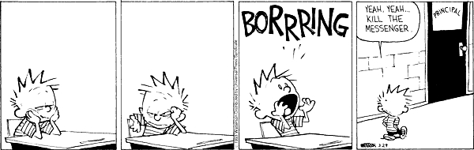
PBL curriculum design
Full PBL design
Themes
modules

Slide 28
PBL student
Prompt and present for all sessions
A knowledge of the PBL process
Commitment to self/student directed learning
Active participation in discussion and critical thinking whilst contributing to a friendly non-threatening environment
Willingness to make constructive evaluation of self, group and tutor

Slide 29

Tutor as facilitator
The facilitator is no needed to be content expert
The facilitator’s role is to prompt, guide and question, when necessary, to ensure that predetermined learning issues are identified, researched and discussed.
Open-ended questions should be used to foster student metacognitive growth.
A wait-time is essential to allow the student to process the information and formulate their ideas – they should not be rushed.
Creating PBL Scenarios

Slide 30
Problems PBL
Staff/student ratio- an ideal group is 6-8 students.
Faculty busy with traditional curriculum
Quality control on triggers (scenarios) is difficult
Heavy on library, computer and support resources
Inherent conflict with traditional lectures

Slide 31

We wish you goodluck

