Slide 1


CCNURCA project
Willem vanden Berg
Odisee University College

Slide 2
Content
  Main objective
  Coordinator & Partner
  Activities & Results
  Validation & Quality Management
  Capacity Building
  What’s next?

Slide 3
Main objective
CCNURCA
“Competency based Curriculum Reform in Nursing and Caring in Western Balkan Universities”

Slide 4
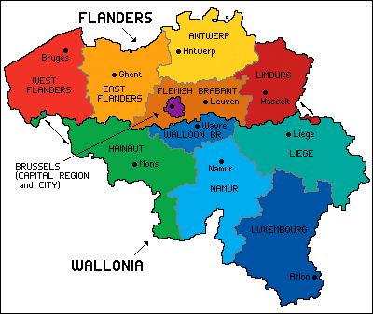
Coordinator & Partners

Slide 5
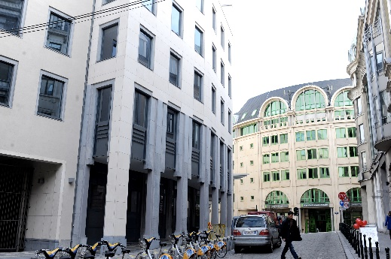
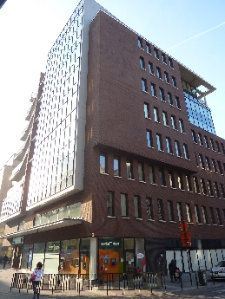
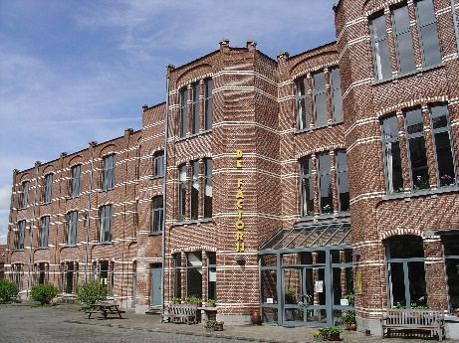
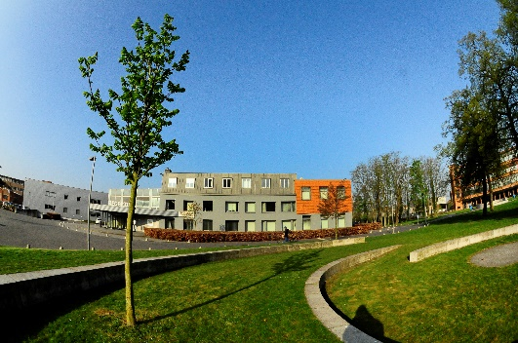
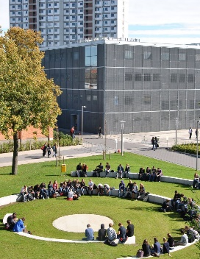
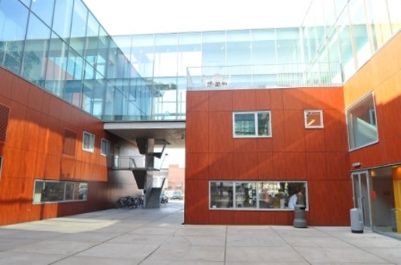
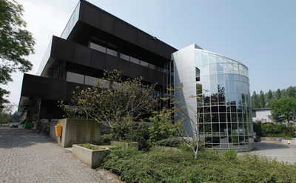
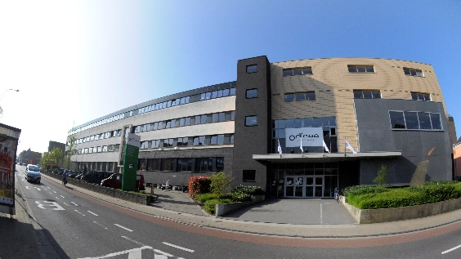
Coordinator & Partners
Brussel
Gent
Aalst Sint Niklaas

Slide 6
Coordinator & Partners
EU partners:
Odisee University College
Hanze University of Applied Sciences
University of Presov
KU Leuven (Quality Mgt)

Slide 7



Coordinator & Partners
WB partners

Slide 8
Activities & Results
2013
2017

Slide 9
Activities & Results
Meeting in Gent & Mostar
Analysis of EU nursing curriculum
Analysis of WB nursing curriculum
Comparative analysis between EU & WB

Slide 10
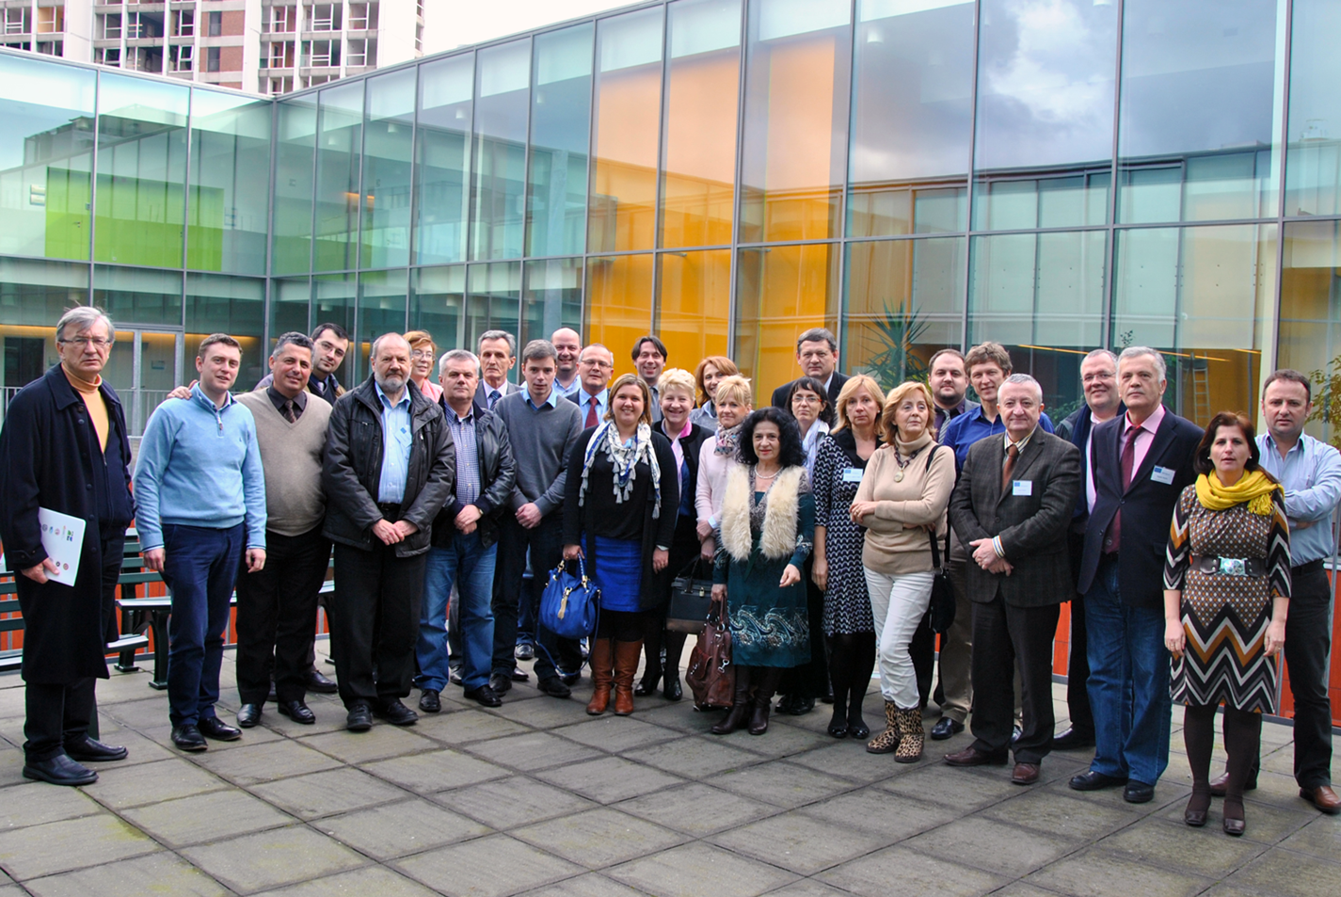
Activities & Results

Slide 11
Activities & Results
Meeting in Zenica
Defining the educational goals and the learning outcomes of the new nursing curriculum

Slide 12
Activities & Results
TTT in Sint Niklaas (BE) & Groningen (NL)
New teaching methodologies
New examine methodologies

Slide 13
Activities & Results
Meeting in Montenegro & Presov
Common set of competenties for all WB partners
We made a guide for curriculum development: “Competences, goals and outcomes for new nursing curriculum in WB”

Slide 14
Activities & Results
The curriculum reform needs to focus on:
Practical skills
Communication skills
Nursing concepts (e.g. nursing diagnose)
Problem based learning & critical thinking
Integrated learning (theory & practise)
Evidence based practise

Slide 15
Activities & Results
For all courses following issues must be clear:
Objective (Learning Outcome)
Content
Learning material
Learning methodology
Ways of assessment
Expected level

Slide 16
Activities & Results
Consortium meetings in Groningen & Foca
TTT in Shkodra & Mostar

Slide 17
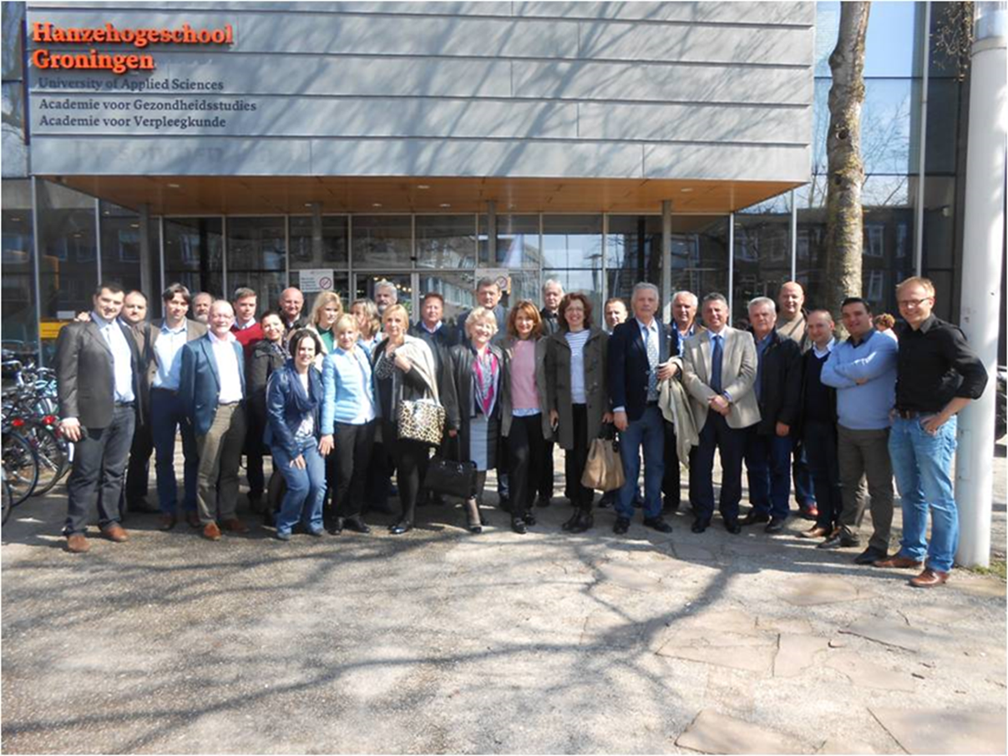
Activities & Results

