Slide 1
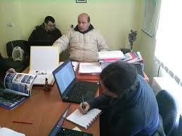
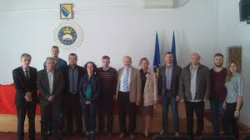
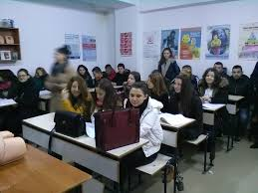
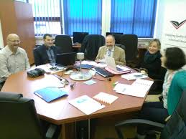
And last but not least …
Notes:
Belgium was represented as a member of the panel that did the trial visitation to all the universities in BiH, Albania and the university of Montenegro.

Slide 2
Sustainability of the project
Bilateral agreement between Odisee (university college) and University of Zenica.
  Last year 2 students of Odisee, Aalst, came to Zenica for an internship
  Last year, but also this year, one of my colleague (Tim Torsy), is visiting Zenica and will teach some subjects to nurse students.
  This week 2 students of the University of Zenica are coming to Sint-Niklaas for an internship of 12 weeks.
Notes:
Together with the university of zenica, the university college, odisee is working on the sustainability of the project. At this moment their is a bilateral agreement between the Odiqee , university college and the university of Zenica. The main purpose of this agreement is the exchange of staff and students.

Slide 3
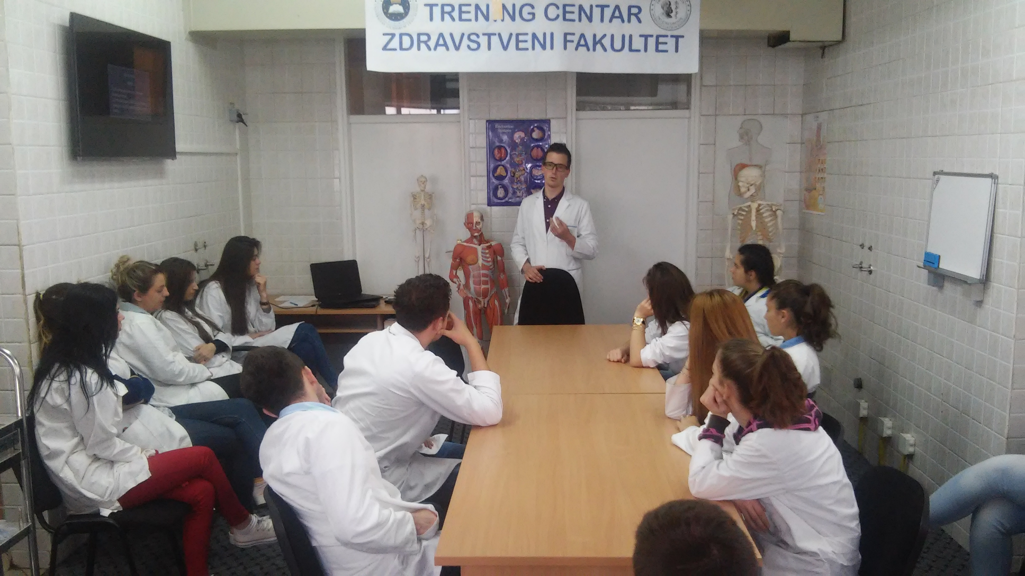
Sustainability of the project

Slide 4
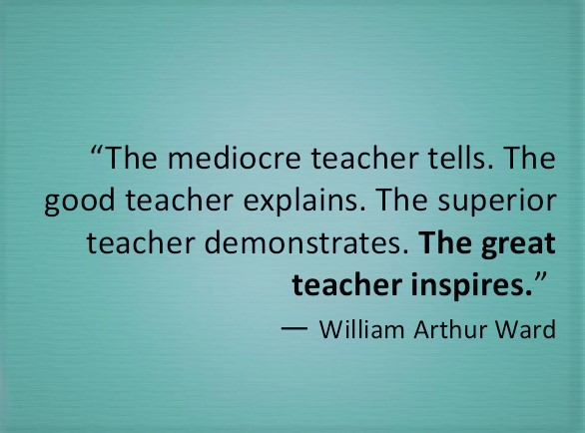
Thank you for Listening!

