Slide 1

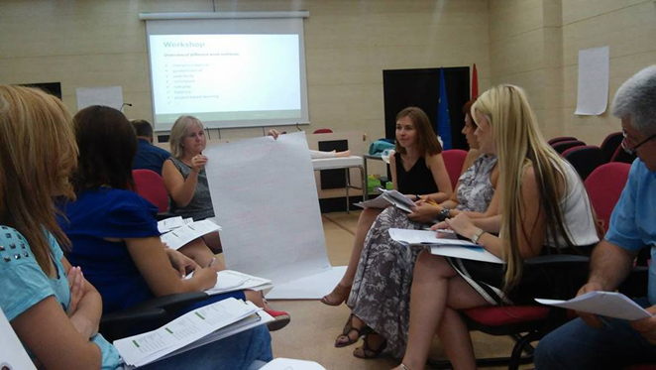


Training of Trainers, Shkodra
An overview of alternative teaching methods
Notes:
We also take part in the train the trainer session in Shkodra (september 2015). This training was devoted to teaching and examining methodologies in nursing. During this training a core group of Western Balkan nursing schools were trained in new teaching and examinations methodologies and they were learned how to introduce them in their new competence based curriculum. The workshops mentioned on this slide were organised and leaded by members of the odisee university college

Slide 2

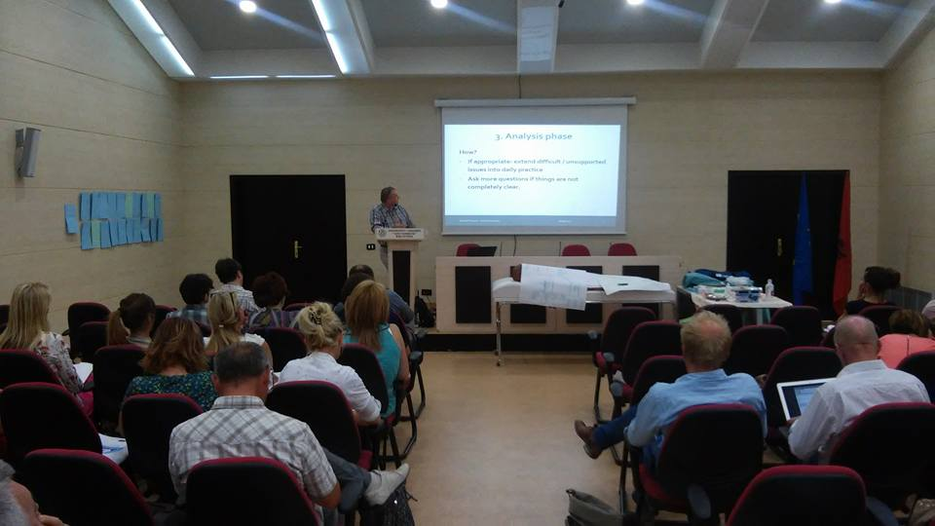
Training of Trainers, Shkodra
Debriefing

Slide 3
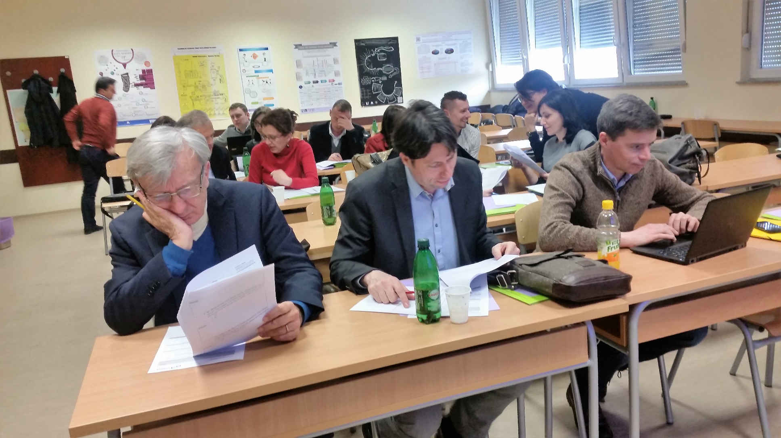
Training, Mostar
Notes:
The last training organised by university college Odisee, took place in Mostar (february 2017) and handled about pitfalls and necessary tools in the implementation of a new curriculum. Also quality assessment was an important subject.
In the morning their were theoretical explenations, in the afternoon their were two alternating workshop. As you can see on the picture all participants worked actively.

Slide 4

Website: www.ccnurca.eu
Notes:
Besides the trainings that were organised by the Odisee (university college of Belgium), the university college was also responisble for the website of CCNURCA. This webpage was created for information on dissemination of the project results. A collega (Willem vandenberg) was responsible for updating the information on the website.

