Slide 1

Nursing situation in Gjirokastra Region
Curricula in General Nursing and Midwife

Slide 2
Albania Health Sector actually is under reforming process. This reform is focused on the following directions:
1
Increase of the efficiency of health services, through a more rational use of structural network
2
Improvement of health services
3
Protection and improvement of financial resources about health services
4
5
Development of Human Resources
Improvement of Health informative system

Slide 3
In urban areas primary care services of mothers and children is provided through maternal and children Consulting centers of Mothers and Children (CCMC), which are responsible for providing key services to the prevention and control of diseases and promotion of health, including reproductive health, prenatal and postnatal health care, maternal health, child nutrition, growth monitoring and vaccination. Primary care of mother and child health in rural areas is provided through health centers and clinics of villages by Family Physicians, nurses and midwives / nurses.

Slide 4
At the regional level there is a woman health consultancy centre, health centers and hospitals, homes for the elderly.
The number of health centers and nurses of different services are described in the following tables.
The employees, who work in these centers, according to data provided by ISS, are doctors, nurses and nurse / midwife.

Slide 5
Their level of education (years of training in the relevant profession and curricula) is very different. Only young nurses and midwives have a university degree in the field of nursing.
Nurses and midwives have the same training in the field of nursing, there is no specific course in the field of midwife, but there is only one module during the three and four years of nursing studies, (or during the course of 6 months after the end of school for those people who not have a university degree).

Slide 6
The Ministry of Health has planned that starting from 2012 only nurses with bachelor's degree will be allowed to practice their profession. Meanwhile since 2009 to all the others was given the chance to be qualified. A significant number of employees (about 50 %) are above the age of 50 years old. Due to a relatively high number of employees of the third age, may be predicted that after a few years a significant number of employees NURSES will retire.
Sector of Reproductive Health (SRH), within the Department of Public Health provides policy, strategic direction and technical guidance about SRH and maternal /child services.
At the district level, the centers are under the direct responsibility of the Department of Public Health of the District.

Slide 7
Consultancy Children Health Centers, employees report to Control of Public Health manager to which they belong.
Basic Education is different:
a) the level of secondary professional education
b) University level which is a positive novelty.
Liberalization of higher education created spaces and opportunities for all those who want this profession, but even here there is much to be improved.

Slide 8
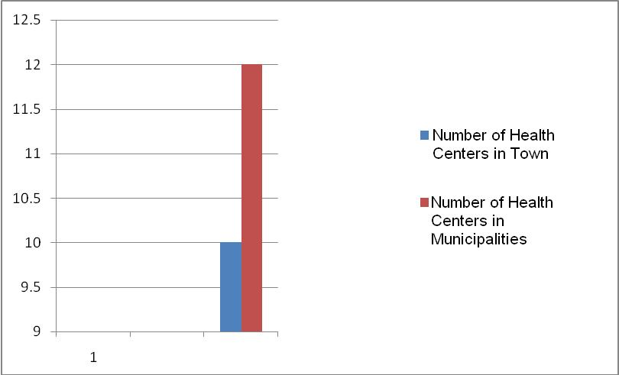

Slide 9
NUMBER OF NURSES AT PRIMARY SERVICE IN O CITY | 75
MOTHERS CONSULTANCY CENTRES | 4
AT SCHOOLS | 3
AT PUBLIC HEALTH DIRECTORATE | 10
AT ELDERY HOUSE | 10
AT COMMUNES | 99

Slide 10
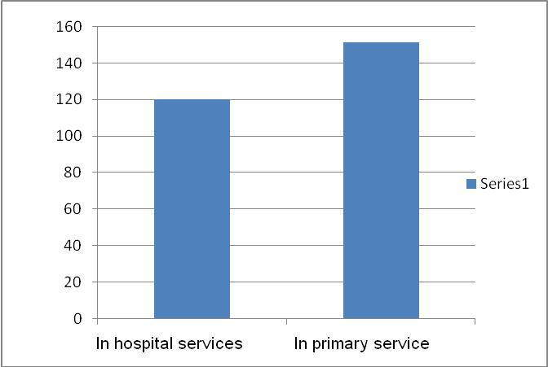

Slide 11
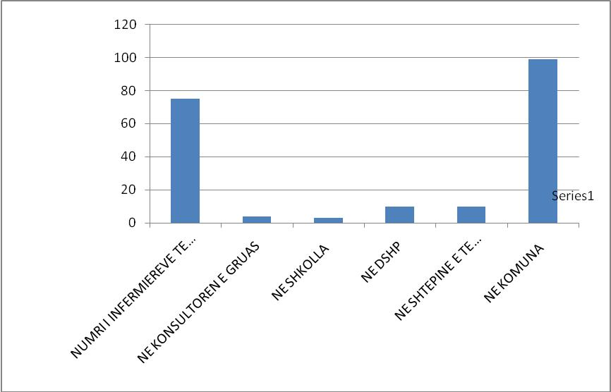

Slide 12
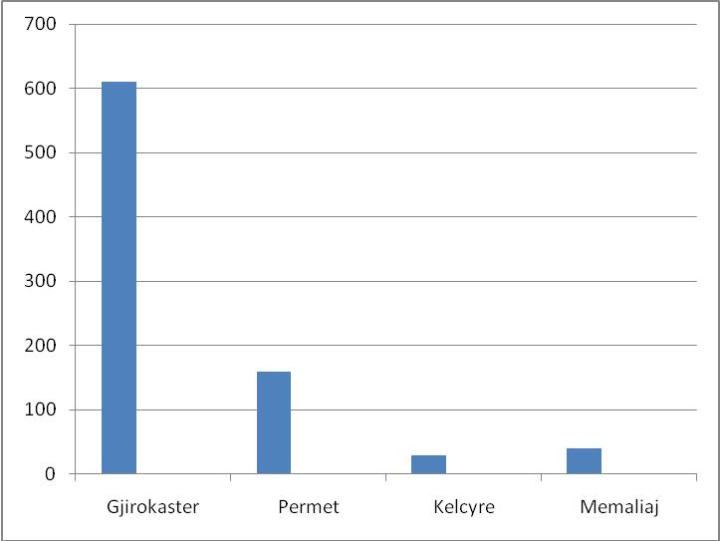

Slide 13
Nr | CURRICULA OF GENERAL NURSING | ACADEMIC YEAR | CREDITS
1 | MEDICAL PSYCHOLOGY | FIRST YEAR | 2 ECTS
2 | SOCIOLOGY | FIRST YEAR | 2 ECTS
3 | ETHIC –DEONTOLOGY | FIRST YEAR | 2 ECTS
4 | BASIC PRINCIPALS OF NURSING | FIRST YEAR | 7 ECTS
5 | GENERAL BIOLOGY | FIRST YEAR | 3 ECTS
6 | NORMAL ANATOMY 1 | FIRST YEAR | 4 ECTS
7 | NORMAL ANATOMY 2 | FIRST YEAR | 3 ECTS
8 | HISTOLOGY | FIRST YEAR | 3 ECTS
9 | HUMAN PHISIOLOGY | FIRST YEAR | 3.5 ECTS
10 | PROFESSIONAL PRACTICES 1 | FIRST YEAR | 6 ECTS
11 | ENVIRONMENTAL AND PUBLIC HEALTH | FIRST YEAR | 3.5 ECTS
12 | MEDICAL MICROBIOLOGY | FIRST YEAR | 4 ECTS
13 | PUERICULTURE AND NURSING PUERICULTURE | FIRST YEAR | 3 ECTS
14 | ( selective) : a. ENGLISH / b.FRENCH | FIRST YEAR | 2 ECTS
15 | LATIN LANGUAGE | FIRST YEAR | 3 ECTS
16 | ITALIAN LANGUAGE | FIRST YEAR | 3.5 ECTS
17 | MEDICAL BIO PHYSICS | FIRST YEAR | 2 ECTS
18 | INFORMATICS | FIRST YEAR | 2 ECTS
19 | MEDICAL STATISTICS | FIRST YEAR | 3 ECTS

Slide 14
Nr | CURRICULA OF GENERAL NURSING | ACADEMIC YEAR | CREDITS
1 | PATOLOGICAL ANATOMY | SECOND YEAR | 3.5 ECTS
2 | FARMACEOLOGY | SECOND YEAR | 3.5 ECTS
3 | MEDICAL BIO CHEMISTRY & IMUNOLOGY | SECOND YEAR | 2 ECTS
4 | PEDIATRY 1 | SECOND YEAR | 3.5 ECTS
5 | NURSING PEDIATRY 1 | SECOND YEAR | 3 ECTS
6 | SURGERY AND NURSING SURGERY 1 | SECOND YEAR | 4.5 ECTS
7 | ONCOLOGY AND NURSING ONCOLOGY | SECOND YEAR | 2 ECTS
8 | ANESTHESIA RESUSCITATION, NURSING ANESTHESIA & INTENSIVE CARE | SECOND YEAR | 2 ECTS
9 | INTENSINAL DISEASES | SECOND YEAR | 3 ECTS
10 | NURSING OF INTESTINAL DISEASES | SECOND YEAR | 3 ECTS
11 | RADIOLOGY (SECOND YEAR) | SECOND YEAR | 1.5 ECTS
12 | PROFESSIONAL PRACTICE 2/1 | SECOND YEAR | 7 ECTS
13 | OBSTETRICS | SECOND YEAR | 3.5 ECTS
14 | OBSTETRIC NURSING | SECOND YEAR | 3 ECTS
15 | NEUROLOGY & NURSING NEUROLOGY | SECOND YEAR | 2 ECTS
16 | PRO-TEST & NURSING | SECOND YEAR | 2 ECTS
17 | (OPTIONAL): A. DIETOLOGY / B. DERMATOLOGY | SECOND YEAR | 1.5 ECTS
18 | (OPTIONAL): A. PHYSIC- THERAPY / B. REHABILITATION IN THE COMMUNITY | SECOND YEAR | 2.5 ECTS
19 | PROFESSIONAL PRACTICE 2/2 | SECOND YEAR | 7 ECTS

Slide 15
Nr | CURRICULA OF GENERAL NURSING | ACADEMIC YEAR | CREDITS
1 | GYNECOLOGY | THIRD YEAR | 3 ECTS
2 | NURSING IN GYNECOLOGY | THIRD YEAR | 3 ECTS
3 | SURGERY AND ITS NURSING 2 SURGERY 2 | THIRD YEAR | 5 ECTS
4 | INTESTINAL DISEASES 2 | THIRD YEAR | 3 ECTS
5 | NURSING OF INTESTINAL DISEASES 2 | THIRD YEAR | 3 ECTS
6 | GERIATRICS, GERONTOLOGY NURSING OF GERIATRICS , GERONTOLOGY | THIRD YEAR | 3 ECTS
7 | PEDIATRICS 2 | THIRD YEAR | 3 ECTS
8 | PEDIATRICS NURSING 2 | THIRD YEAR | 3 ECTS
9 | DISEASES AND ILLNESS NURSING. | THIRD YEAR | 3 ECTS
10 | PROFESSIONAL PRACTICE 3/1 | THIRD YEAR | 9 ECTS
11 | PROFESSIONAL PRACTICE 3/2 | THIRD YEAR | 9 ECTS
12 | URGENCY AND EMERGENCY NURSING | THIRD YEAR | 4 ECTS
13 | TRAUMA - ORTHOPEDICS AND TRAUMA - ORTOPEDY NURSING | THIRD YEAR | 2 ECTS
14 | (SELECTIVE): A. OKULISTIC AND ITS NURSING / B. ORL AND ITS NURSING | THIRD YEAR | 2 ECTS
15 | DEFENSE OF THESES /DIPLOMA | THIRD YEAR | 5 ECTS

Slide 16
Nr | CURRICULA OF MIDWIFE NURSING | ACADEMIC YEAR | CREDITS
1 | MEDICAL PSYCHOLOGY AND ETHYCS | FIRST YEAR | 4 ECTS
2 | Basic principals of nursing | FIRST YEAR | 6 ECTS
3 | Normal Anatomy | FIRST YEAR | 6.5 ECTS
4 | HISTOLOGY | FIRST YEAR | 3.5 ECTS
5 | HUMAN PHYSIOLOGY | FIRST YEAR | 3.5 ECTS.
6 | General Biology | FIRST YEAR | 3 ECTS
7 | MEDICAL MICROBIOLOGY | FIRST YEAR | 4 ECTS
8 | MEDICAL BIO CHEMISTRY & IMUNOLOGY | FIRST YEAR | 3.5 ECTS
9 | MEDICAL STATISTICS | FIRST YEAR | 3 ECTS
10 | Medical Bio Physics | FIRST YEAR | 2 ECTS
11 | PUERICULTURE AND NURSING PUERICULTURE | FIRST YEAR | 3 ECTS
12 | ENVIRONMENTAL AND PUBLIC HEALTH | FIRST YEAR | 3 ECTS
13 | PROFESSIONAL PRACTICES 1 | FIRST YEAR | 6 ECTS
14 | ( selective) : a. ENGLISH / b.FRENCH | FIRST YEAR | 2 ECTS
15 | LATIN LANGUAGE | FIRST YEAR | 2.5 ECTS
16 | ITALIAN LANGUAGE | FIRST YEAR | 3 ECTS

Slide 17
Nr | CURRICULA OF MIDWIFE NURSING | ACADEMIC YEAR | CREDITS
1 | PATOLOGICAL ANATOMY | SECOND YEAR | 4 ECTS
2 | FARMACEOLOGY | SECOND YEAR | 6 ECTS
3 | EMBRIOLOGY,ANATOM Y AND OBSTETRICAL AND FETUS PHYSIOLOGY | SECOND YEAR | 5 ECTS
4 | NEONATOLOGY & NEONATOLOGY NURSING | SECOND YEAR | 6 ECTS
5 | PREGNANCY AND NORMAL BIRTH | SECOND YEAR | 6 ECTS
6 | NURSING OF PREGNANCY AND NORMAL BIRTH | SECOND YEAR | 6 ECTS
7 | PROFESSIONAL PRACTICE 2/1 | SECOND YEAR | 8 ECTS
8 | PROFESSIONAL PRACTICE 2/2 | SECOND YEAR | 8 ECTS
9 | SURGERY, ANESTHESIA, REANIMATION AND NURSING SURGERY, ANESTHESIA AND REANIMATION | SECOND YEAR | 8 ECTS
10 | PHYSIOTHERAPY AND RADIOLOGY | SECOND YEAR | 3 ECTS

Slide 18
Nr | CURRICULA OF MIDWIFE NURSING | ACADEMIC YEAR | CREDITS
1 | GYNECOLOGY, VENEROLOGY & REPRODUCING HEALTH | THIRD YEAR | 4.5 ECTS
2 | NURISING IN GYNECOLOGY, VENEROLOGY AND REPRODUCING HEALTH | THIRD YEAR | 4.5 ECTS
3 | PREGNANCY IN RISK | THIRD YEAR | 4 ECTS
4 | NURSING OF PREGANCY IN RISK | THIRD YEAR | 4 ECTS
5 | PROFESSIONAL PRACTICE 3/1 | THIRD YEAR | 9 ECTS
6 | PROFESSIONAL PRACTICE 3/2 | THIRD YEAR | 9 ECTS
7 | PEDIATRY | THIRD YEAR | 3.5 ECTS
8 | NURSING IN PEDIATRY | THIRD YEAR | 3.5 ECTS
9 | INTENSTINAL DISEASES AND NURSING OF INTENSTINAL DISEASES | THIRD YEAR | 5 ECTS
10 | BIRTH COMPLICATIONS AND EMERGENCIES OBSTETRICAL | THIRD YEAR | 4 ECTS
11 | NURSING CARE IN BIRTH COMPLICATIONS AND EMERGENCIES OBSTETRICAL | THIRD YEAR | 4 ECTS
12 | DEFENSE OF THESES OF DIPLOMA | THIRD YEAR | 5 ECTS

Slide 19
MAIN GOAL OF THE PROJECT
The reform of the nursing and caring in WB countries involved in the project. Reform of nursing education is a very important part of the strategy for development of health system.
The reform of the nursing curricula in line with the Bologna declaration is aiming at introducing better contacts with the work field, more clinical practice, more competence based training focusing on learning outcomes.

Slide 20
Project objectives
1
Analysis of current European requirements for higher education in nursing and analysis of curricula in Western Balkan Nursing schools;
2
Design of a new nursing educational frame, which will be in line with Bologna declaration and will be in harmony with European standards including full implementation of European Credit Transfer System (ECTS) into new curriculum;
3
Retraining of teaching staff and capacity building of institutions in the WB region
5
6
7
Selection of the best students for pilot course from partner countries and prepare them for training;
Implementation of the pilot phase of the training in accordance with new curriculum;
Outline the proposal for new legislation, to correspond to new competence based curriculum in nursing education and establishment of trans-European network of excellent nursing educational institutes.
Evaluation and accreditation of new program and publishing the results of new educational approach in view of sustainability of project.
4

Slide 21
Role of Gjirokastra University
Eqrem Çabej” University of Gjirokastra was fully involved in preparation of project proposal and will participate in all activities very actively.
Due to the fact that University of Gjirokastra was one of leading institutions in Albania concerning reform of curricula , it will be in charge of coordinating work package 2 (together with University of East Sarajevo and KAHO) which main aim is developing a competence based curriculum in nursing in the WB region.
Representatives of the University will take very active part also in management of the project and training of the staff.

Slide 22
Impact of the project to Gjirokastra University and its Region
Establishing of two professional skill laboratories where students of general nursing and midwife can improve their skills and get practical sessions about different nursing issues
Establishing of new curricula which will be unified with other European Universities curricula and will offer to students possibilities to be employed in European Labor market.
Trainings of the academic staff who will provide professional lectures to the student of general nursing and midwife students
Sharing of ideas and experiences among lecturers and students of other Western Balkan and European universities will improve the curricula and lectures in favor of students and community.
Will strengthen the links between Western Balkan and European universities for future project collaborations.
Preparation of professional students who will contribute to the community of Gjirokastra Region implementing in practice best experience, skills and professionalism they will get during their studies at Gjirokastra University.

Slide 23
THANK YOU
FOR
YOUR ATTENTION !

