Slide 1


CCNURCA
Financial Rules

Slide 2
CONTENT
Budget and contractual ceilings
Budget headings
Co-financing
Rule of origin
Exchange rate

Slide 3

ANNEX II - Grant Agreement
Estimated budget of the action
PROJECT COSTS |  | €
I | Staff cost (max 40% of total eligible direct costs) | 294.880,00
II | Travel costs, costs of stay | 369.980,00
III | Equipment (max 30% of total eligible direct costs) | 214.550,00
IV | Printing and publishing | 9.700,00
V | Other costs | 15.500,00
 | Eligible direct costs (total I - V) | 904.610,00
VI | Indirect costs (7% of total eligible direct costs) | 63.322,70
Total eligible costs (total I – VI) |  | 967.932,70
PROJECT FINANCE |  | €
Co-financing of at least 10% of the total eligible costs |  | 96.793,36
Tempus grant: includes financing to a maximum of 90% of the total eligible costs |  | 871.139,34
TOTAL PROJECT FINANCE |  | 967.932,70

Slide 4
Budget
Original budget was revised by EACEA:
  -5% of the staff costs
Budget cuts impacted equally the individual budgets of each partner

Slide 5
Breakdown budget by partners
Number | Name | Country | Staff costs (€) | Travel costs &costs of stay (€) | Equipment (€) | Printing | Other costs | Total eligible DIRECT COSTS (€) (1+2+3+4+5) | INDIRECT COSTS* (€) | Total cost | Tempus Grant (€) (90%) | Cofinan
1 | HUB-KAHO | BE | 82930,00 | 35400,00 | 0,00 | 700,00 | 13000,00 | 132030,00 | 24500,00 | 156530,00 | 139958,60 | 16571,40
2 | UES | BA | 33437,50 | 34900,00 | 30650,00 | 1800,00 | 2500,00 | 103287,50 | 7000,00 | 110287,50 | 98611,71 | 11675,79
3 | SVEMO | BA | 20612,50 | 31020,00 | 30650,00 | 1100,00 | 0,00 | 83382,50 | 4000,00 | 87382,50 | 78131,59 | 9250,91
4 | UNZE | BA | 20280,00 | 31520,00 | 30650,00 | 1200,00 | 0,00 | 83650,00 | 4000,00 | 87650,00 | 78370,77 | 9279,23
5 | UOM | ME | 19947,50 | 29670,00 | 30650,00 | 1100,00 | 0,00 | 81367,50 | 4000,00 | 85367,50 | 76329,91 | 9037,59
6 | ECUG | AL | 18475,00 | 34360,00 | 30650,00 | 1000,00 | 0,00 | 84485,00 | 4000,00 | 88485,00 | 79117,37 | 9367,63
7 | FSNU | AL | 18617,50 | 33860,00 | 30650,00 | 1000,00 | 0,00 | 84127,50 | 4000,00 | 88127,50 | 78797,72 | 9329,78
8 | UNISHK | AL | 19615,00 | 31690,00 | 30650,00 | 1100,00 | 0,00 | 83055,00 | 4000,00 | 87055,00 | 77838,76 | 9216,24
9 | HENZAUAS | NL | 27211,50 | 22420,00 | 0,00 | 400,00 | 0,00 | 50031,50 | 3422,70 | 53454,20 | 47795,17 | 5659,03
10 | UNIPO | SL | 23753,50 | 21500,00 | 0,00 | 300,00 | 0,00 | 45553,50 | 3000,00 | 48553,50 | 43413,29 | 5140,21
11 | MINRS | BA | 0,00 | 6610,00 | 0,00 | 0,00 | 0,00 | 6610,00 | 0,00 | 6610,00 | 6610,00 | 0,00
12 | MONKSZDK | BA | 0,00 | 6050,00 | 0,00 | 0,00 | 0,00 | 6050,00 | 0,00 | 6050,00 | 6050,00 | 0,00
13 | MOE | ME | 0,00 | 6600,00 | 0,00 | 0,00 | 0,00 | 6600,00 | 0,00 | 6600,00 | 6600,00 | 0,00
14 | MZRS | BA | 0,00 | 6610,00 | 0,00 | 0,00 | 0,00 | 6610,00 | 0,00 | 6610,00 | 6610,00 | 0,00
15 | MINZDRSHNZ | BA | 0,00 | 5940,00 | 0,00 | 0,00 | 0,00 | 5940,00 | 0,00 | 5940,00 | 5940,00 | 0,00
16 | MINZDR | BA | 0,00 | 6050,00 | 0,00 | 0,00 | 0,00 | 6050,00 | 0,00 | 6050,00 | 6050,00 | 0,00
17 | MOH | AL | 0,00 | 15780,00 | 0,00 | 0,00 | 0,00 | 15780,00 | 0,00 | 15780,00 | 15780,00 | 0,00
18 | KUL | BE | 10000,00 | 10000,00 |  |  |  | 20000,00 | 1400,00 | 21400,00 | 19134,45 | 2265,55
TOTAL : |  |  | 294880,00 | 369980,00 | 214550,00 | 9700,00 | 15500,00 | 904610,00 | 63322,70 | 967932,70 | 871139,37 | 96793,33

Slide 6
Budget headings & ceilings
Staff costs
Travel costs and costs of stay
Equipment
Printing & publishing
Other costs
Indirect costs

Slide 7
Budget headings & ceilings
Staff costs: Max 40% of the total eligible direct costs
Equipment: Max 30% of the total eligible direct costs
Indirect costs: flat rate of 7% of the total eligible direct costs
Up to 10% flexibility for transfers amongst budget headings
Art. I.8 Grant Agreement
Transfers between headings of eligible direct costs is allowed if:
• the adjustment does not affect the implementation of the action
• the transfer between headings does not exceed 10% of the amount of the
heading for which the transfer is intended
N.B. The flexibility of 10% applies also to the ceiling for equipment and staff
costs (30% and 40% of the total eligible direct costs shown in Annex II).

Slide 8
Tempus Budget headings
Purpose
Contractual rules
Supporting documents

Slide 9
I. Staff costs
Purpose
To cover the costs of staff directly necessary for the achievement of the results and not covered by other sources:
  Administrative or academic tasks
  Course development, maintenance of online courses/website, etc.
  Language / IT courses, translation services, evaluation activities when performed by internal staff
  (if subcontracted → other costs)

Slide 10
I. Staff costs
Contractual rules
Salaries and fees should reflect the employing institution's usual policy on remuneration and respect local salary rates
Maximum reference daily rates per country: Guidelines/Annex 3
Total expenditure for Staff Costs cannot exceed the 40% ceiling (plus 10 % flexibility) - Co-financing is also subject to the 40% ceiling

Slide 11
Example: Staff Costs – maximum eligible daily rates (in €)
Extract from Guidelines for the use of the Grant (Annex 3)
Country | Manager | Researcher Teacher Trainer | Technical | Administrative
Belgium | 460 | 360 | 240 | 214
BiH | 100 | 85 | 65 | 45
Albania | 80 | 70 | 35 | 25
Montenegro | 115 | 97 | 60 | 50

Slide 12
I. Staff costs
Supporting documents
Staff Conventions (Guidelines/Annex 1) + timesheets
Employment contract (copies)
Staff performing both administrative and academic tasks must use separate conventions

Slide 13
II. Travel costs and costs of stay
Purpose
To cover the costs of travel and subsistence allowances of staff for mobilities mainly linked to:
  • teaching/training assignments, retraining
  • update of courses
  • practical placements
  • short visits for coordination and planning
  • language training
  • dissemination

Slide 14

II. Travel costs and costs of stay
ONLY the staff members of project partners can be reimbursed for mobilities from the project

Slide 15
II. Travel costs and costs of stay
Contractual rules
The budget for Travel Costs and Costs of Stay should:
  cover only actual travel costs (including visa fee and related obligatory insurance, travel insurance and cancellation costs if justified)
  cover the daily allowance: the ceilings per person (per day/week) indicated at point 4.3.3 of the Guidelines must be respected

Slide 16
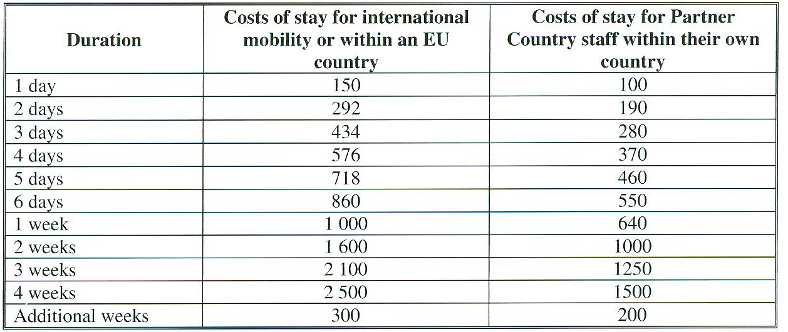
II. Travel costs and costs of stay
Ceilings in Euro

Slide 17

II. Travel costs and costs of stay
Ceilings in Euro
For an international mobility of 17 days:
  (3 weeks) 2100 – (2weeks) 1600 = 500
  Divided by 7 = 71,43.
  The costs of stay can be 1600 + ( 3 X 71,43) = 1814,29 Euro max.

Slide 18
II. Travel costs and costs of stay
Supporting documents
a SIGNED & filled-in Individual Mobility Report (IMR) for each mobility using the standard form (Guidelines/Annex 2)
readable copies of travel tickets, invoices, boarding passes, receipts,
NO any receipts are required to claim the daily allowances

Slide 19
III. Equipment
Purpose
To cover the costs of equipment directly relevant to the project’s objectives
such as:
IT equipment (hardware and software) including costs for installing
internet connection
books, e-books, publications
access to database
equipment insurance/ transport/ installation, maintenance of equipment

Slide 20
III. Equipment
Contractual rules
Total expenses for equipment cannot exceed the 30% ceiling (plus 10% of flexibility).
Co-financing is also subject to the 30% ceiling.
Comply with the rule of origin
VAT is not eligible and can’t be paid from the grant

Slide 21
III. Equipment
Supporting documents
The beneficiary shall retain with project accounts:
all invoices for all equipment declared costs
proofs of tendering procedure (min. 3 quotations) for purchases above EUR 25.000
certificate of origin for equipment of a unit cost above EUR 5.000

Slide 22
IV. Printing & Publishing
Purpose
Printing & Publishing budget heading can cover:
paper and electronic productions (electronic form)
photocopying of teaching materials/documentation
General photocopying -> Indirect Costs

Slide 23
IV. Printing & Publishing
Contractual rules
VAT is not eligible and can’t be paid from the grant
Internal staff costs cannot be covered by this budget heading

Slide 24
IV. Printing & Publishing
Supporting documents
The beneficiary shall retain with project accounts:
all invoices
proofs of tendering procedure (min. 3 quotations) for costs above EUR 25.000
Tempus & project logo

Slide 25
V. Other costs
Purpose
"Other costs" budget heading can cover costs related to:
Dissemination of information (advertising in media, promotional materials such as pen, bags, posters, etc.)
Inter-project coaching (maximum of EUR 2.500)
Bank charges (including bank guarantee charges where requested)
External audit fees
Costs of subcontracting (for specific and time-bound tasks)
Hire of premises only for dissemination events (prior EACEA authorisation needed).

Slide 26
V. Other costs
Contractual rules
For sub-contracts: prior autorisation needed when total value > EUR 10.000
Amongst ineligible costs (guidelines 10.2):
  hospitality costs
  costs related to the use of materials & equipment incurred by institutions when hosting students/staff
  registration fees for courses/conferences,
  exchange losses, VAT, etc.

Slide 27
V. Other costs
Supporting documents
The Beneficiary shall provide with the final report:
Copies of sub-contracts and invoices if the costs are above EUR 25.000
The names of the firms consulted (min. 3) have to be indicated in the
Financial statement of the final report

Slide 28
VI. Indirect costs
"Indirect Costs" budget heading can cover the costs incurred by the project for:
stationary, office supplies, general photocopying
postage and telecommunication
use of internet/communication software/etc.
They are eligible for flat-rate funding of 7% of the total eligible direct costs

Slide 29
Co-financing

Slide 30
Co-financing
Tempus finances up to 90% of the total eligible costs (staff costs, travel & stay, equipment, printing, other costs)
Consortium must co-finance itself min 10%

Slide 31
Rule of origin
All equipment purchased by the project shall comply with the rule of origin and shall therefore originate from any EU Member State or from an eligible country
Certificate of origin: document made out by the competent authorities of the country of origin of the equipment – it is to be asked to the supplier

Slide 32
Exchange rates
Which exchange rate should be applied?
1. From the start of the eligibility period until the date of receipt of the second pre-financing: the rate of the month in which you received the first pre-financing
2. From the date of receipt of the second pre-financing until the end of the eligibility period: the rate of the month in which you received the second pre-financing

Slide 33
Exchange rates
The rate to be applied is the monthly accounting rate established by the Commission and published on its website:
http://ec.europa.eu/budget/inforeuro

Slide 34
Exchange rates
January 2014
1 EUR is equal to 1.95583 BAM
1 EUR is equal to 139.53 ALL
1 EUR is equal to 1 EUR

Slide 35
Proof of reception of payments (i.e. bank transfer)

Slide 36


