Slide 1


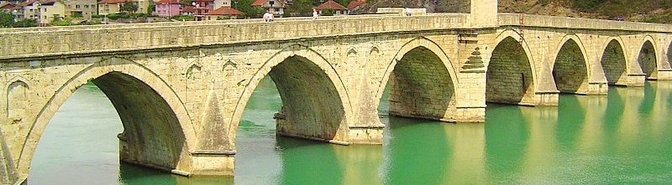
FAN S. NOLI UNIVERSITY OF KORÇA

Slide 2

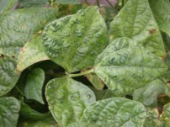
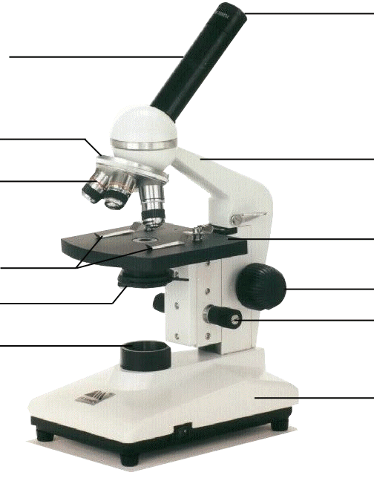

FAN S. NOLI UNIVERSITY OF KORÇA
Education Faculty
Economic Faculty
Agriculture Faculty
Faculty of Natural and Social Sciences

Slide 3

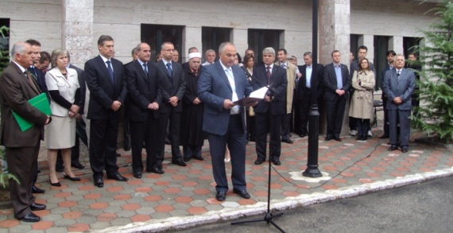
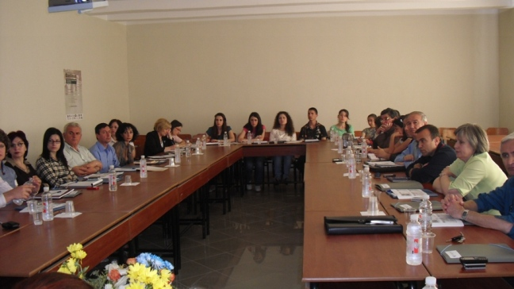
FAN S. NOLI UNIVERSITY OF KORÇA
UNIVERSITY HISTORY
“Fan S. Noli” University is an educational institution, and the scientific research center of the region, since 1971.
There are about 7000 students attending our university.
The academic staff consists of 210 full-time lecturers, professors and assistants and of about 145 part-time ones. There are also 63 employees in administration and in labs as labs assistants.
The majority are young people, who have attended post university qualifications in Albania and abroad.

Slide 4
FAN S. NOLI UNIVERSITY OF KORÇA
Fan S. Noli University is one of the highest educational institutions located in South Eastern part of Albania and consists of four Faculties :
The Faculty of Agriculture,
The Faculty of Education
The Faculty of Economy
The Faculty of Natural and Social Sciences

Slide 5
FAN S. NOLI UNIVERSITY OF KORÇA
Fan S. Noli University offers contemporary academic programs:
Undergraduate studies, which provide students with respective professional knowledge for all degree directions
Post graduate education, which offers a deeper professional knowledge through advanced programs

Slide 6
FAN S. NOLI UNIVERSITY OF KORÇA
Didactic organization of the university
The study package is created in compliance with the Law on Higher Education
(which is currently being improved), No.9741, Date 21.05.2007
Years
FLD ____ First Level Degree 3
SLD ____ Second Level Degree 2
FLM ____ First Level Master 1
SLM ____ Second Level Master 2
PhD ____ 3

Slide 7
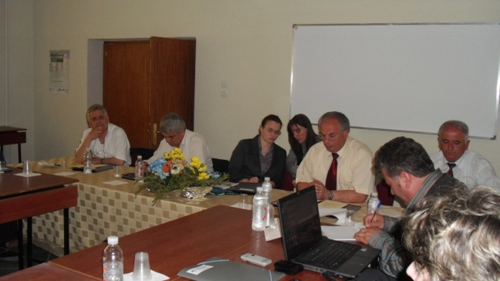
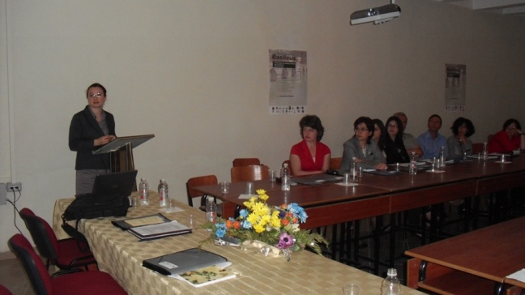
FAN S. NOLI UNIVERSITY OF KORÇA
The curricula and teaching programs are in compliance with the Bologna Declaration
It’s purpose is to improve the education and scientific research, and to approach the European institutional standards.

Slide 8
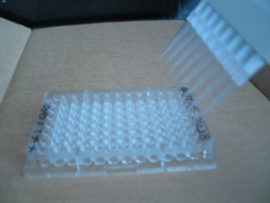
FAN S. NOLI UNIVERSITY OF KORÇA
BRANCH OF NURSING
The Programs of Study for Nursing and Midwife are founded upon objectives which aim at providing general nurse practitioners and midwives with the necessary theory and practice to enable them to work in the primary health hospital service.
By the completion of these programs, the Nursery Department of " Fan S. Noli " Korça University issues:
Diploma of First Level in General Practitioner Nurse or Midwife
The full study program of the three-year course in General Practitioner Nurse or Midwife is composed of 22 subjects. The full curricula consists of 60-minutes’ classes and practice classes in hospital institutions. An academic year has a total of 60 credits, one credit being equal to 10-12.5 active lesson classes in the classroom + 25 classes of independent learning at home. An academic year is divided into two semesters which are organized in integrated modules.

Slide 9

First Level Study Course
First Semester
30 Credits
First Year 60 Credits
Unique for whole Faculty
Second Semester
30 Credits
Third Semester
30 Credits
Second Year 60 Credits
≈ 30 unique credits for whole Faculty
Fourth Semester
30 Credits
Fifth Semester
30 Credits
Third Year 60 Credits
Specific to each direction
Sixth Semester
30 Credits

Slide 10
MASTER STUDY COURSES
First Semester 30 Credits
Serves for the unification of candidates coming from different directions.
Professional and Scientific formation in applied subject
Second Semester 30 Credits
Deeper knowledge on basic subjects
Preparation of Master Study Thesis

Slide 11
FAN S. NOLI UNIVERSITY OF KORÇA
  Every academic year consists of two exam seasons (1 season per semester)
  A Guided Research (Thesis), minimum of 3 weeks, is performed under a supervisor in order to graduate.
  The teaching and didactic quality is evaluated through questionnaires distributed to students from the students office
  The e-learning application is not applied momentarily but is recommended from the Academic Senate in order to increase the level of studies

Slide 12
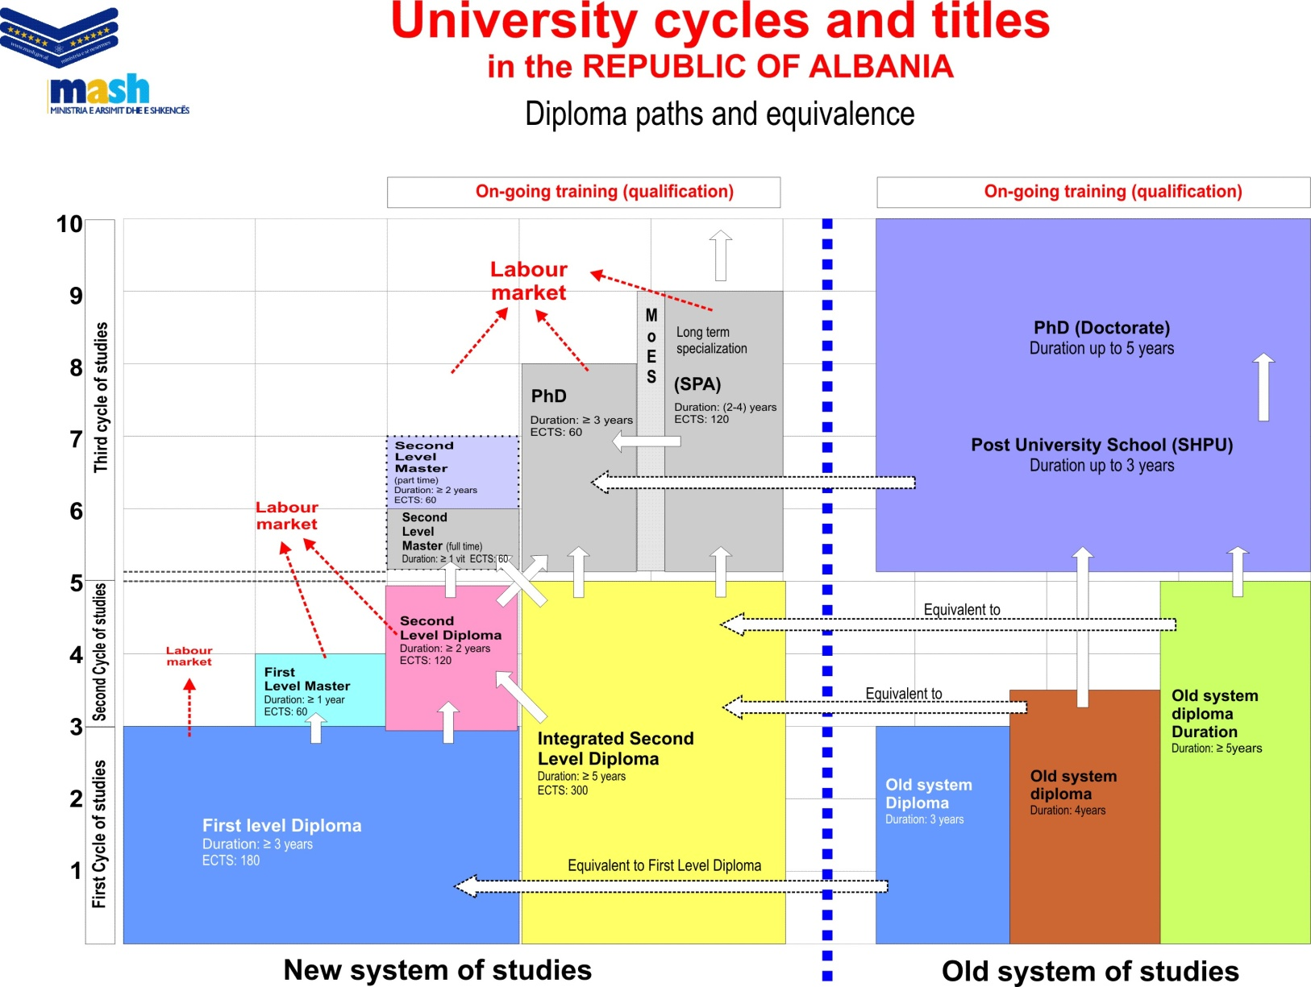

Slide 13

REFERENCES
THANK YOU FOR YOUR ATTENTION ….!!!!
-

