Slide 1
Engaging students in practical training

Slide 2
ECTS
Contract between student and teacher
Amount of study points
Language
Amount of contact hours
Semester
Goals
Beginning terms
Place in education
Content of the course
Study material
Study form
Evaluation activities
Possibility of tolerance

Slide 3
Tolerance
10% of total amount of study points e.g. 18/180 study points, over a period of 3 years
Study efficiency 50% needed
≤ 7/20 can not be 7/20
First year students: max. 12 study points
Practical skills can NOT be tolerated (+ internship)

Slide 4
How do students need to prepare themselves for practical training?
Before the course of practical training, students have had a few theoretical lessons
During these lessons the students get to see the different materials for the first time
It is recommended that students take a look at this theory or read in their theoretical course

Slide 5
How do students need to prepare themselves for practical training?
During their first year of nursing the students buy the book
“ stappenplannen: technisch verpleegkundige verstrekkingen”
In this book all nursing skills are fully written out according to the latest literature
The students can see in the lesson planning which nursing skill is scheduled when
They practice the practical skills in small groups

Slide 6
How do students need to prepare themselves for practical training?
In the first year, students are divided into different groups and they can practice the various techniques in their assigned practice group
In the second and third year, the different technical skills are scheduled a few times (usually four times, depending on the number of students) in the lesson planning. Students sign up at the desired time using a digital registration tool

Slide 7
How do students need to prepare themselves for practical training?
When students are not able to come to a practical training they have to unsubscribe themselves or they have to notify the person in charge of the skill center
When students fail to keep this appointment, they will be appealed
Once students know when they can practice which skill, they can prepare themselves

Slide 8
How do students need to prepare themselves for practical training?
Actual preparation:
Students have to read the nurse procedure as described in the book “het stappenplan”
Afterwards they have to view the film material that belongs to the nursing skill. This film material is also available using our digital learning platform
When the students have done the above mentioned steps, they can make the digital knowledge test (available on our digital learning platform)

Slide 9
How do students need to prepare themselves for practical training?
Digital knowledge test
For each practical skill there is a digital knowledge test. Each test consists of 10 multiple choice questions. Each question represents one point. Students have 5 minutes to complete the test. After 5 minutes, the test is automatically closes and sent
The questions are randomly displayed. The time limit is added to avoid that students search for the information
When students haven’t made the digital test, the teacher knows that they are not fully prepared to the practical class

Slide 10
How do students need to prepare themselves for practical training?
Digital knowledge test
When students haven’t made the digital test, there are no consequences linked for the students. Some teachers let students who didn’t made the test or failed for the test demonstrate the technique or clean up the class room after the training. This isn’t a general accord yet.
In the second semester or next academic year they’re may be consequences for the students who didn’t made the digital test.

Slide 11
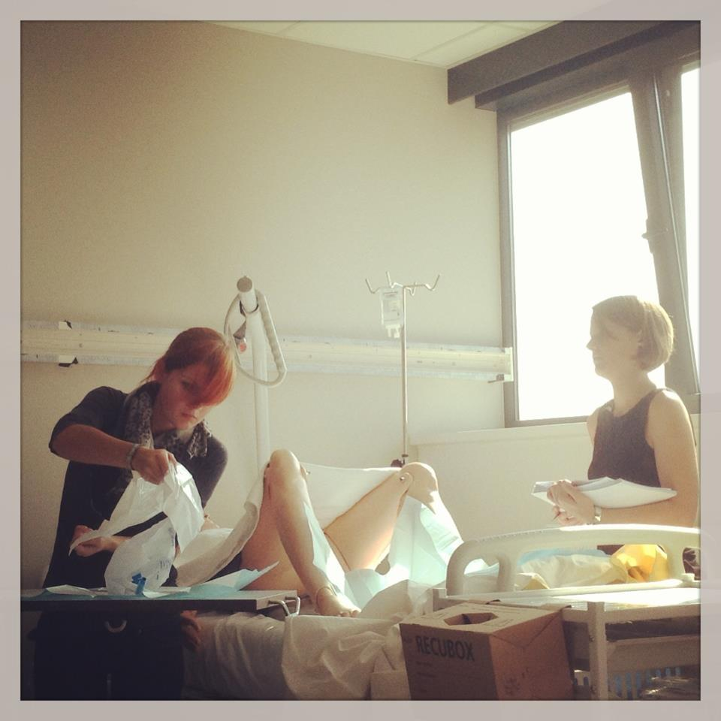
Then the students are normally ready to participate in the lesson of pratical training

