Slide 1
Katrin Gillis
How to monitor the implementation of a new nursing curriculum?
Pitfalls and necessary tools Mostar 2/17

Slide 2
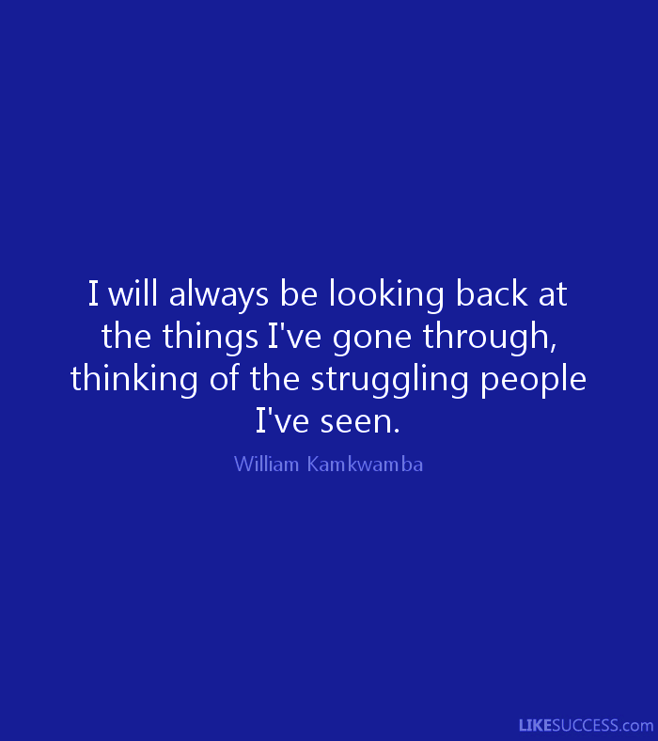

Slide 3
TIME STAGES
10%
90%
Initiation of the curriculum
Implementation of the curriculum

Slide 4
TIME STAGES
10%
90%
Initiation of the curriculum
Implementation of the curriculum

Slide 5

Start with…
Notes:
What do you want?
The BEST students with the highest results in your country?
Do you want to be the reference for emancipating students, supporting also the weaker once to reach the end?
Reputation of the most difficult university?

Slide 6
The vision of Odisee
We are attentive for a growing globilizing and a more diverse student population.
Inclusion is our credo.
Notes:
Odisee is gelokaliseerd in steden met een sterke diversiteit: Brussel, Gent, Sint-Niklaas…
So, what is the most important for us at the end? Not the number of student that are graduated after 4 years.
It’s more important that as much of possible students that start our curriculum also will finish it, no matter in how many time…
So we are working with Universal design for learning.

Slide 7
Universal design for learning
Recognizes the reality of diversity
Is build and developed from the beginning
Is cheaper than finding solutions afterwards
Is focused on the group, what makes it cheaper than finding individual solutions
Notes:
For example students with dyslexia: if they can document their disabality, they get 30% more time for their exams.
SO it means that someone has to do a take in and to give a certificate. Students with that specific certificate get more time.
But your collegues have to stay, however. So now we give all students 30% more time.
It gives the student also less a feeling of being different.

Slide 8
Universal design for learning
Principles
(based on three neurological pathways)
Offer your content in different ways (recognizing pathway)
Students can show in different ways what they’ve learned (strategic pathway)
Make students feeling more engaged (affective pathway)
Notes:
UDL is opgesplitst in 3 grote principes, die gelinkt kunnen worden aan de 3 neurologische netwerken in ons brein.
De 3 grote principes zijn:
Informatie op verschillende manieren aanbieden cf. Herkenningsnetwerk
Studenten kunnen op verschillende manieren met materiaal omgaan en op verschillende manieren aantonen wat ze geleerd hebben cf. Strategisch netwerk
Studenten op verschillende manieren betrokken laten voelen cf. Affectief netwerk
Meer informatie over de 3 principes en bijhorende richtlijnen vind je bij “principes en richtlijnen”.

Slide 9
Four levels
Goals:
Competent nurses
Qualified and motivated teachers
Supported by the management
Prepared for the real nursing work environment
Student
Team/teacher
Organization
Stakeholders

Slide 10
Students
Ensure a clear communication about the curriculum
What
Why
When
Who
Student
Notes:
Why: here importance of a educational vision. So, that each teacher can explain why he is giving that specific course.
We for example had collegues who said to the student: I don’t know or I have to give this class or I didn’t decide this…
It kills the credibility of your team and your curriculum
When: implementation in one moment for all the students or step by step…? Both have advantages and disadvantages. But the most important is that you’re aware of the consequences
Who will do teh communication and who support the students with finding their way in the new curriclum. Please give those collegues enough “space”. Because their job is crucial.
My experience is that we had no clear strategic communication plan…

Slide 11
Students
Avoid educational inequality
- Especially within nursing practice!
Student
Notes:
Why: here importance of a educational vision. So, that each teacher can explain why he is giving that specific course.
We for example had collegues who said to the student: I don’t know or I have to give this class or I didn’t decide this…
It kills the credibility of your team and your curriculum
When: implementation in one moment for all the students or step by step…? Both have advantages and disadvantages. But the most important is that you’re aware of the consequences
Who will do teh communication and who support the students with finding their way in the new curriclum. Please give those collegues enough “space”. Because their job is crucial.
My experience is that we had no clear strategic communication plan…

Slide 12

Students
Stimulate participation
During curriculum development
During team meetings
Student meetings
Student
Notes:
Why: here importance of a educational vision. So, that each teacher can explain why he is giving that specific course.
We for example had collegues who said to the student: I don’t know or I have to give this class or I didn’t decide this…
It kills the credibility of your team and your curriculum
When: implementation in one moment for all the students or step by step…? Both have advantages and disadvantages. But the most important is that you’re aware of the consequences
Who will do teh communication and who support the students with finding their way in the new curriclum. Please give those collegues enough “space”. Because their job is crucial.
My experience is that we had no clear strategic communication plan…

Slide 13
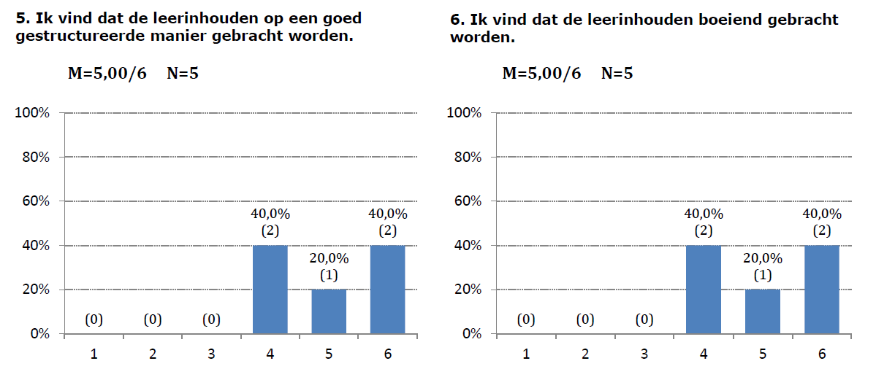
Students
Let them evaluate…
Student
Notes:
Why: here importance of a educational vision. So, that each teacher can explain why he is giving that specific course.
We for example had collegues who said to the student: I don’t know or I have to give this class or I didn’t decide this…
It kills the credibility of your team and your curriculum
When: implementation in one moment for all the students or step by step…? Both have advantages and disadvantages. But the most important is that you’re aware of the consequences
Who will do teh communication and who support the students with finding their way in the new curriclum. Please give those collegues enough “space”. Because their job is crucial.
My experience is that we had no clear strategic communication plan…

Slide 14
Four levels
Goals:
Competent nurses
Qualified and motivated teachers
Supported by the management
Prepared for the real nursing work environment
Student
Team/teacher
Organization
Stakeholders

Slide 15

If you want quality … focus on the teacher
Notes:
Teveel wordt er geëvalueerd bij de student. Maar bij de implementatie van het curriculum focus je best op de docent

Slide 16
If you want quality … focus on the teacher
Implementation
Engagement
Burnout
Satisfaction
QOE
Notes:
Teveel wordt er geëvalueerd bij de student. Maar bij de implementatie van het curriculum focus je best op de docent

Slide 17
If you want quality … focus on the teacher
Workload: new courses, new methods, …
Implementation
Engagement
Burnout
Satisfaction
QOE
Allow to make mistakes… (building trust)
Competence: invest in training (in a structural way)
Increase objectivity in assessment
Create Ownership
Stimulate innovation (to avoid staying with the familiar)
Notes:
Teveel wordt er geëvalueerd bij de student. Maar bij de implementatie van het curriculum focus je best op de docent
Competence: zowel op inhoud, als op methode als op visie (UDL)

Slide 18
Four levels
Goals:
Competent nurses
Qualified and motivated teachers
Supported by the management
Prepared for the real nursing work environment
Student
Team/teacher
Organization
Stakeholders

Slide 19
Supported by the management
Office for quality management
Office for communication
Office for training
Analytic team
External support by educational expert (we are nurses ☺)
Investment in teambuilding

Slide 20
30/4/2015
% generation students with SE >75%:
  Decreasing trend for the regular traject (72% -> 67%)
    Lowest % in AY 2013-2014: 57,1%
      = higher than the mean % in Healthcare ALL (53,3%)
  Decreasing trend for distance learning (45% -> 29%)
    AY 2013-2014: 30%
      = lower than the mean % in Helathcare ALL (32%)

Slide 21
Students with SE >75%
  0-60 SP
    Decreasing trend for regular students (78% -> 67%)
    Increasing trend for distance learners (43% -> 55%)
  60-120 SP
    Decreasing trend for regular students (95% -> 78%)
    Increasing trend for distance learners(45% -> 66%)
  120-180 SP
    Increasing trend for regular students (97% -> 93%)
    Increasing trend for distance learners (67% -> 82%)

Slide 22
% students with effectice graduation
  4% decrease icw 2012-2013 86% -> 82%) regular
  14% decrease icw 2012-2013 (93% -> 79%) distance

Slide 23
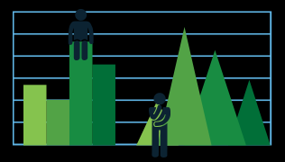
Benchmarking

Slide 24
Four levels
Goals:
Competent nurses
Qualified and motivated teachers
Supported by the management
Prepared for the real nursing work environment
Student
Team/teacher
Organization
Stakeholders

Slide 25
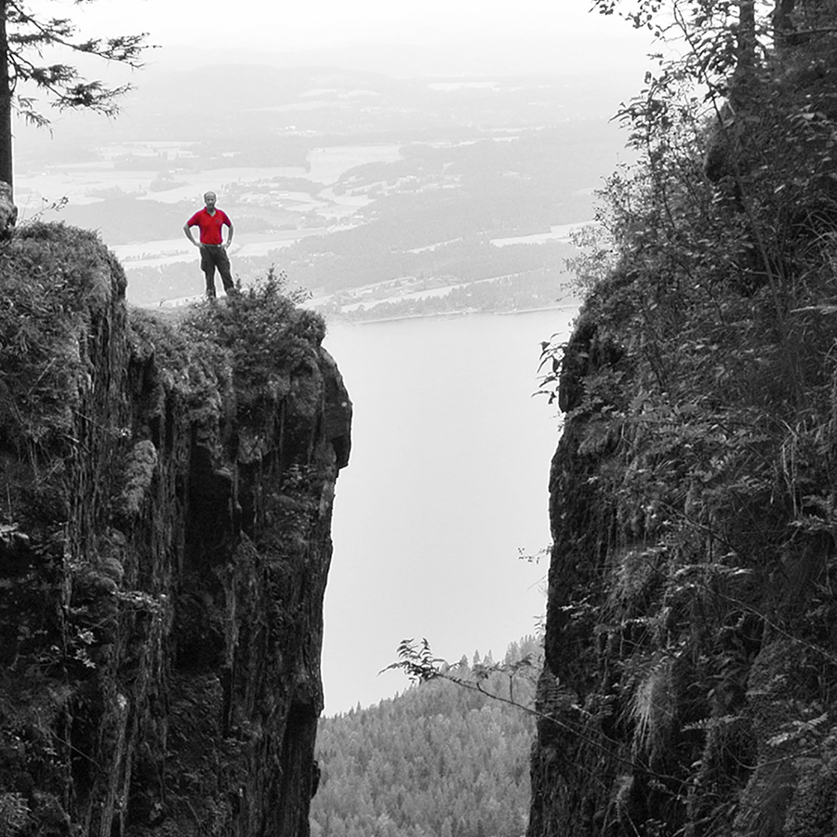
Stakeholders: nursing practice
Bridging the gap by
Involvement of stakeholders during development of curriculum
On a regular base communication about the progress – feedback
Exchange experience
Notes:
Exchange experience:
Laat nurses or doctors uit de praktijk lesgeven en laat collega’s op de vloer werken.
We doen resonantieraden, infomomenten voor werkveld, mentorendagen, participatie bij ontwikkeling, debat over EBP…

Slide 26


