Slide 1
NURSE

Slide 2
COMMUNICATIONS SKILLS

Slide 3
SOURCE
MESSAGE
RECIPIENT

Slide 4
COMMUNICATION PROCESS: KEY ELEMENTS
Content
Relations
Self declaration
Self-consciousness
Apeal

Slide 5
WHAT THE PATIENT EXPECTED
Kindness
Privacy
Certainty
Competence
Respect
Empathy

Slide 6
WHAT IS KINDNESS
ADRESS NAMES
EYE CONTACT
HEARING
EMPATHY
SMILE
SITTING WITH THE PATIENT

Slide 7
What is achieved by kindness
Diminish fears
Create trust
Better cooperation
Increases the success of treatment
Speeds up recovery

Slide 8
TYPE OF COMMUNICATIONS
Intrapersonal
Interpersonal
Group
Organizational
Mass

Slide 9
NON-VERBAL COMMUNICATIONS
Emotional
Oblivious
Truthful
Autonomous
Permanent

Slide 10
Non-verbal Communications:Elements
KINETIC
PARALINGQUISTIC
EXTRALINGQUISTIC
Facial mimics
Gesticulation
Hand movements
Posture
Diction
Accent
The pace and power
Dialect
Buzzwords
Time
Place/Area
Dressing

Slide 11
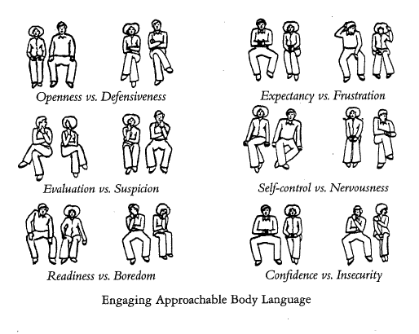

Slide 13
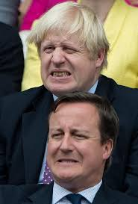
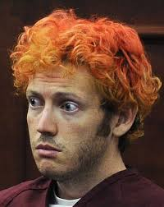
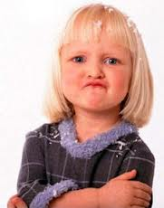

Slide 14
Thereupitic
Communications
Hearing
Thereupitic
Communications
Empathy
Mode
Thereupitic
Communications
Advice
Content
Quantity

Slide 15
THERAPEUTIC COMMUNICATIONS
BEGINNING
The Flow of
Communication
COMPLETION
Greet patients
Introduce oneself
Explain goals
Determine time
Privacy
Ask questions
Encourage conversation
Clarify details
Be careful/precise
Repeat essentials
Check whether anything is unclear
Follow the patient and greet

Slide 16
Communications skills
Empathy
Hearing
Cognitive
complexity
Communications skills
Flexibility
Understanding of
the situation
Communications skills
Self-control
Mediated by
an interaction

Slide 17
Mediated by an interaction
Understanding of the situation
Empathy and hearing
Cognitive complexity
Self-control
Flexibility

Slide 18
Communication with the Patient in Stress
Listen carefully
Show patience
Provide support
Avoid persuasion
Relax the patient

Slide 19
How to Recognize the Patient in Stress
Speech: louder or quieter
Face: redness
Bihevior: anxious

Slide 20
Do not accept insults
Eye contact
Assessment
Listen
Be careful
Avoid promises

Slide 21
Communication With Depressed Patients
Dedication
Empathy
Explain: aims of communication
Observe nonverbal cues
Questions : short and simple

Slide 22
Communication With The Patient In Intensive Care
Use the patient's name
Informations: about yourself, time, space
Informations about activities
Understanding
Encourage communication
Communicate with family

Slide 23
Communication With Chronic Patient
Positive emotions
Clarify therapy
Respect
Signs of care:rub-down
Satisfy the needs of the patients

Slide 24
Thank you !!!

