Slide 1
Assessing practical skills: intermediate and final

Slide 2
Practical examination
Different exercises
Different teachers
Preparation time
Time span for the practice
The level of difficulty increases in accordance to the study program

Slide 3
First year students
Four exercises in the first semester:
  Surgery skill e.g. wound care
  Medical skill e.g. hygienic care
  Basic life support
  Medical count
  Four exercises in the second semester:
    Two medical skills e.g. placement of a nasogastric tube and injections
    Social skills
    A digital progress test

Slide 4
Second year students
Four exercises in the first semester:
  Surgery skill e.g. complicated wound care
  Medical skill e.g. infusion therapy
  Social skills
  Medical count
  Four exercises in the second semester:
  Surgery skill
  Medical skill
  Patient education and handling difficult patient situations
  A digital progress test

Slide 5
Third year students
Skills of the past three years can be examined
Examination in group (4 students)

Slide 6
Checklist
Objectivity and standardization during the exam
Based on scientific research
The skill as it should be done

Slide 7
Content professional skills
The professional skills are offered in the three training years, both in the first as in the second semester. The skills are gradually built up. In concrete terms, this means that the base is offered in the first semester and that we build further on in the second semester.

Slide 8
Content professional skills
First, second and third year, first semester (PV1, PV3 & PV5):
  Practical skills
  Medical count or nursing calculations
  First, second and third year, second semester (PV2, PV4 & PV6):
  Practical skills
  Progress test

Slide 9
Practical skills (1st & 2nd semester)
Each technique is graded on 20. At a deficit (8 or 9) on 1 nursing skill, the student may still retrieve this with the other nursing skills. When a student has a major deficit (≤ 7/20) or when a student has a deficit (8 or 9) on 2 out of 3 nursing skills than the student has to retake this course in august.

Slide 10
Medical count or nursing calculations
Content first year:
  Percentage
  Measures and sizes
  Concentration
  International units
  Solutions and dilutions
  Medication administration
  Oxyygen calculation
Content second year:
  Calculating the infusion speed: ml/hr or dr/min
Content third year:
  γ- and μ- calculations

Slide 11
Medical count or nursing calculations
First year:
The test nursing calculation is a written test. The students have to make 10 calculations. To do this, they get about 15 minutes time. In the first year, students are expected to get 75% on the test to succeed. In concrete terms, this means that they should get 15/20 to succeed. This grade is converted to a 10/20.
Second year:
In the second year , students are expected to get 85% on the test to succeed. In concrete terms, this means that they should get 17/20 to succeed. This grade is converted to a 10/20.
Third year:
In the third year, students are expected to get 90% on the test to succeed. In concrete terms, this means that they should get 18/20 to succeed. This grade is converted to a 10/20.

Slide 12
Converting grade
First year:
Second year:
0 | 1 | 2 | 3 | 4 | 5 | 6 | 7 | 8 | 9 | 10
0 | 1,5 | 3 | 4,5 | 6 | 7,5 | 9 | 10,5 | 12 | 13,5 | 15
11 | 12 | 13 | 14 | 15 | 16 | 17 | 18 | 19 | 20
15,5 | 16 | 16,5 | 17 | 17,5 | 18 | 18,5 | 19 | 19,5 | 20
0 | 1 | 2 | 3 | 4 | 5 | 6 | 7 | 8 | 9 | 10
0 | 1,7 | 3,4 | 5,1 | 6,8 | 8,5 | 10,2 | 11,9 | 13,6 | 15,3 | 17
11 | 12 | 13 | 14 | 15 | 16 | 17 | 18 | 19 | 20
17,3 | 17,6 | 17,9 | 18,2 | 18,5 | 18,8 | 19,1 | 19,4 | 19,7 | 20

Slide 13
Converting grade
Third year:
0 | 1 | 2 | 3 | 4 | 5 | 6 | 7 | 8 | 9 | 10
0 | 1,8 | 3,6 | 5,4 | 7,2 | 9 | 10,8 | 12,6 | 14,4 | 16,2 | 18
11 | 12 | 13 | 14 | 15 | 16 | 17 | 18 | 19 | 20
18,2 | 18,4 | 18,6 | 18,8 | 19 | 19,2 | 19,4 | 19,6 | 19,8 | 20

Slide 14
Grade professional skills first semester
To calculate the point of professional skills we need to look at the credits of the individual parts.
  Practical skills (2 or 3 study points)
  Medical count or nursing calculations (1 study point)
Practical skills counts for 2/3 or ¾ of the points and medical count for 1/3 or 1/4.
A deficit (8 or 9) on 1 of the 2 items could possibly be picked up with a good grade on the other part. A large deficit (≤ 7/20) on 1 of the 2 items automatically leads to a failure. The student will only have to do a retake of the component with a deficit.

Slide 15
Progress test
The digital progress test is not part of a specific course. It's course and competency exceeding.
This test is intended to examine captivated knowledge throughout the training.
The digital progress test is a questionnaire, consisting of 120 multiple choice questions. The questions asked are situated on three levels:
multiple choice questions, aimed at reproduction knowledge (recognition questions)
multiple choice questions focused on insightful knowledge (deepening questions)
multiple choice questions aimed at applying knowledge (application questions)
120 multiple choice questions:
60 questions that deal with profession specific sciences → questions related to nursing sciences
60 questions related to supporting sciences.
  30 questions about biomedical sciences
  12 questions about behavioural sciences
  18 questions about social sciences.
Notes:
The digital test is a questionnaire, consisting of 120 multiple choice questions. The questions asked are situated on three levels namely multiple choice questions, aimed at reproduction knowledge (recognition questions), multiple choice questions focused on insightful knowledge (deepening questions) and multiple choice questions aimed at applying knowledge (application questions).
Of the 120 multiple choice questions there are 60 questions that deal with profession-specific Sciences and 60 questions related to supporting Sciences. Questions that deal with profession-specific sciences are all questions related to nursing sciences. The questions related to the supporting Sciences contain 30 questions about the biomedical sciences, 12 questions about the behavioural sciences and 18 questions about the social sciences.

Slide 16
Progress test
Need to be done in a time span of 60 minutes .
The test is organized twice a year. Once during the examination period in the first semester and once during the second semester. The first test is an exercise and doesn’t count for points. The second test is summative.
Based on results of the tests of all the students of all the participating colleges a relative norm is set for each level of education. On the basis of this relative standard a point is given on 20.

Slide 17
Cesuur summatieve VGT 1st year
Cijfer | Procent | Juiste antwoorden op 120 | Cijfer | Procent | Juiste antwoorden op 120
1/20 | 20% | 25 | 11/20 | 52% | 63
2/20 | 23% | 29 | 12/20 | 56% | 67
3/20 | 26% | 33 | 13/20 | 59% | 70
4/20 | 30% | 37 | 14/20 | 62% | 74
5/20 | 33% | 40 | 15/20 | 65% | 78
6/20 | 36% | 44 | 16/20 | 69% | 82
7/20 | 39% | 48 | 17/20 | 72% | 85
8/20 | 43% | 52 | 18/20 | 75% | 89
9/20 | 46% | 55 | 19/20 | 78% | 93
10/20 | 49% | 59 | 20/20 | 82% | 97

Slide 18
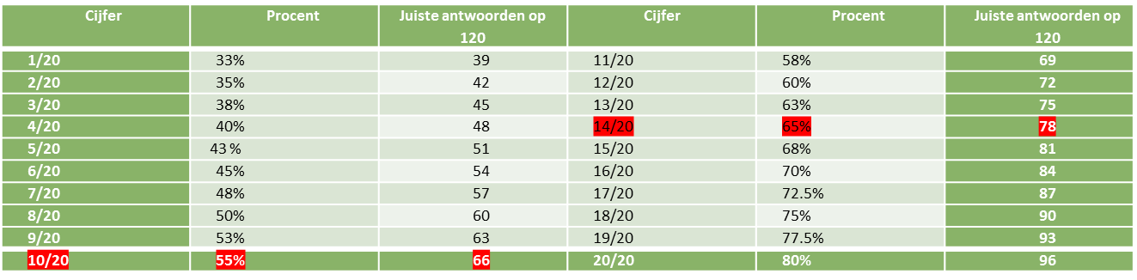
Cesuur summatieve VGT 2nd year

Slide 19
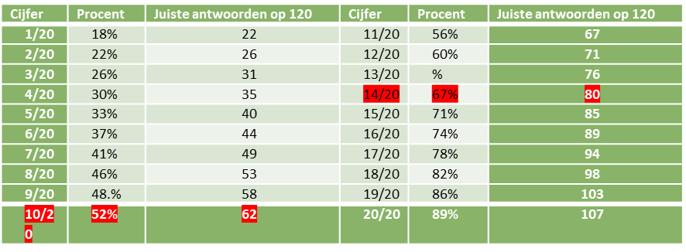
Cesuur summatieve VGT 3th year

Slide 20
Grade professional skills second semester
To calculate the point of professional skills we need to look at the credits of the individual parts.
  Practical skills (2 or 3 study points)
  Progress test (1 study point)
Practical skills counts for 2/3 or ¾ of the points and the progress test for 1/3 or 1/4.
A deficit (8 or 9) on 1 of the 2 items could possibly be picked up with a good grade on the other part. A large deficit (≤ 7/20) on 1 of the 2 items automatically leads to a failure. The student will only have to do a retake of the component with a deficit.

Slide 21


