Slide 1

Analysis of Competences at the University of Prešov
Lubica Rybarova

Slide 2
Legislative documents in Slovakia
Regulation of the Government of the Slovak Republic no. 296/2010 about
  competences for the providing of the health care profession and
  educational standards as basic criteria for health care professions
Regulation of the Ministry of Health no. 364/2005 about
  range of nursing practice provided by nurse independently and in cooperation with physician and the range of midwifery practice provided by the midwife independently and in cooperation with the physician

Slide 3
Nursing Curriculum
1 Theoretical education
1.1 Nursing
the aspects and ethics of the nursing profession,
general principles of health and nursing,
nursing principles in relation to:
  general medicine and specialized medicine
  general surgery and specialised surgery
  childcare and to pediatrics
  maternity care
  mental health care and to psychiatry
  care of the elderly and geriatrics
1.2 The basic sciences
anatomy and physiology
pathology
bacteriology, virology and parasitology
biophysics, biochemistry and radiology
dietetics
hygiene
public health
health education
pharmacology,
1.3 Social sciences
sociology
psychology
principles of administration
principles of teaching
social and health legislation
legal aspects of nursing

Slide 4
Cont.
2 Practical training
2.1 Nursing in relation to:
general and specialised medicine
general surgery and specialised surgery
childcare and pediatrics
maternity care
mental health care and psychiatry
care of the elderly and geriatrics
primary care and the community care
https://student.unipo.sk/maisportal/studijneProgramy.mais

Slide 5
Learning outcomes
Know the theoretical basis of nursing as a discipline with an emphasis on the historical development of the profession
Theoretically know and practically work with method of nursing process in fullfing the bio-psycho-social and spiritual needs of patient
Know the principles of medical and nursing ethics, with the ability to solve ethical dilemmas in nursing practice
Recognize a wide range of psychological, personal and psychosocial mechanisms, which are manifested in individuals during health and disease
Have a knowledges of health and disease and uses them in primary, secondary and tertiary prevention
Have a basic knowledge of the structure and function of the human body to the extent necessary for an understanding of disease processes
Acquire knowledges of applied clinical nursing,form the basis of knowledges, which are necessary for professional ability to perform work activities in the nursing profession

Slide 6
Cont.
Be able to make changes, take risks, take responsibility, demonstrates the ability to improvise in accute situations
Fast, wisely and decisively work, know legal responsibility in her/his profession, constantly gains expertise related to her/his own expertise and improves personal growth
Use knowledge of management and control as a purposeful human activity in to creating optimum conditions for the provision of quality nursing care
Acquire communication skills which are essential for interpersonal cooperation in the team as an essential part of nursing practice and synonymous for creating nurse-patient relationship
Use knowledge of nursing education in the protection, support and restore the health of individuals, families, communities

Slide 7
Practical skills
The nurse independently:
Identifyes needs person, family or community, and arranges or makes satisfying the needs in health-relation with disease or dying
Participates in the establishment of the quality system and evaluates the quality of nursing care
Organizes and ensures the implementation of interventions in order to the needs of the person
Supports the promotion of advocacy of the needs and rights of people
Organizes and executes activities related to the admision, discharge, transfer and patients death
Does the nursing documentation, checks and analyzes the results in the nursing documentation
Uses assessment scales in nursing care
Ensures the providing of continuous nursing care to person after discharge from hospital care to home care
Provides nursing care in a home environment

Slide 8
Cont.
Recommendes care and collaboration with other individuals and legal persons
Educates people about family or community nursing care with an emphasis on self-sufficiency
Offers information related to providing nursing care according the required extent to the person, family or community
Collaborates with other health care professionals
Provides environmental hygiene, including desinfection, and sterilization of medical devices
Provides compliance of the safe environment of a person and the protection of his/her intimacy in providing nursing care
The nurse measures, monitors and interprets the established numerical and clinical data of vital signs, examines visual acuity and auditory acuity, participates in the prevention of disorders of immobility, evaluates and treats disorders of the skin and mucous membrane integrity, applies dresses and compresses, suctiones secretions from the respiratory tract, treats drains, peripheral catheters, stoma, in the performance of nursing practice

Slide 9
Practical skills
Indepedently by the physician indications:
Prepares the person for diagnostic and therapeutic procedures and provides nursing care during and after these procedures
Perform sampling of biological material
Provides redressesing and care about wounds
Applyes oxygen therapy, enteral therapy
Administers the medication in all available forms; i.v. administration of medication and parenteral nutrition may administer only upon written authorization of the physician
In cooperation with a physician:
Provides surgical nursing procedures
Administers an epidural catheter, urinary catheter in children and men
Provides endoscopic examinations
Provides invasive and non-invasive procedures
Provides an administration of contrast agents intravenously
Provides an administration of transfusion medication and transfusion preparations

Slide 10
Nursing Procedures – 1st year
• Dressing material and dressings
• Care of the device
• Bed care
• Records to nursing documentation
• Admission, transfer and discharge of a patient
• Hygiene care
• The administration of food
• Physical activity and nursing rehabilitation - physiotherapy
• The excretion of urine and bowel
• Monitoring, measuring and recording vital sights
• Administration of drugs, medication
• Infusion therapy
• Administration of blood components
• Sampling of biological material
• Examination of vision and hearing
• Ward round
• Cooperation and assisting in the endoscopy
• Cooperation and assisting in puncture

Slide 11
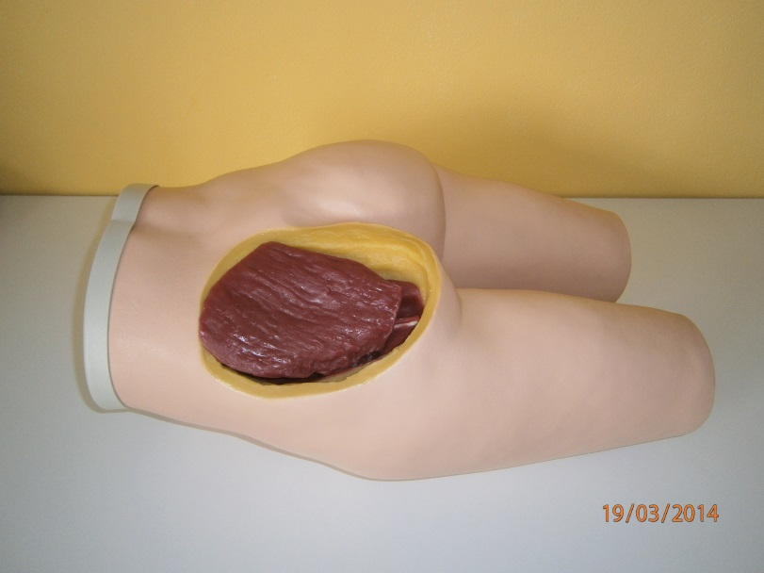
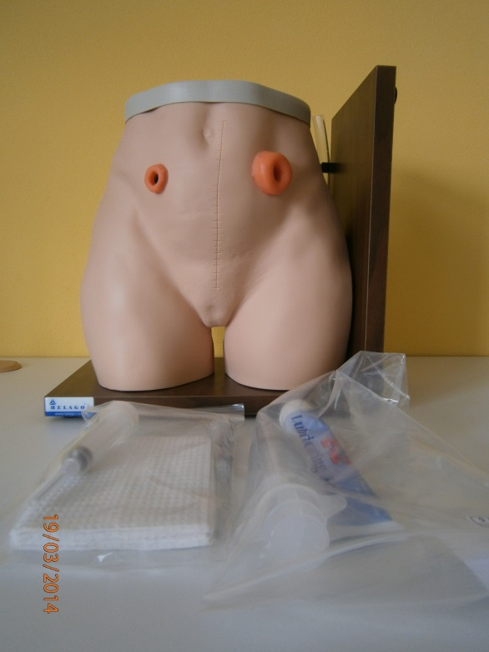
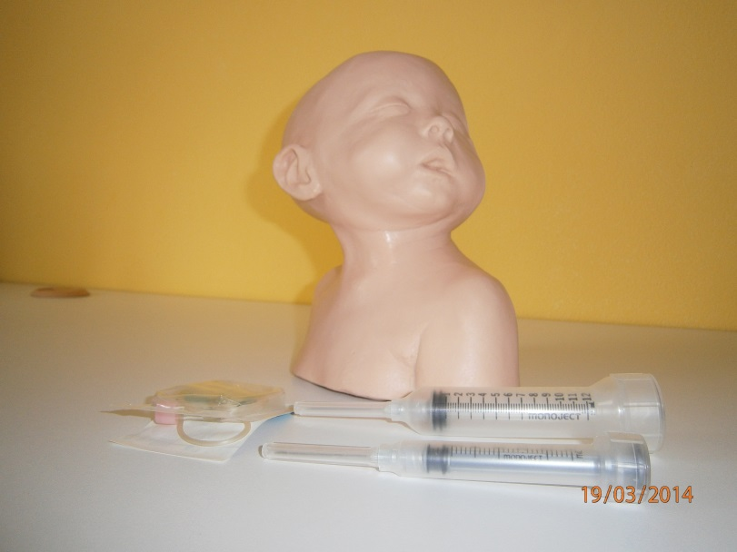
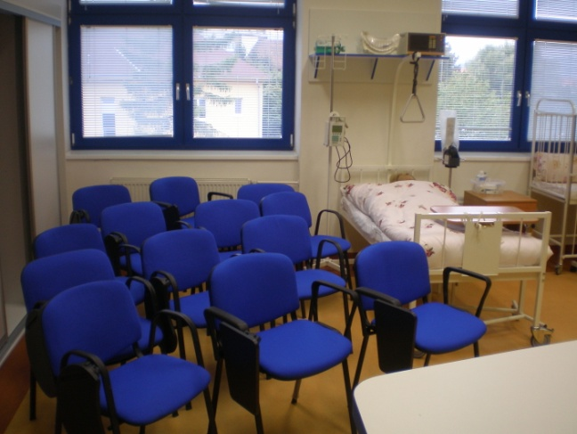
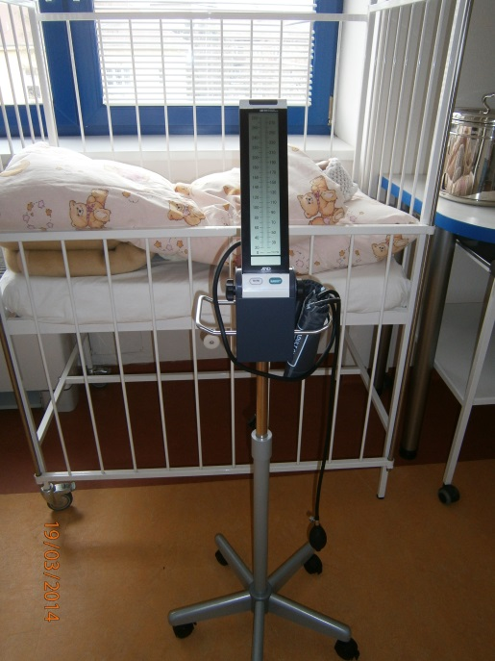
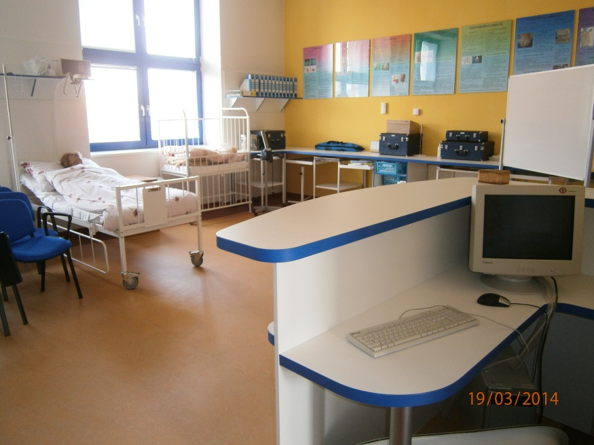
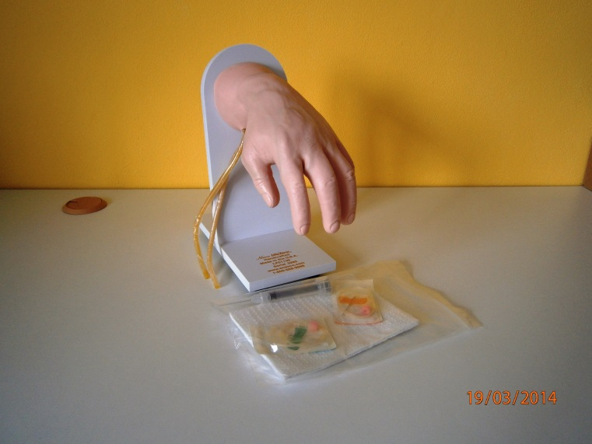
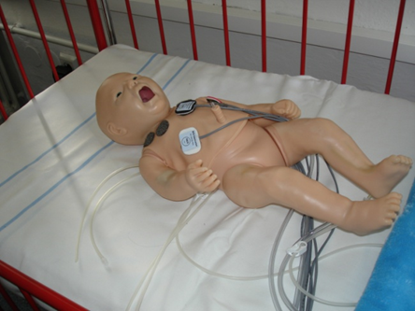
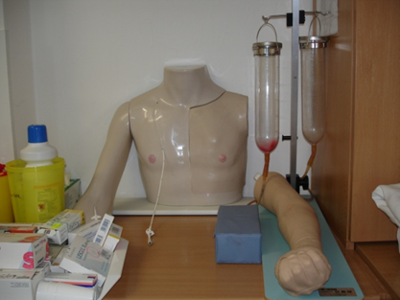

Slide 12
Workplace training 1st year
(summer semester)
SS | Geriatrics ward 1 | 40 h
SS | Surgical ward 1 | 80 h
SS | Internal medicine ward 1 | 80 h
SS | Pediatric ward1 | 80 h
SS | Intern 1 | 80 h
SS | Summer intern 1 | 80 h

Slide 13
Workplace training 2nd year
WS | Community care 1 | 80 h
WS | Internal ward 2 | 120 h.
WS | Pediatric ward 2 | 80 h.
WS | Intern 2 | 80 h.
SS | Geriatric ward 2 | 80 h.
SS | Surgical 2 | 120 h.
SS | Neurological ward | 80 h.
SS | Summer intern 2 | 80 h.
SS | Intern 3 | 80 h.

Slide 14
Workplace training 3th year
WS | Gynekology and obstetric ward | 80 h.
WS | Community care 2 | 40 h.
WS | Oncology ward | 80 h.
WS | Psychiatric ward | 80 h.
WS | Intern 4 | 80 h.
SS | Geriatric ward 3 | 80 h.
SS | Surgical ward 3 | 120 h.
SS | Community care 3 | 80 h.
SS | Internal ward 3 | 120 h.
SS | Pediatric ward 3 | 80 h.

Slide 15
Nursing Procedures – 2nd year
Surgical nursing
• Redressing aseptic wounds
• Redressing septic wounds
• The treatment of leg ulcers (ulcus cruris)
• Treatment of pressure ulcers
• Assistance in incision
• Assistance in suture
• Education of patient with a stoma
• Care of colostomy
• Care of urostomy
• Care of free drainage
• Care of subhepatal drainage
• Care of T – drain
• Care negative pressure drainage (Redon drain)
• Care flushing drainage
• Assessment of patient's pain before the surgery
• Assessment of pain patient's in after surgery
• Immediate preoperative preparation of the patient
• Immediate postoperative care
• Treatment of post-operative pain
• Prevention of postoperative complications

Slide 16
Nursing Procedures – 2nd year
Internal nursing
• Electrocardiography (ECG)
• Endurance ergometry (exercise ECG)
• Treatment of patients with permanent cardiostimulance
• Care of patient during coronarography
• Care of the patient when PTCA (percutaneous transluminal coronary angioplasty)
• Measurement of oxygen saturation
• Cooperation in cardioversion, defibrilation
• Cooperation in hemodialysis
• Cooperation in peritoneal dialysis
• Measurement of blood glucose
• Cooperation in spirometry
• Cooperation in connection BP Holter
• Cooperation in connection ECG Holter
• Cooperation on ultrasound examination of the abdominal organs
• Cooperation in the test on an inclined plane (HUT test)
• Cooperation in transesophageal ECHO (TEE) examinations of the heart
• Cooperation in transthoracic ECHO (TTE) examinations of the heart
• Cooperation in transesophageal atrial stimulation (TES)

Slide 17
Nursing Procedures – 2nd year
Neurological nursing
• Assessment of the state of consciousness of the patient
• Assessment of the patient's self-sufficiency with neurological disease
• Assessment of the risk of pressure sores in patients with selected neurological disease
• Preparing the patient for EEG
• Administration food to the patient with paresis
• Positioning the patient with neurological disease
• Practicing self-sufficiency in selected patients with neurological disease
• Nursing rehabilitation in patients with neurological disease
• Caring for a patient with impaired consciousness

Slide 18
Nursing Procedures – 2nd year
Pediatric nursing
• measurement of body weight and length in the infant, toddler, child
• measurement of body temperature in a child
• measurement of respiration in a child
• measurement of pulse palpation in a child
• measuring the apical pulse in a child
• measurement of blood pressure in a child
• measurement of oxygen saturation in the child
• assessment of the state of consciousness on a scale from GCS in a child
• assessment of pain in a child
• assessment of fluid balance in the child
• assessment of psychomotor development of the infant, toddlers, child
• bathing infant (or toddler)
• positioning of a disabled child
• administering food in infant, toddler
• admnistering meal by gavage in a child
• sampling of capillary blood in a child
• a blood test to determine blood glucose with child
• cooperation for the sampling of venous blood in a child
• nasal, throat, rectal swabs in a child
• urine sampling for chemical and biochemical and microbiological examination
• stool sampling in a child
• administration of peroral drugs in a child
• administration of drugs to the skin in a child
• administration of drugs into the conjunctival sac of the child
• administrationof medication into the nasal cavity in a child
• administration of drugs into the external auditory canal in a child
• administration of drugs into the rectum in a child
• inhalation drug delivery in the child (hand inhaler)
• inhalation drug delivery in the child (nebulizer)
• application of oxygen in a child
• administration of insulin by insulin pen in a child
• administration of subcutaneous injection in a child
• administration of intramuscular injection in a child
• dilution of antibiotics
• cooperation in the establishment of peripheral venous catheter in a child
• cooperation in administratering intravenous drug in a child
• cooperation in administering the infusion solution in a child
• cooperation in the administration of blood components in a child
• suction secretions from the airways in a child
• baby monitor in the ICU
• education of the child's parent / child
• cooperation in the first treatment for healthy newborns
• measurement of body weight, length, head circumference and chest in a newborn
• bathing newborn
• newborn screening
• consideration of selected neonatal reflexes
• ensure thermoneutral environment

Slide 19
Nursing Procedures – 2nd year
Nursing in primary and community care
• working with documentation in out patient clinic
• first visit of newborn in the family
• vaccination
• promoting health in the community
• health education in community
• home care

Slide 20
Nursing Procedures 3th year
Geriatric nursing
• Assessment of the patient according to the ADL test
• Assessment of the patient according to the IADL
• Assessment of the patient according to the Gait functional test
• Assessment of the urgency of the patient mental test scoring
• Assessment of geriatric patients by functional geriatric index (FGI)
• Assessment of the patient's quality of life according to IQoL test (according to Spitzer)
• Nutritional assessment in geriatric patients
• The pain management in geriatric patients
• Assessment of pain in patient with advanced dementia (PAINAD)
• Administration food to geriatric patients

Slide 21
Nursing Procedures 3th year
Oncological nursing
• Administration of opiates
• Introduction to preparation and administration of cytotoxic agents for intravenous administration
• Nursing care of patients treated with cytostatics
• Nursing care of patients with neutropenia
• Oral care of patients receiving chemotherapy / radiotherapy
• Skin care of patients receiving radiation therapy
• Administering analgetics plaster

Slide 22
Nursing Procedures 3th year
Psychiatric nursing
• Cooperation in electroconvulsive therapy
• Care of patient in delirium
• Administration of drugs orally to a patient with mental illness
• Application of depot psychopharmacs
• Occupational therapy
• Assessment of the patient according Folstein test of cognitive function (MMSE)

Slide 23
Nursing Procedures 3th year
Gynecological and obstetric nursing
• Vaginal swab
• Administering of the drug into the vagina
• Cooperation in gynecological examination
• Treatment of women in antenatal period
• Observation of physiological childbirth
• Treatment of women in postnatal period
• Placing the newborn to the breast

Slide 24
Evaluation
Teoretical knowledges:
  nursing
  nursing in medical sciences
  social sciences in nursing
Practical skills:
  Check of the students logbook
  Assesment of students´ skills (procedures)
  Defence of nursing plan (patient care)
Defence of bachelor thesis (graduation)

