Slide 1
Alternative teaching methods
K. Pletinckx & L. Van Droogenbroeck

Slide 2
Educational reform Educational innovation

Slide 3
Educational reform/innovation
Content design: content of the curriculum – goals of the curriculum
Educational design:
Deciding which educational concept to follow
F.e. problem based learning, project based learning, competence based learning
Didactical design:
Selecting the right didactic approach
Choosing appropriate teaching methods

Slide 4
LET’s GO!
Content design:
Educational design:
Didactical design:
Choosing appropriate learning activities
O.a. training in Shkoder 7-9 september 2015
full-fledged learning process

Slide 5
Full-fledged learning process
Crucial components on the part of the student
Activity
Ownership
Learning output

Slide 6
Didactical design
motivational education
Learning = knowledge experiencing

Slide 7
Learning process Kolb (1984)
Two dimensions
concrete versus abstract
active versus reflective
Four-stage learning cycle
reflective observation
concrete experience
abstract conceptualization
active experimentation
concrete
active
reflective
abstract

Slide 9
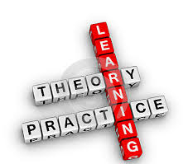
Effective learning
Kolb (1984): ideally go through all phases
Goal: touch all the bases, ie. a cycle of
Experiencing
Reflecting
Thinking
Acting
Starting point: person-related, depending on the learning style

Slide 10
Learning styles
Do-er
Dreamer
Decision-taker
Thinker

Slide 11
Dreaming?
Training “How to gather knowledge of learning style students?”
Measuring instruments
Determine learning style students (ànd teacher)
Insight in learning styles (tips and tricks)
Adjust didactical methods to learning styles
Teacher organizes lectures according to own learning style

Slide 12
Active teaching
Key? Motivational education
Why? Didactical concept influences learning process
What? Powerfull learning environment
stimulates
active participation
How? Active teaching methods

Slide 13
Active teaching
In every phase
Regardless of educational design
Depending on the course itself
Important to adjust to the learning goals/competences/test forms
Small and big groups
Challenge: choosing the one method that meets the requirements

Slide 14
Workshop alternative teaching methods
Potatoe potahto
As an alternative to more classic teaching methods f.e. lectures
Suggest some but EXPERIMENT/VARY/NEW IDEAS
teacher-driven student-driven

Slide 15
Lectures don’t work, but we keep using them…
What’s the Use of Lectures?
Notes:
It no longer made sense to stand up in public and read out your notes if anyone could read the original text for themselves.

Slide 16
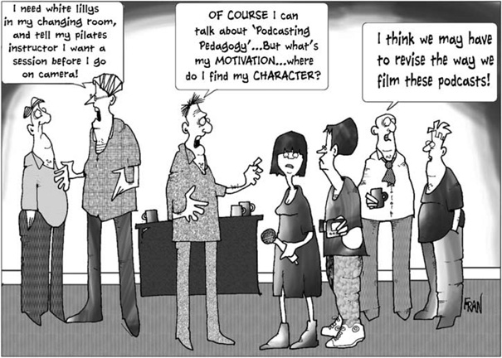
Lecturer orientated vs student orientated?

Slide 17
Digital learning environment
Digital learning environment > courses/powerpoint presentations / instruction movies/…

Slide 18
Alternative (activating) teaching methods
Interactive lecture
Guided tutorial
Simulation
Case study
Role-play

Slide 19
Field trip
Project based learning
(Digital) assignments/(digital) assignments through digital learning environment
Digital portfolio
Preparation instructions
Self study / blended learning

Slide 20
To discuss during the workshop
Meaning of the activity
Specific features
Procedure
Tips & tricks
…

Slide 21
Questions?

Slide 22
Workshop
Overview of different work methods
interactive lecture
guided tutorial
case study
simulation
role play
field trip
project based learning
…

Slide 23
Interactive lecture
Meaning of the activity:
classes in which the instructor incorporates engagement triggers (f.e. interpreting graphs, brainstorming, …) and breaks the lecture at least once per class to have students participate in an activity that lets them work directly with the material
Special features:
to engage students by finding ways for them to interact with the content, the instructor, and their classmates
the ability of the instructor to choose the content of the lecture segments based on the students' needs
foster active engagement and accountability
promote student retention and learning of the material presented during lecture
give students practice in developing critical-thinking skills
enable instructors to assess how well the class is learning that day
Notes:
http://serc.carleton.edu/introgeo/interactive/whatis.html

Slide 24
Procedure:
Engage in pre-instructional planning.
Select engagement triggers and learning tasks for interactive segments.
Select and adapt from interactive lecture techniques.
Structure and manage the interactive class session.
Select mechanisms and methods for collecting, organizing, and responding to feedback.

Slide 25
Guided tutorial
Meaning of the activity:
with clearly established learning goals and under the guidance of a tutor, students work in small groups, exploring a series of real life nursing situations
Special features:
to learn specific skills
to enhance problem solving ability
Procedure
making agreements about mutual expectations
be sure that students are prepared to participate
instructors circulate through the room and engage with students in dialog, leading students to discover the answers to their own questions

Slide 26
Tips & tricks:
make sure that it is worthwhile for students to come prepared to the lesson
avoid to explain theory again and again
give no ready-made storage solutions; answer only questions from students as they give themselves an attempt to answer
a digital environment can support

Slide 27
Case study
Meaning of the activity:
can be very useful in bringing "life" to the content
take the student step by step through the process of clinical thinking and decision making
Special features:
presents students with a situation they can relate to from their own life experience
includes realistic information
has a conflict that students can resolve

Slide 28
Procedure
get source material (short story, video, etc.) to use as the basis for the case study
provide students with a focus or framework to use in doing their analysis
give students time to analyze the case individually or in groups, and to write down their analysis
begin a discussion of students’ analyses
act as a mediator of the discussion
after analysis has been completed, show how the case study illustrates application of theoretical or background concepts in course material
use a case study to lead into a discussion or lecture of course material, showing its relevance by referring back to the case study
Tips & tricks:
don’t offer your own opinion except to provide guidance on the process
remind students of the framework if discussion becomes unfocused
Tell me and I'll forget; show me and I may remember; involve me and I'll understand."
Chinese proverb

Slide 29
Simulation
Meaning of the activity:
a technique or device that attempts to create characteristics of the real world
students are active participants, not merely recipients of didactic content as in a lecture class
since simulations are based on real-life situations, they present students with choices and constraints that reflect real-world problems

Slide 30
Special features:
they also learn to work as a team and can experience a variety of roles as team members
working in small groups with patient simulation scenarios, learners benefit from each other’s successes and mistakes
it provides opportunity for active and interactive learning without risk to an actual patient
allows the educator to control the learning environment through scheduling of practice, providing feedback, and minimizing or introducing environmental distractions

Slide 31
provide students with practice in decision making, but in a different, more engaging, format
in health care education, simulation can take many forms, from relatively simple to highly complex
students can be permitted to make mistakes without fear of harming a live person; simulations can be very effective in teaching problem solving and in developing students’ self-confidence
scenarios can be selected or designed to meet specific course objectives and in accordance with learning needs of the students

Slide 32
Procedure
small numbers of students (generally, no more than five students) are typically involved in each scenario, with each student having a role in the simulation and working well together in a simulated scenario
most scenarios can be conducted in 30 minutes
it is important to allow time for debriefing when the scenario is over
Tips & tricks:
simulations are more difficult and time-consuming to write than case studies, and they usually take more time in class, although the teacher’s role is less directive than in the case study method
they also require more explanation before the exercise and, when completed, a careful exposition of what has been learned by relating students’ experiences to the general principles involved
the debriefing is a critical part of the patient simulated scenario, providing participants with an opportunity to reflect on their learning experience

Slide 33
Variants:
Screen-Based Computer Simulators
Integrated Simulators
Human patient simulators

Slide 34
Role-play
Meaning of the activity:
is a discussion technique that makes possible to get maximum participation of a group through acting out an example of some problem or idea under discussion
is a form of interactive case study where the experience of participating in the role-play is the basis for further discussion
is a method that teaches learners real life situations to develop understanding of other people
they are generally used in classes dealing with social issues (social sciences, management sciences, etc.) or communication strategies (interviewing techniques, conflict management, etc.).
Special features:
people learn through observing others’ behaviors, attitudes and outcomes of those behaviors, f.e. enhancing communication skills
it emphasizes the "real-world" side of science
it challenges them to deal with complex problems with no single "right" answer

Slide 35
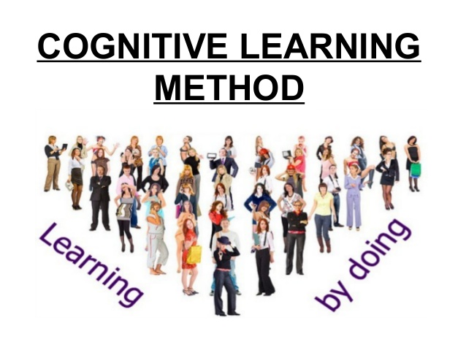
Procedure:
define objectives
choose context and roles
introducing the exercise
student preparation: each student takes the role of a person affected by an issue and plays this role from the perspective of that person
the role-play
concluding discussion
assessment

Slide 36
Tips & tricks:
can be integrated with other teaching techniques
requires active participation and interaction
must have certain level of comfort within the group to be effective
should never be performed at the beginning of training session
may not appeal to those learners who do not like to be the center of attention
cognitive learners may not accept the physical involvement of learning
requires an post-activity discussion or debriefing session after the role-play is completed
“I hear and I forget. I see and I remember I do and I understand.”
Confucius

Slide 37
Field trip
Meaning of the activity:
reflective observation, concrete experience
Time requirements:
at least 50 minutes; preferably a couple of hours
Special features:
can be especially interesting for students and instructors, and it facilitates some types of learning that cannot take place in a classroom
a field trip to a professional institution can show students where their studies may lead them

Slide 38
Procedure
look at past course outlines or notes to gather ideas for where to go
prepare for purposes, time constraints or misfortunes
communicate a clear “mission” of the field trip to the students
encourage students to participate in their surroundings by giving an assignment that must be accomplished using data from the field or notes from a visit
Tips & tricks:
students learn more from field trips in which they are not simply observers
taking effective field notes and identifying the key points of a field trip can be hard: consider giving students a worksheet allowing them to do a self-guided tour – include questions to be answered
during the class before the field trip, have a preparatory session: discuss practical matters (dress, safety, equipment to bring) and the academic background to the field trip
allow enough time for debriefing (discussing and processing data obtained on the field trip) as soon as possible afterwards

Slide 39
Project-Based Learning
Meaning of the activity:
a teaching method in which students gain knowledge and skills by working for an extended period of time to investigate and respond to a complex question, problem, or challenge
is focused on student learning goals, including standards-based content and skills such as critical thinking/problem solving, collaboration, and self-management.
Special features:
the key is for the teacher to provide very little direction; students are responsible for doing their own research and solving problems for themselves, with minimum guidance

Slide 40
Procedure
the teacher puts students into groups and gives them a specific challenge
class time is devoted to group collaboration
when the project is complete, each group presents to the rest of the class their project results and, more importantly, what they’ve learned along the way
Tips & tricks:
need-to-Know List
tools for self-Management and collaboration
formative assessments and benchmarks
Get Out of the Way

Slide 41
References
Allgood, S., W. Bosshardt, W. van der Klaauw and M. Watts, 2004. What Students Remember and Say About College Economics Years Later . American Economic Review, 94 (2), 259-265. Crouch et al., 2007. Peer instruction: Engaging students one-on-one, all at once . Reviews in Physics Education Research v.1: Research-based reform of University Physics. Rao, S. P., and S. E. DiCarlo, 2000. Peer instruction improves performance on quizzes . Advances in Physiology Education 24 (1): 51–55. Saroyan, Alenoush and Linda S. Snell, 1997. Variations in Lecturing Styles . Higher Education v33 n1 p85-104. Watts, M. and W. E. Becker, 2008. A little more than chalk and talk: Results from a third national survey of teaching methods in undergraduate economics courses . Journal of Economic Education 39(3) p273-286

