Slide 1

Faculty of Health
University of Zenica

Slide 2
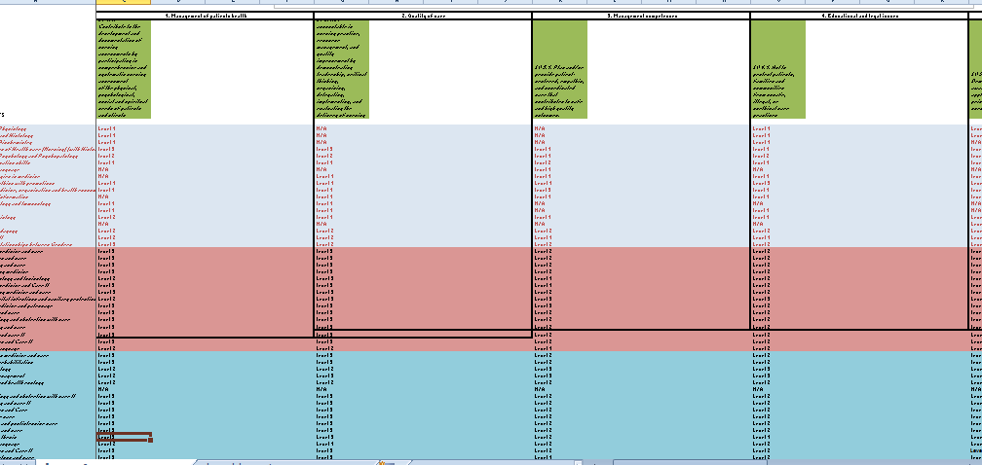
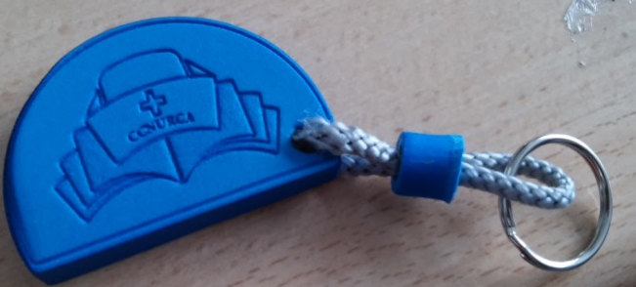
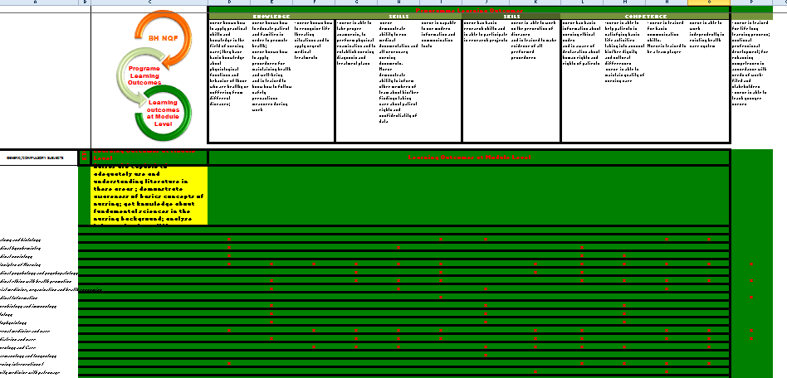

Project activities
Analysis
Training
Reform
Dissemination
Publication

Slide 3
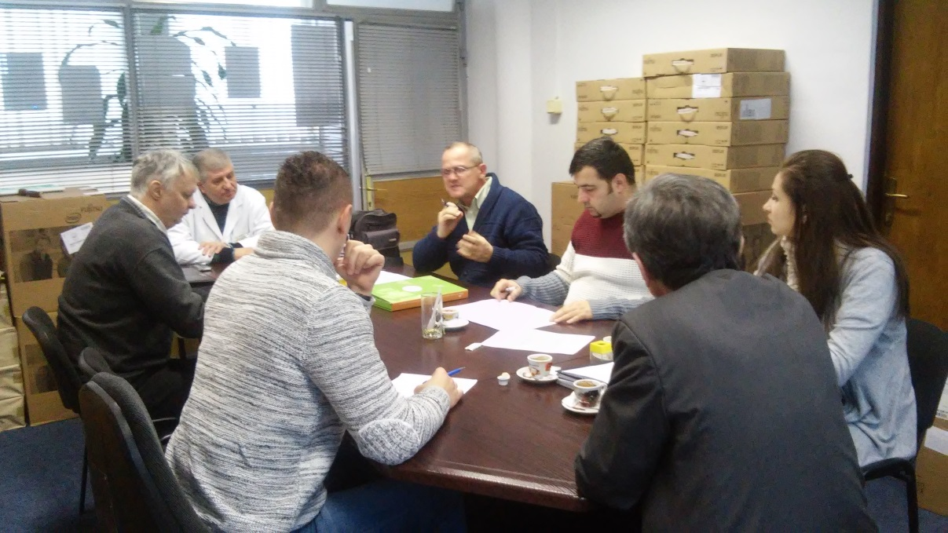

Curricula reform
Prof dr sc Salih Tandir
Prof dr sc Darko Petković
Prof dr sc Hajrudin Skender
Prof dr sc Amir Denjalić
Doc dr sc Harun Hodzic
V.asist. Mirza Oruč MA
V. Asist. Adnan Mujezinović
Adisa Krehmić, dip iur
Dr sc Ibrahim Plančić
Željko Bodul etc..

Slide 4
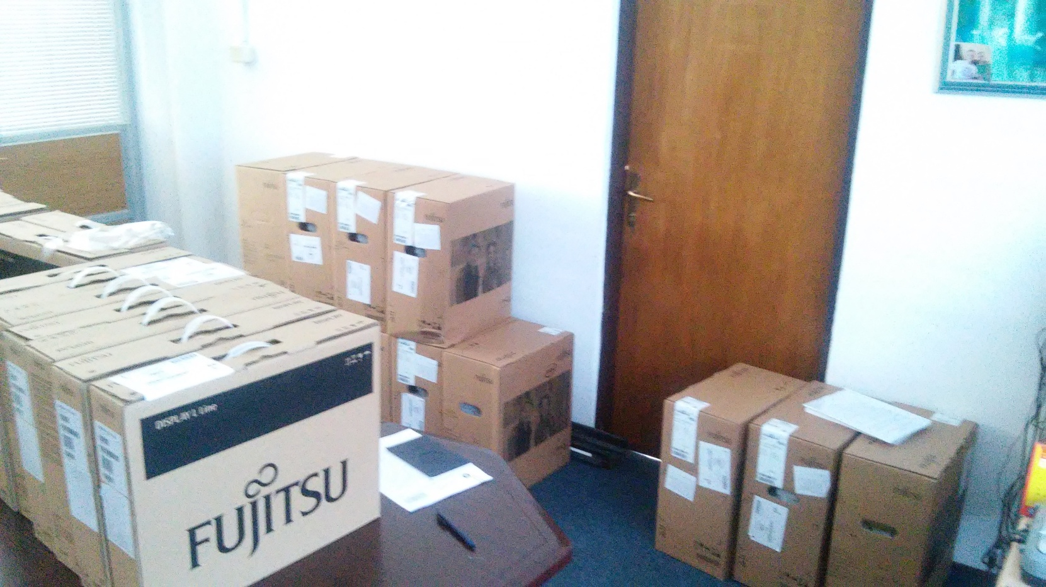
Equipment

Slide 5
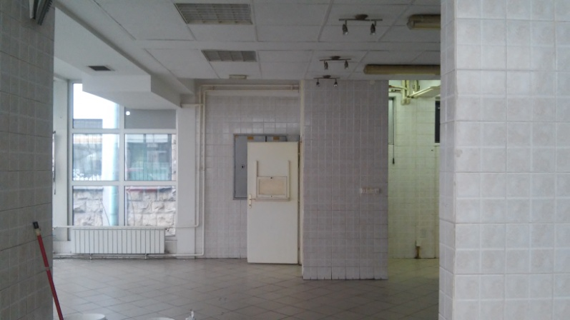
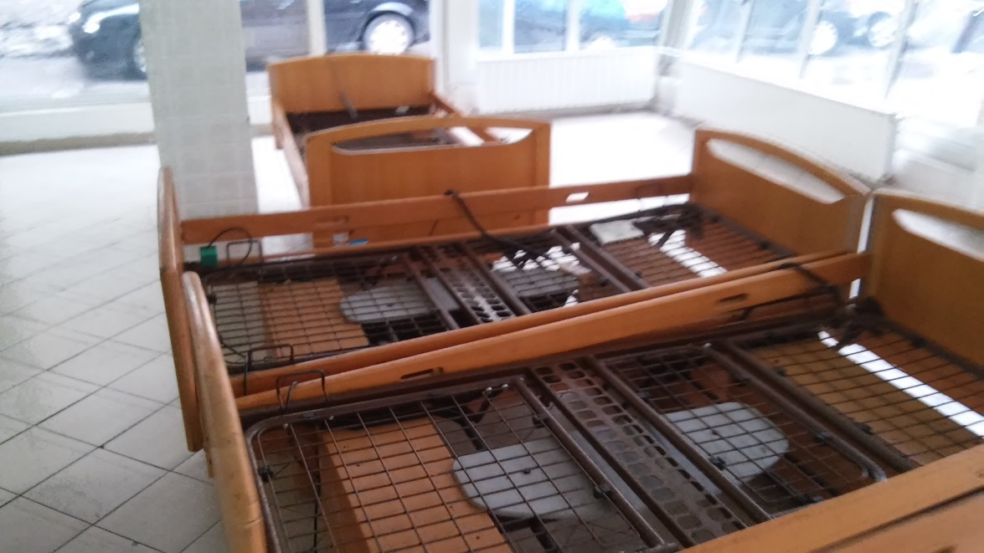
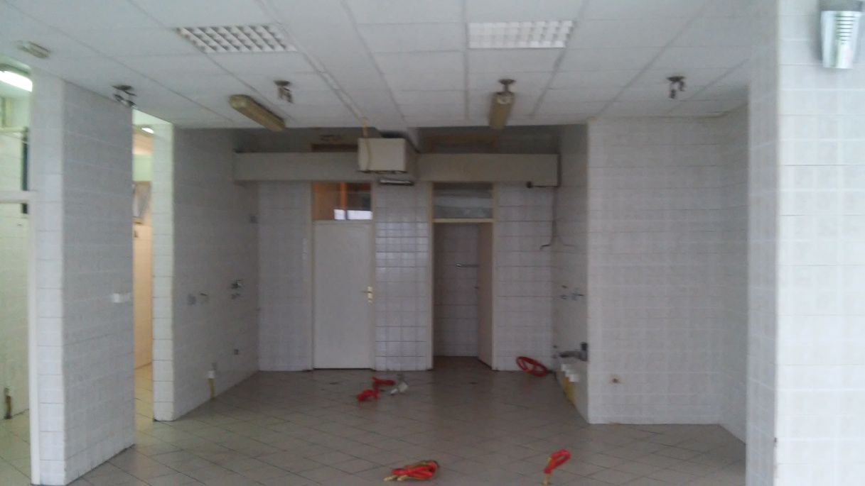
Facilities
Training center
Nursing skills lab

Slide 6
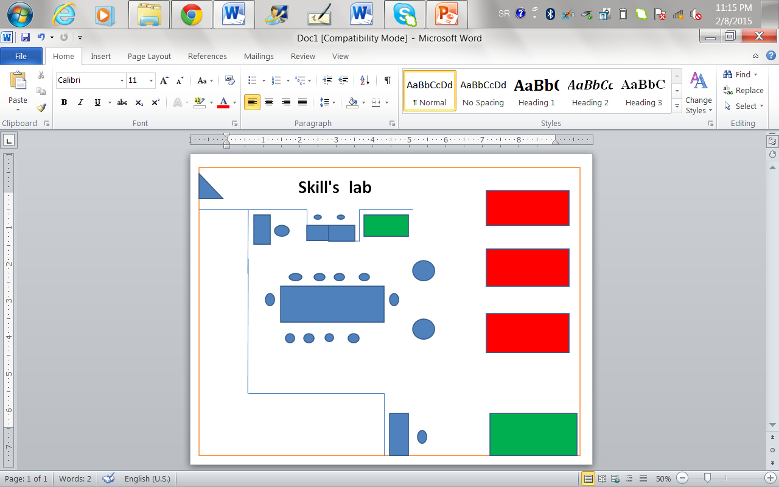

Slide 7
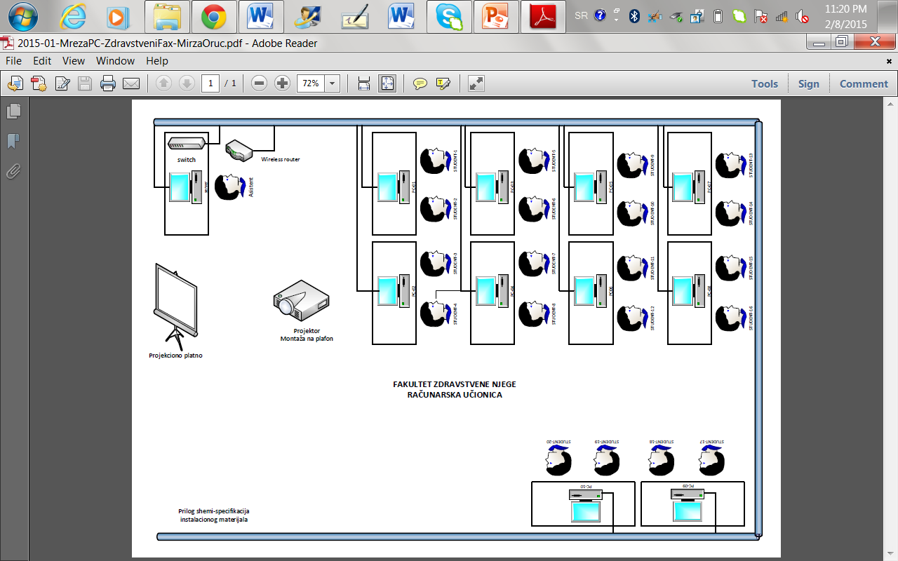
Training center

Slide 8
Final conclusion
Innovation toward EU Directive
New teaching methodoogies
Assessment methods
Statutory changes!!!!
Innovation of currcula
New teaching methodologied
Statutory chnanges
New Assessment methods

Slide 9
Final goal (to be)
Current situation 3+2+3
Statutory changes
Final goal 4+1+3

