Slide 1

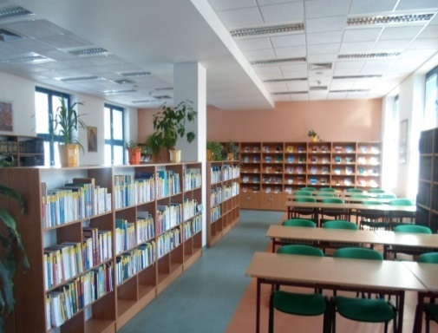

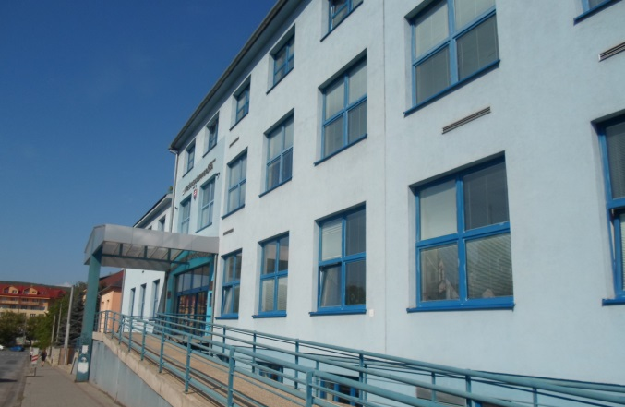
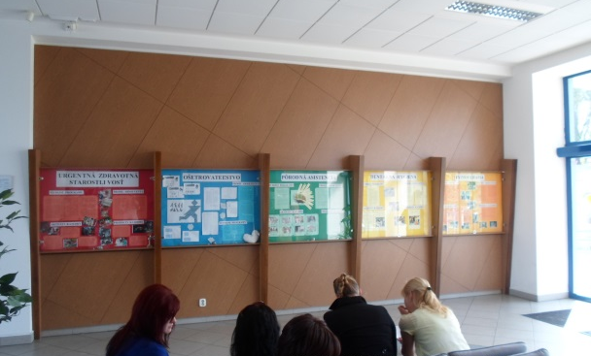
Faculty of Health Care Professions
University of Presov
Faculty
of Health Care Professions
Partizanska 1
080 01 Prešov
Slovak republic
Total 936 students

Slide 2
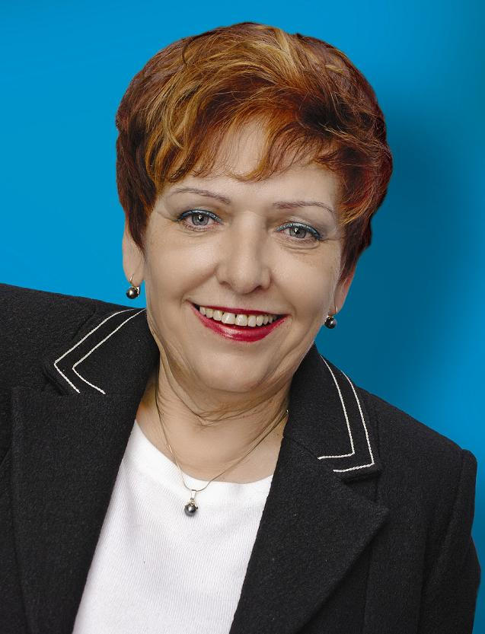
Faculty of Health Care
Dean
Dr.h.c. prof. PhDr. Anna Eliašová, PhD.

Slide 3
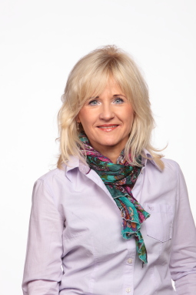
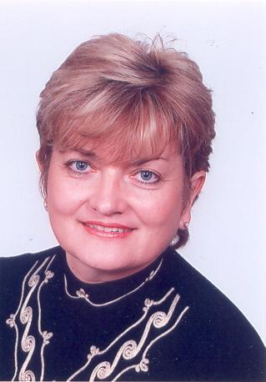
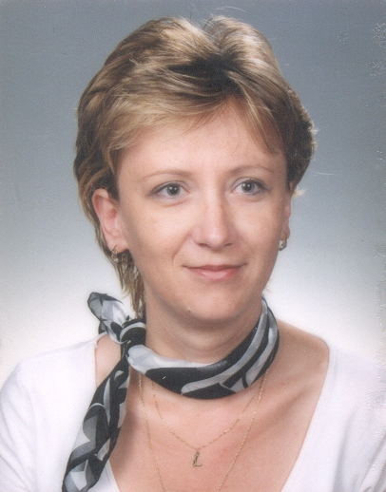
Faculty of Health Care Professions
Vice-Dean for Education
Ass. professor Stefania Andrascikova, PhD.
Vice-Dean for Science and Research
Ass. professor. Lubica Dernarova, PhD.
Vice-Dean for Development and International relationship
PhDr. Lubica Rybarova, PhD.

Slide 4
Faculty of Health Care Professions
Education at the Faculty of Health Care Professions is realized
on the:
Bachelor level (Bc.)
Master level (Msc.)
Doctorand level (PhD.)
Specialization
Full time/ Part time
Length of study: 3/4 years

Slide 5
Study programmes:
nursing, (Bc., Msc., PhD.)
physiotherapy (Bc., Msc., PhD.)
dental hygiene (Bc.)
midwifery (Bc.)
urgent health care (Bc.)
laboratory diagnostic methods in health care (Bc.)
Specializations in the Nursing:
Anesteziology and intensive care
Nursing care in internal medicine

Slide 6
Depatments in the Faculty of Health Care Professions
Department of Nursing
Department of Midwifery
Department of Physiotherapy
Department of Dental Hygiene
Department of Urgent Health Care
Department of Medico-technical fields
Clinical workplaces in the J.A. Reiman Teaching Hospital

Slide 7
Personal trends (internal and external) on the FoHCP
 | 2012 |  | 2013
Category | summary | % part of summary | summary | % part of summary
Professors | 4 | 5,63 % | 3 | 4,10%
Assistent professors | 10 | 14,09 % | 15 | 13,69%
Teachers with PhD. | 38 | 53,52 % | 37 | 50,68%
Lecturers | 19 | 26,76 % | 13 | 17,80%
Summary | 71 |  | 73

Slide 8
Trends of Student numbers
Study programme | 2009/2010 | 2010/2011 | 2011/2012 | 2012/2013 | 2013/2014
Nursing | denná forma: 231 externá forma: 122 | denná forma: 176 externá forma: 100 | denná forma: 149 externá forma: 53 | denná forma:186 externá forma: 25 | denná forma: 256
Midwifery | denná forma: 74 externá forma: 23 | denná forma: 69 externá forma: 18 | denná forma: 67 externá forma: 13 | denná forma: 67 externá forma: 13 | denná forma: 87
Physiotherapy | denná forma: 88 externá forma: 45 | denná forma: 68 externá forma: 24 | denná forma: 81 externá forma: 12 | denná forma: 86 externá forma: 5 | denná forma: 101 externá forma: 58
Dental hygiene | denná forma: 60 exter. forma: 87 | denná forma: 60 exter. forma: 65 | denná forma: 73 externá forma: 49 | denná forma: 79 externá forma: 54 | denná forma: 93 externá forma: 71
Urgentn health care | denná forma: 95 externá forma: 86 | denná forma: 84 externá forma: 59 | denná forma: 83 externá forma: 82 | denná forma: 89 externá forma: 62 | denná forma: 99 externá forma: 43
Summary – Bc. | 911 | 723 | 662 | 666 | 808
Nursing | denná forma: 13 externá forma: 50 | denná forma: 34 externá forma: 60 | denná forma: 33 externá forma: 87 | denná forma: 23 externá forma: 73 | denná forma: 20 externá forma: 47
Physiotherapy | denná forma: 13 externá forma: 42 | denná forma: 30 externá forma: 49 | denná forma: 36 externá forma: 51 | denná forma: 29 externá forma: 50 | denná forma: 26 externá forma: 43
Summary – MSc | 118 | 173 | 207 | 177 | 136
Summary Bc+MSc. | 1029 | 874 | 869 | 843 | 944

Slide 9
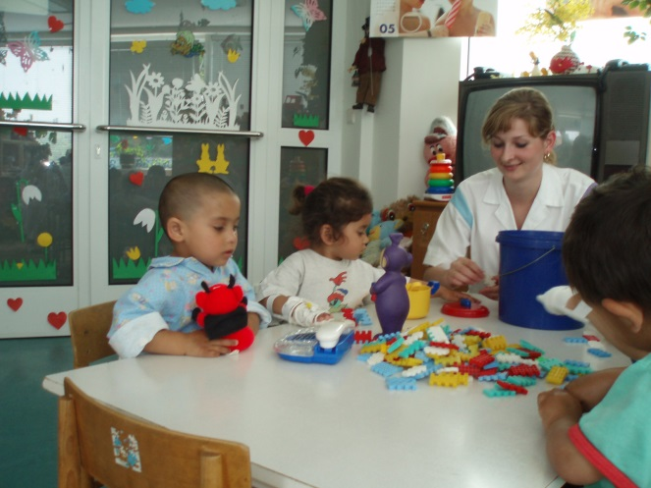
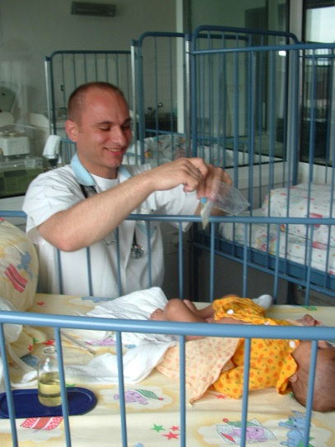
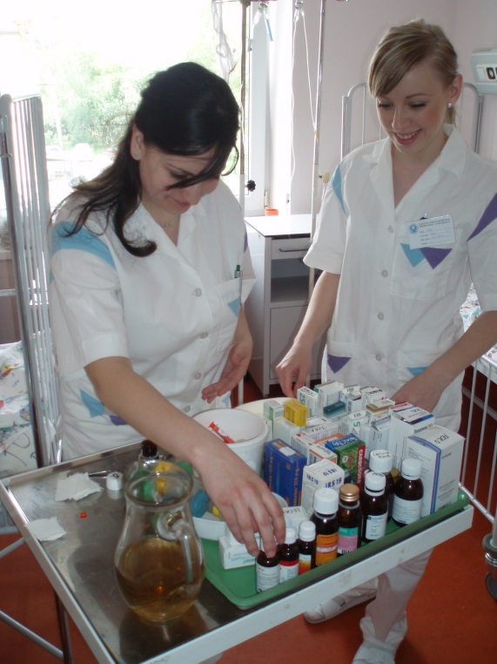
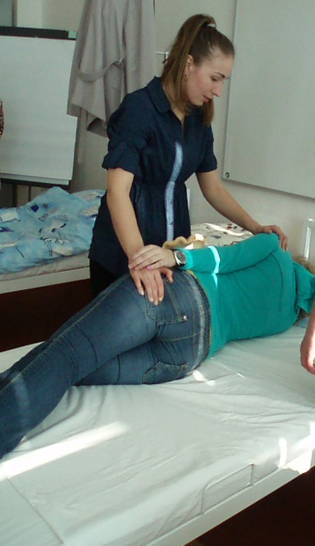
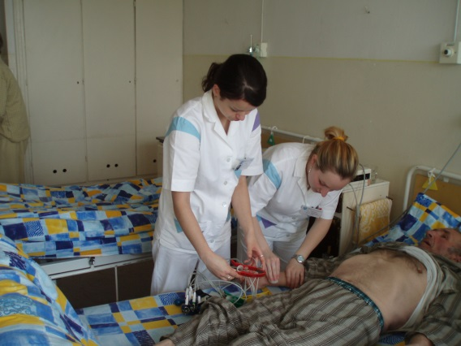
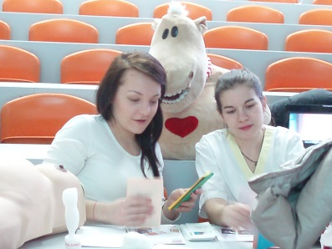
About study programs - Nursing

Slide 10
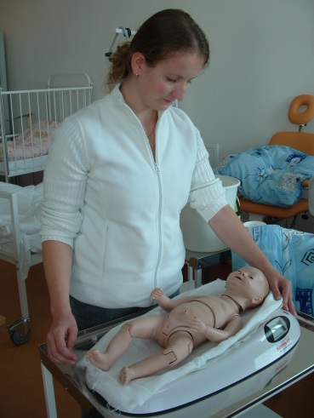
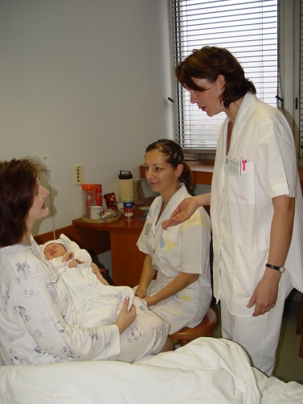
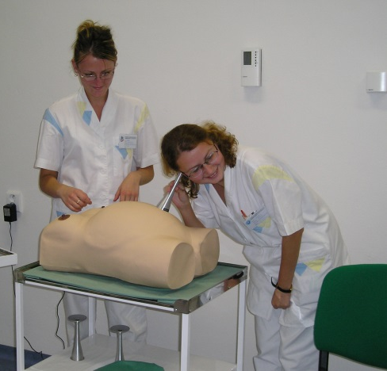
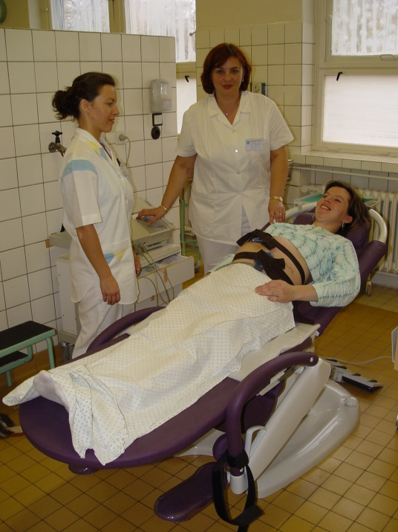
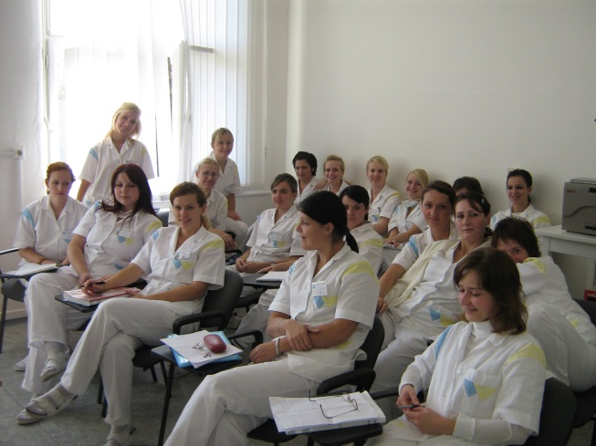
About study programs - Midwifery

Slide 11
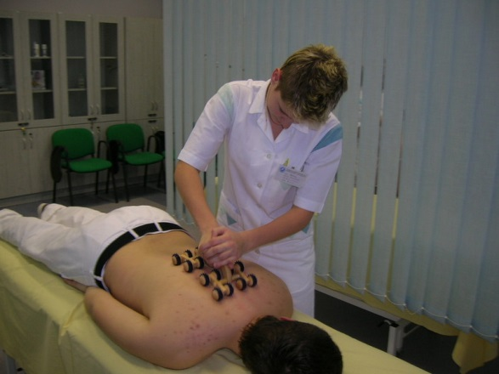
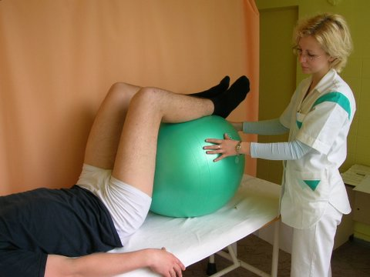
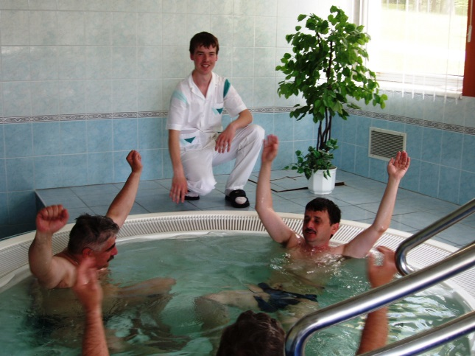
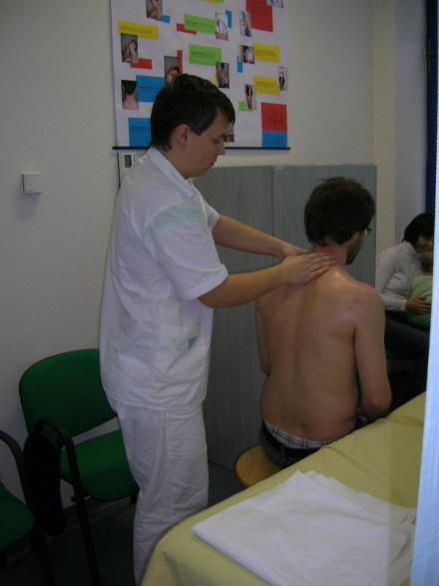
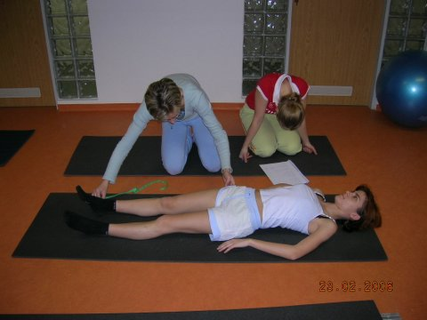
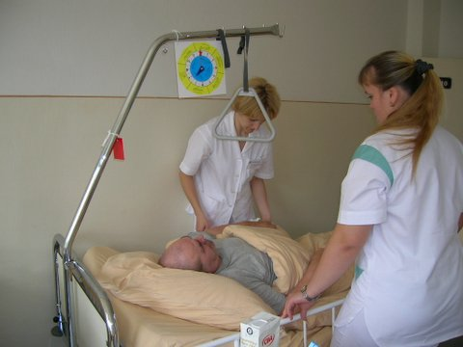
About study program- Physiotheraphy

Slide 12
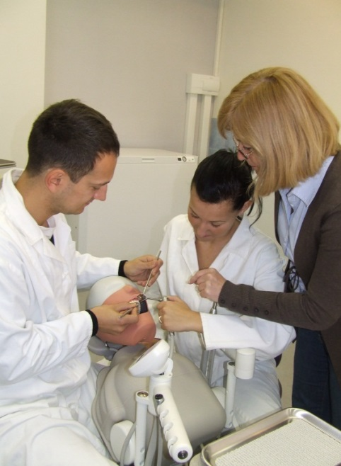
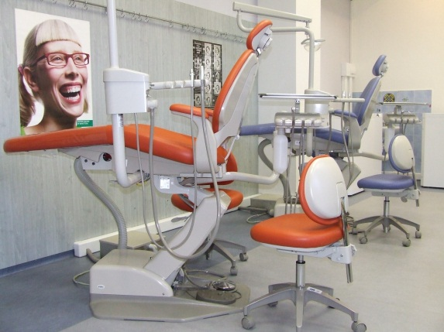
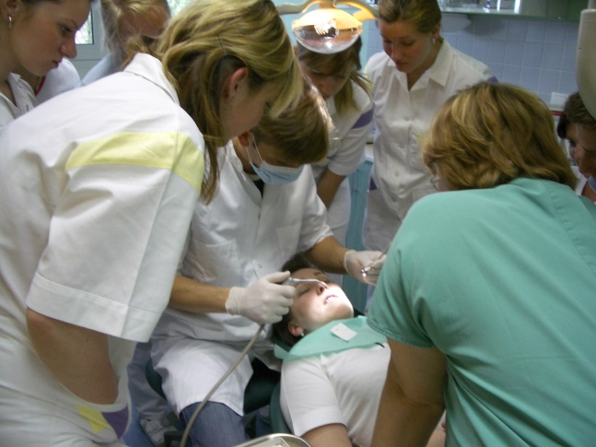
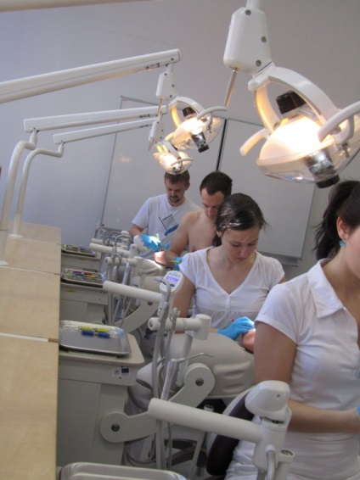
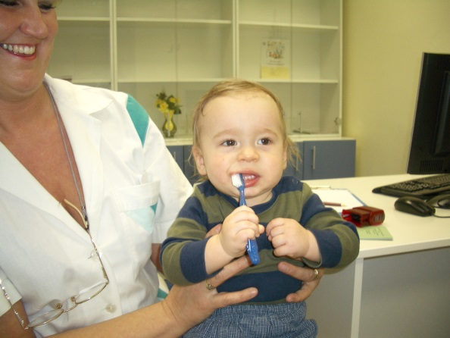
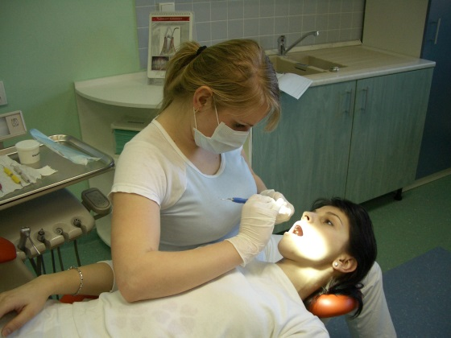
About study programs - Dental hygiene

Slide 13
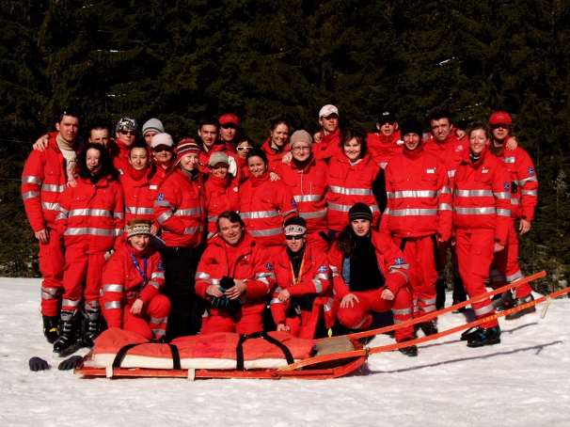
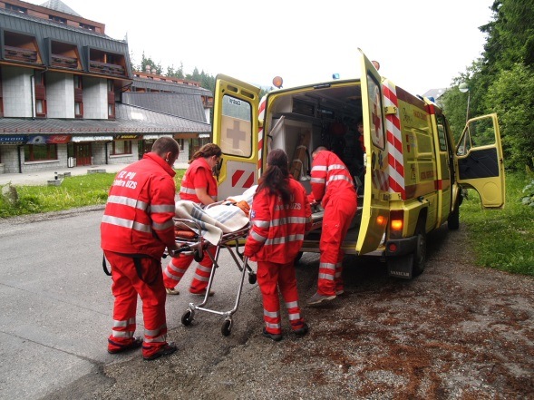
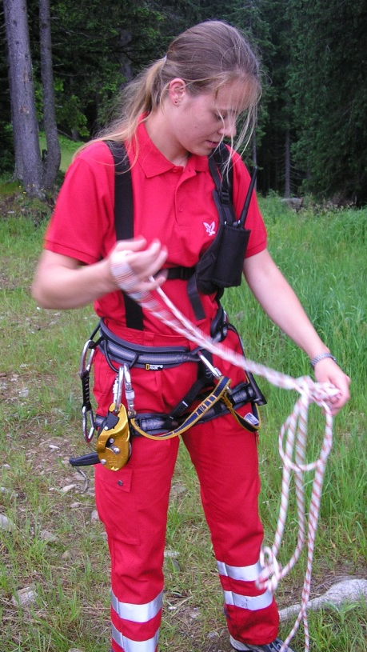

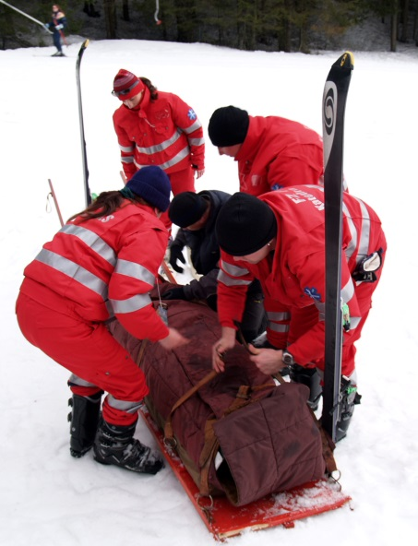
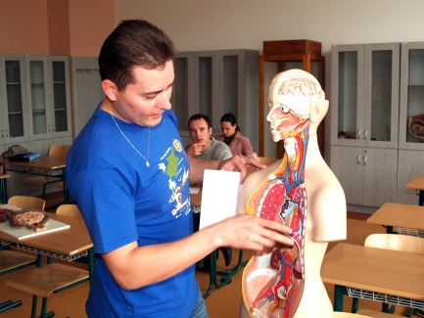
About study programs – Urgent health care

Slide 14

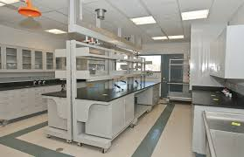
Laboratory diagnostic methods in health care
In academic year 2014/2015 was established and realized
a new accredited study program. (Bc)

Slide 15


Thank you ☺
Have a nice day!

